Slide 1
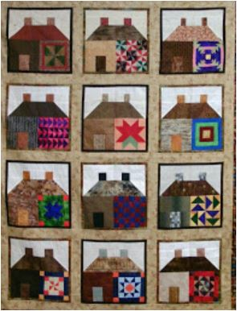
House on the Hill
House blocks can be pieced or appliqued.

Slide 2
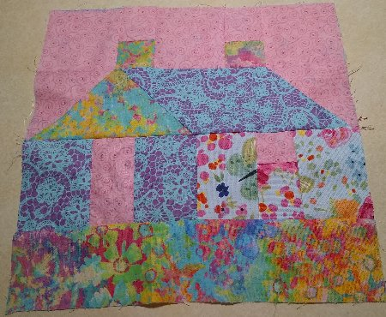
House on the Hill Patchwork block is from The Lap Quilt book. There are 3 strips of pieced patterns and one long rectangle creating the hill. When I pieced the block I needed to fit the bottom strip Rectangle G to the pieced block. That meant some adjustments to fit everything into a 12 ½” block.

Slide 3
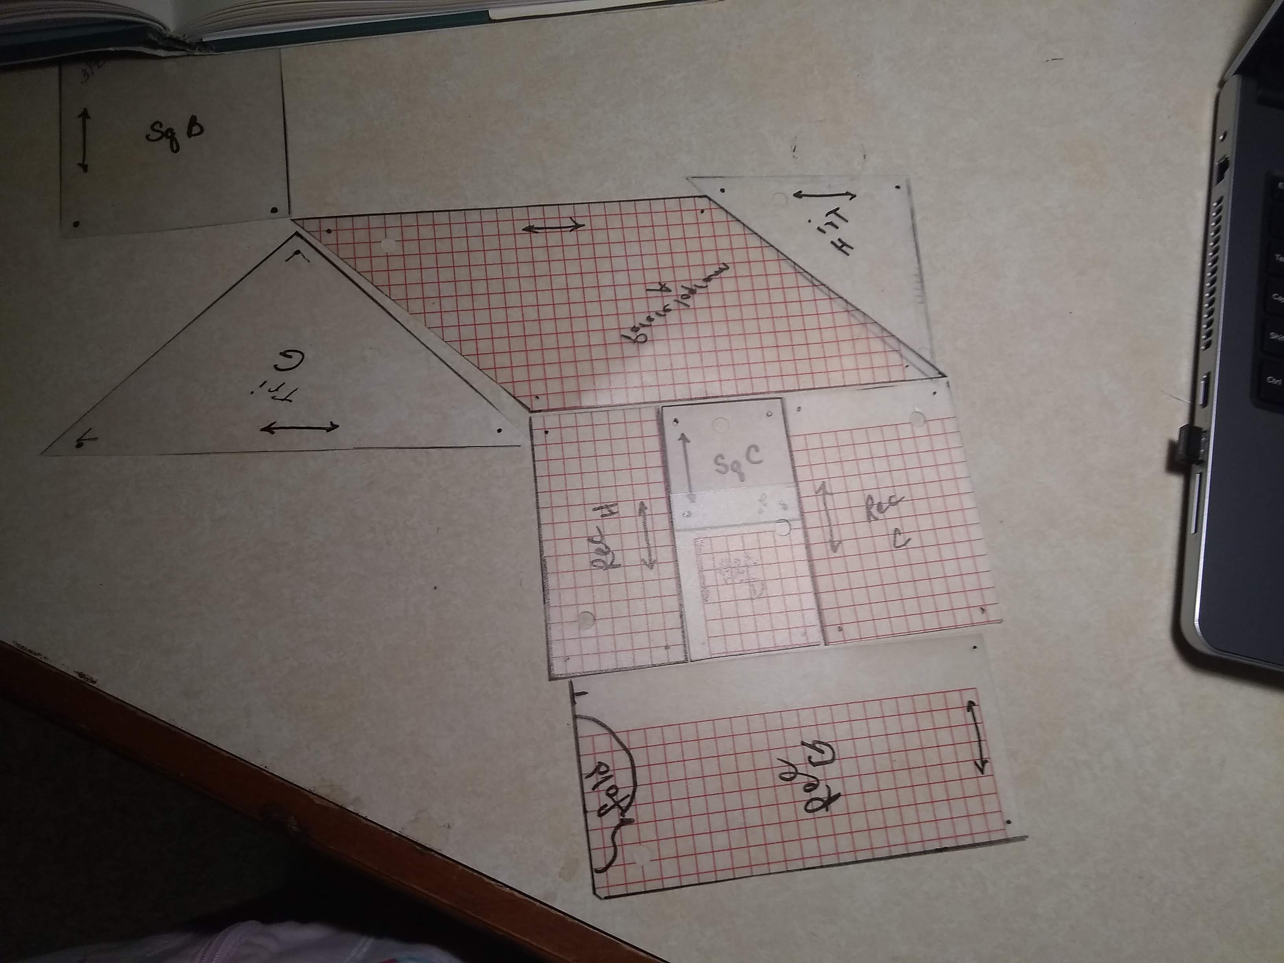
Here are my templates.

Slide 4
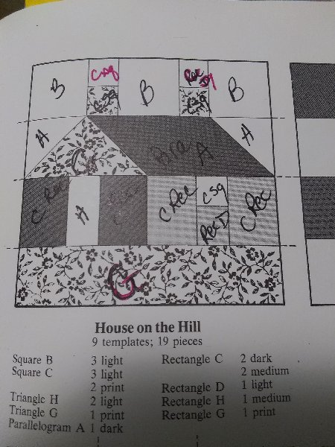
This block has so many pieces I found I had to mark the book drawn block to figure out how to select fabrics, cut and piece the block.
Cut your pieces. Layout the pieces. Piece chimneys C square and sky C square. Piece window C square and house C square pieces to form strips. These strips
fit the B squares of the top row and C rectangles in a house row.

Slide 5
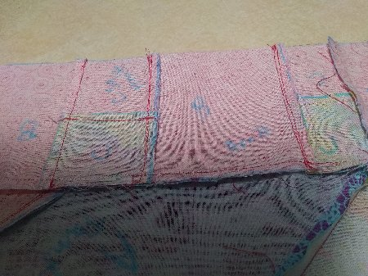
It is hard to see in this picture. I marked the back of each cut fabric to make ID as I am piecing the pieces easier.

Slide 6
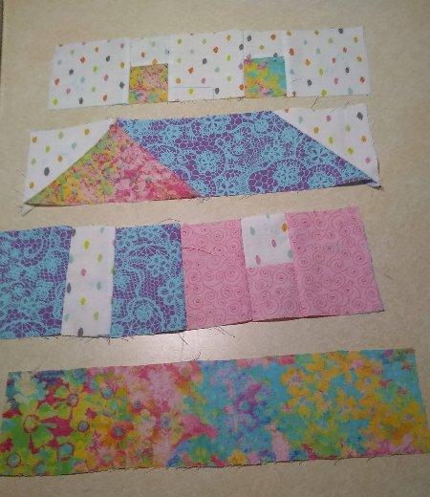
Here are the 4 pieced strips.

Slide 7
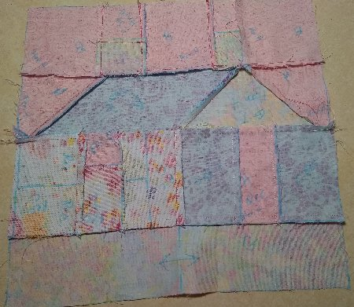
Here is the back of the pieced block. You can see were I marked the pieces To help ID them as I laid out the block.

Slide 8
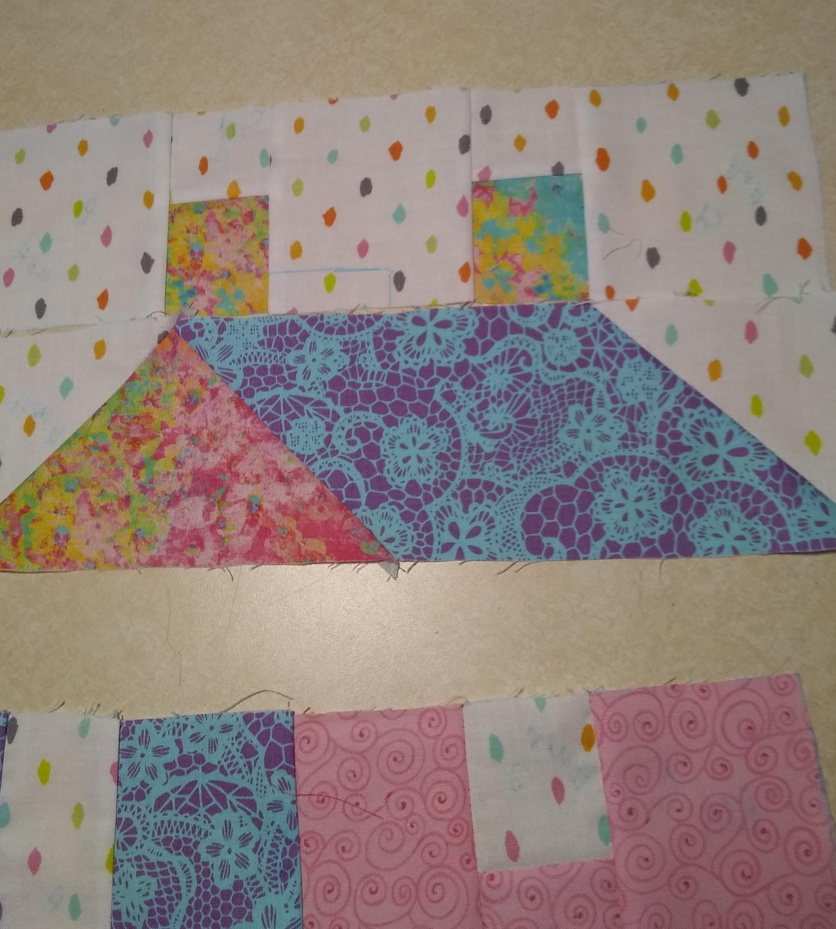
When piecing the 1st and second strip, make sure the chimney fits on the roof.

Slide 9
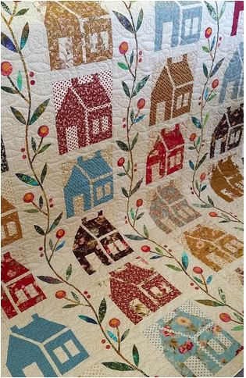
Other styles of pieced houses.

Slide 10
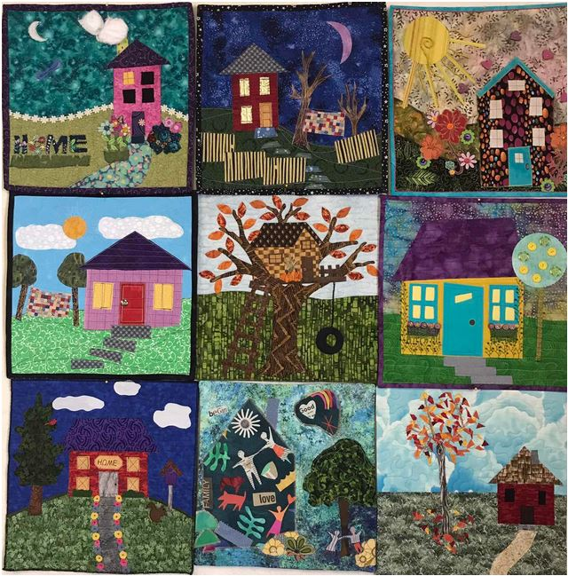
Applique House Blocks

Slide 11
