Slide 1
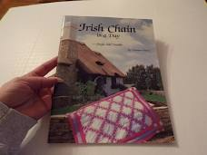
Quilt in a Day Irish Chain

Slide 2
The Irish Chain book by Eleanor Burns and Quilt in a Day is available on line. You can buy a used copy for as little as $5.00. Just Google search.
I did follow the book but found some errors. The instructions were not always clear to me but I have made corrections and have taken pictures step by step to help you. I suggest you might want your own copy of the instructions.
Since we are all isolated for several weeks I thought you may want to take on a new project while waiting for the lap quilt club to resume. I think you will enjoy this quilt.

Slide 3
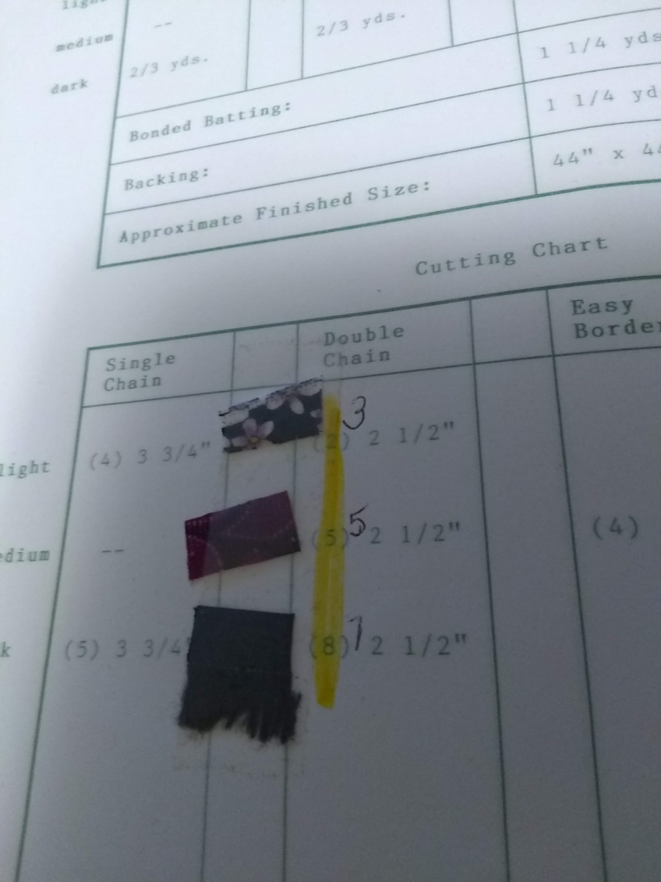
You will need 3 fabrics for the Double Irish Chain! Call them Light, Medium and Dark and paste them in your book to remember which is which. I have picked the baby size quilt. I used fabrics I had in stock and so my quilt is very untraditional. I assigned one light, one medium and one dark.
I thought we could work on the Seminole border later. If the virus keeps us longer than a month I might make instructions for you to follow.

Slide 4
Yardage includes Seminole border and binding.
Finished quilt is 53” X 53”
Light - 2 yds
Medium- 1 5/8 yds
Dark – 1 ½ yds
Binding – 5/8 yd
Backing – 3 ½ yds (or you can use a double faced quilted back to replace the batting and backing).
Batting – 3 ½ yds or a size larger then the finished quilt.
( you can wait on the backing and batting until you are ready. Unless you want it to match the front.)

Slide 5
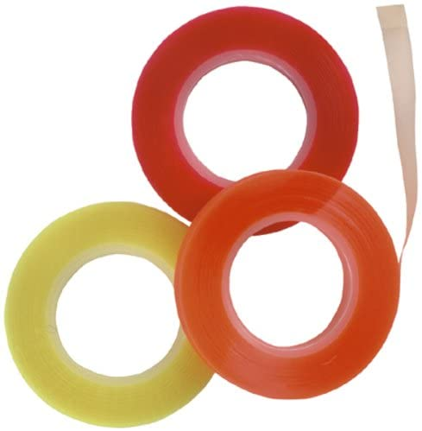
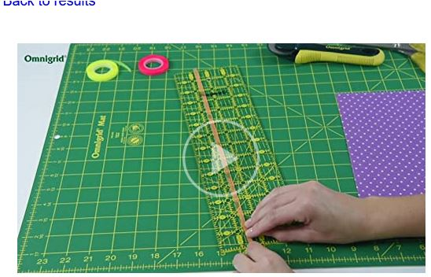
This is a rotary cutter quilt. Most of the strips are 2 ½”. Please cut accurately. You may want to mark your ruler with quilter’s tape to bring your eye to the right cut line. Quilter’s marking tape is made by Omnigrid. Find the tape on line in a google search.

Slide 6
For a double Irish chain you will cut strips of fabric 2 ½” wide across the 45” width of the fabric.
3 - 2 ½” strips of light
5 - 2 ½” strips of medium
9 – 2 ½” strips of dark
Set the additional fabric aside for the borders
You will be sewing 3 groups of 5 strip combinations. Pay attention to light, medium and dark paste up I asked you to make at the beginning. Use a ¼” seam and be accurate, it will pay off later.
Refer to the sewn picture of strips in the next page.

Slide 7
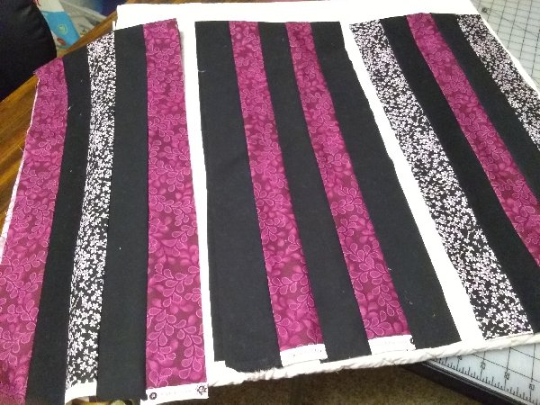

Slide 8
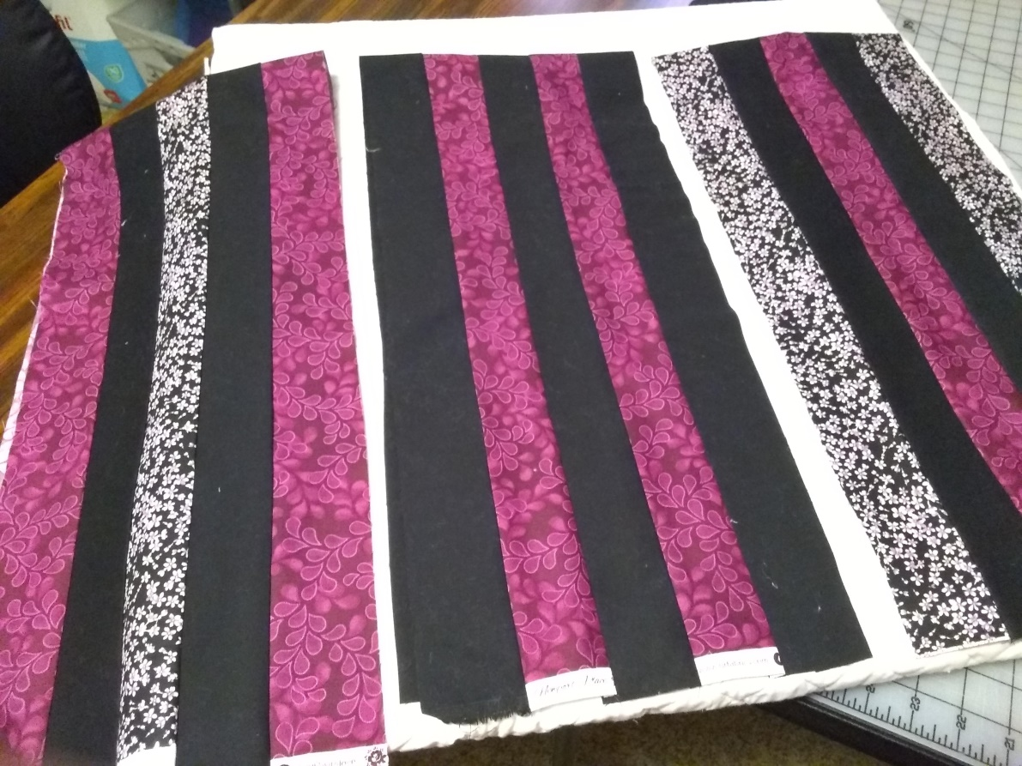
Section 1 is sewn – medium, dark, light, dark, medium
Section 2 is sewn - dark, medium, dark, medium, dark
Section 3 is sewn - light, dark, medium, dark, light
Compare the instructions to my picture-

Slide 9
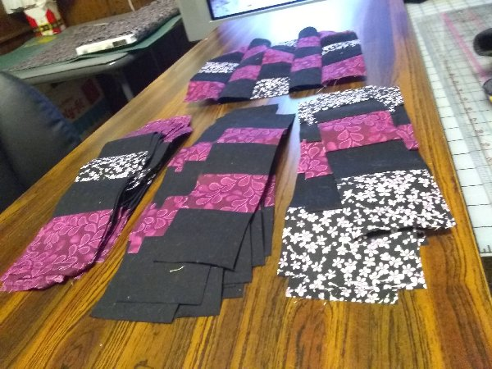
Make sure the strips are pressed to one side and the seam from the right side of the work is opened, not creased. Once the 3 sections are pressed you are ready to cut 2 ½” strips across the sections. You will have 3 plies (sections) of 2 ½” strips. Be careful when cutting as you have just enough fabric to cut the strips.

Slide 10
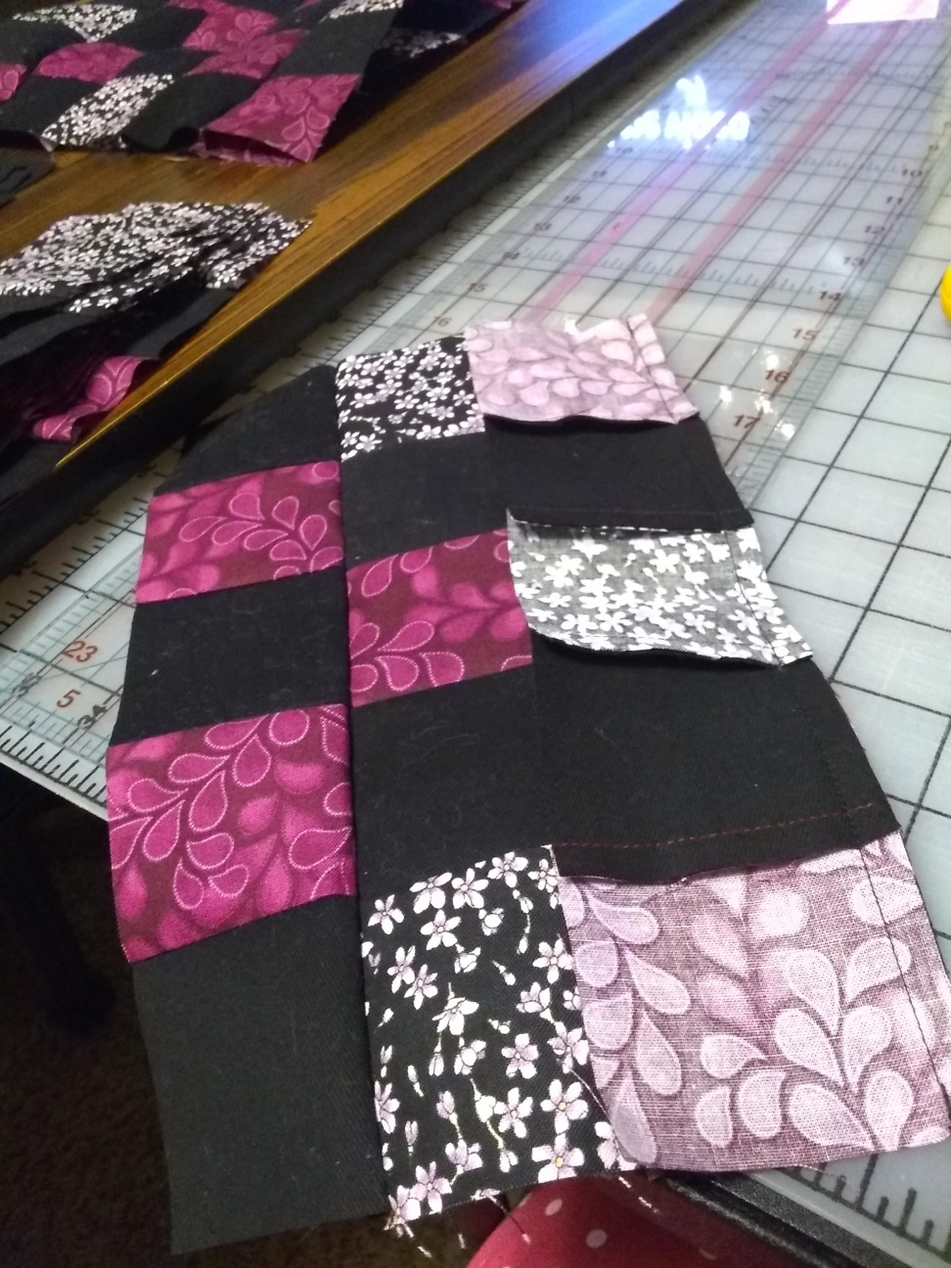
You are now ready to put the strips together to form Block 1. The strips are sewn so the seam is up on one strip and down on the next. This helps lock the strips together and make the sewing more accurate. If on strip is to long to fit, place the longer strip on the bottom side as you piece to help “work it in”.

Slide 11
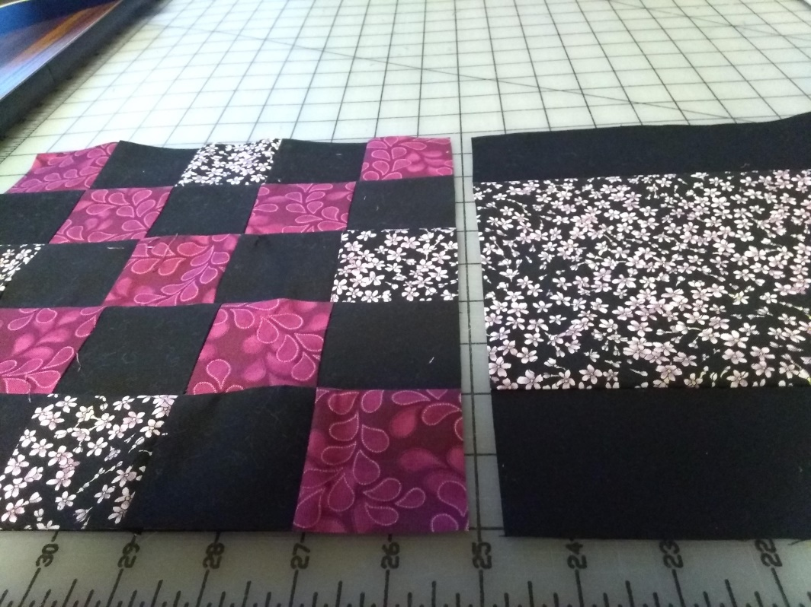
Strip 1, strip 2, strip 3, strip 2 and then strip 1 is how the block is pieced. (Refer back to the 3 sections that were sewn together when thinking about the strip 1, 2 and 3). This creates block 1. You need 8. We will stop the instruction at this point. I will send more in a few days on how to make block 2 so as not to confuse you. The picture show both block 1 and 2.Have fun!

Slide 12
Send me a picture of your progress to show me you understand the instructions. Send me a picture of your progress to show me you understand the instructions.
You will need to concentrate on the next steps as they involve YOUR MEASUREMENTS. Write them down.

Slide 13
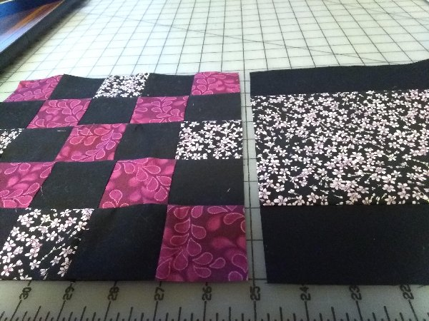
The next step is to press the block 1 well. Once you have pressed, measure the width and the height of the block. Take the smallest measurement from one of the 8 blocks you have sewn. It should be about 10”. Make the block a square. Each person will have a different measurement based on how they sewed. My block was 9 ¾” so I carefully trimmed all my blocks to 9 ¾” square. (The measurement of block 1 needs to match block 2.) write down the measurements!!!

Slide 14
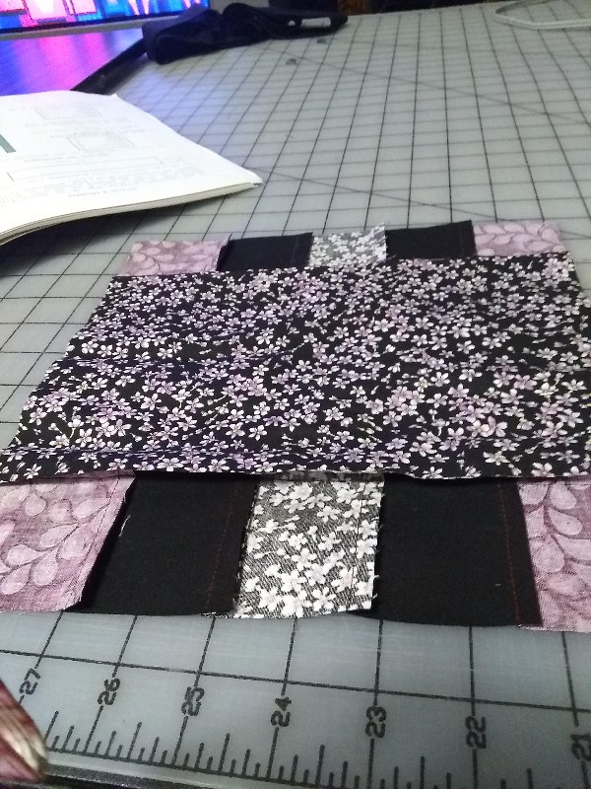
To take the next measurement, you need is the to turn block 1 to the wrong side and measure the width of the 3 inner strips as they are sewn. Include the seam allowance. My measurement was 6 ¼”. I cut a strip 45” wide by 6 ¼” for the center of block 2. (Write down the measurement)

Slide 15
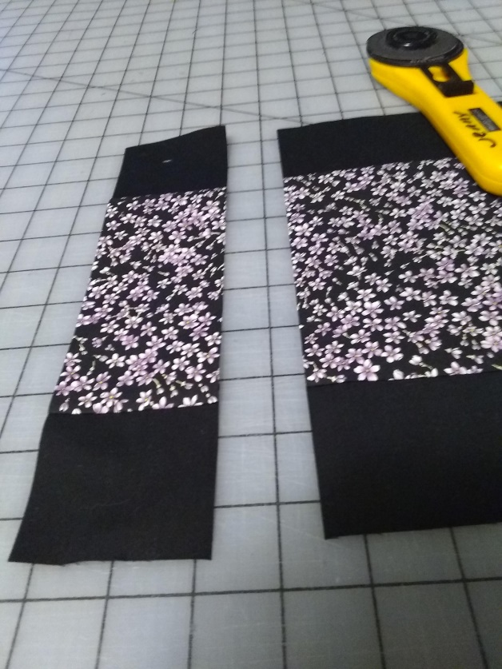
I sewed a dark 2 ½” strip to each side of the 6 ¼” strip. Once the darks were sewn to the center strip I cut 2 ½” strips from the sewn strip, you will need 16. The finished cut strip should measure 9 ¾” X 2 ½” (or your own measurement that you did when you measured block 1.) I needed enough strips to make 8 block 2.

Slide 16
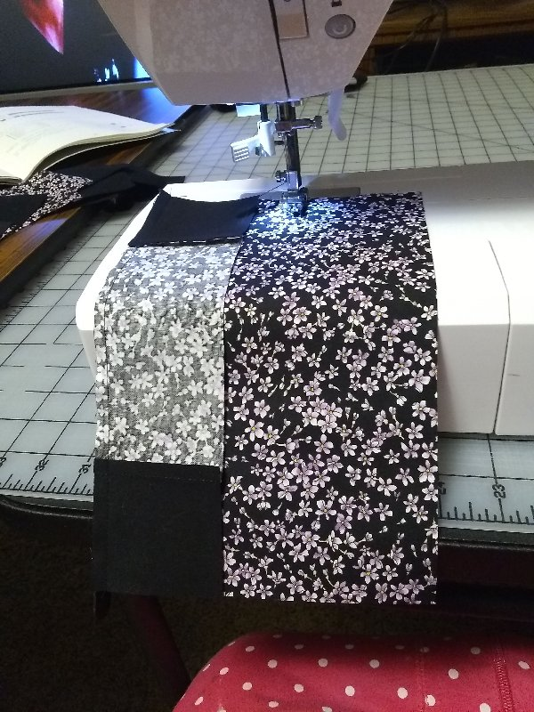
You next step is to cut several strips 6 ¼” X 9 ¾” for the center of block 2.
Using a ¼” seam sew the 2 ½” strips made in the previous step to each side of the center. The finished block should measure 9 ¾” square.

Slide 17
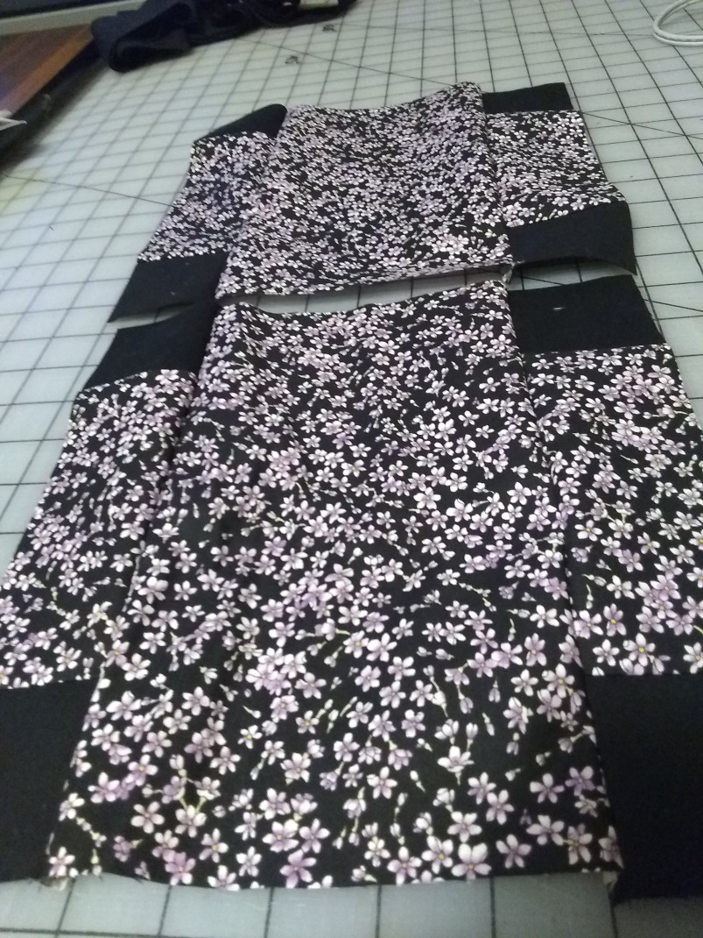
When you finish sewing Block 2 make sure you press well. Block 1 and 2 should measure the same size.

Slide 18
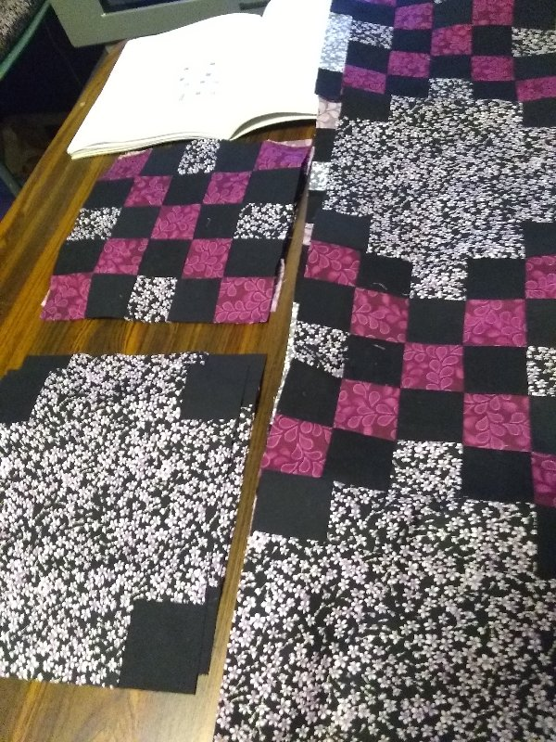
You will now layout the blocks to form the Irish Chain. You will have 4 rows of 4 blocks.

Slide 19
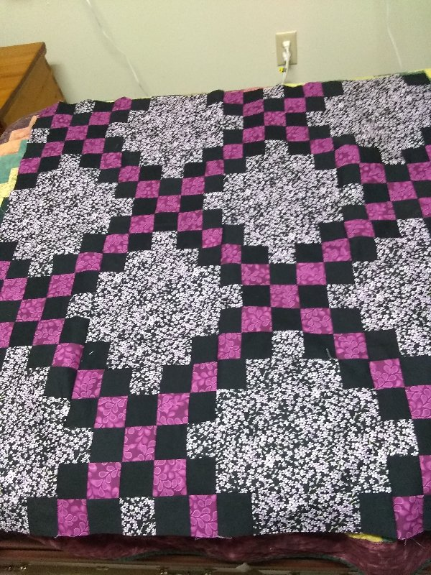
Here is my sewn Irish Chain quilt body. I have borders to add. Since I am using fabrics I had on hand, I need to make the striped border with the checkerboard corners. I did not have enough fabric to squeeze out a seminole border.
I will also show the seminole borders later.

Slide 20
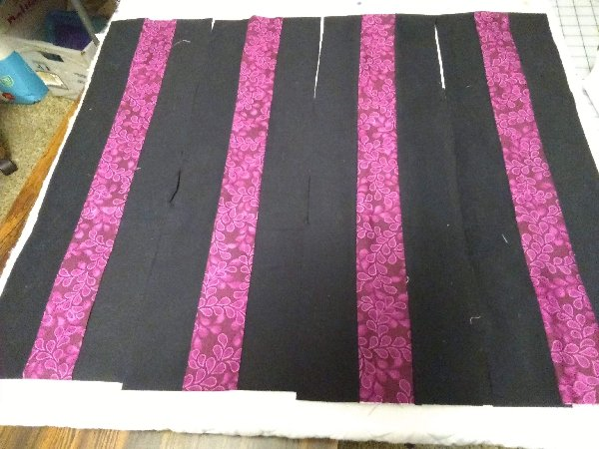
I sewed 4 border groups of 3 strips. Each group had 2- 2 ½” strips of the dark ( Black) and in the center a 2 ½” strip of the medium purple print.

Slide 21
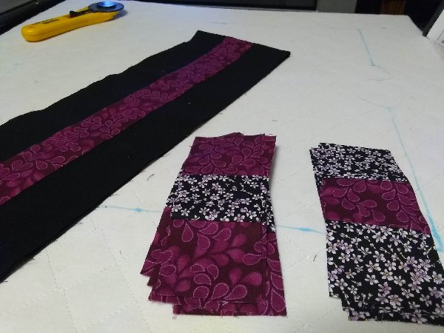
The 4 corner stones were sewn using 3- 2 ½” strips of the light and 3 – 2 ½” strips of the medium. Once the the strips were sewn together in 2 groups ( light, medium, light and medium, light, medium) I then cut the sewn strips into 2 ½” strips as shown above.

Slide 22
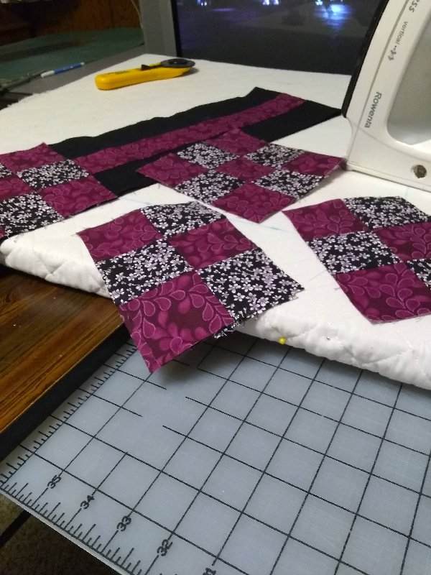
The strips were then reassembled so the medium purple squares were on the outside upper and lower edges and in the center of the cornerstone. You will need 4 corner stones.

Slide 23
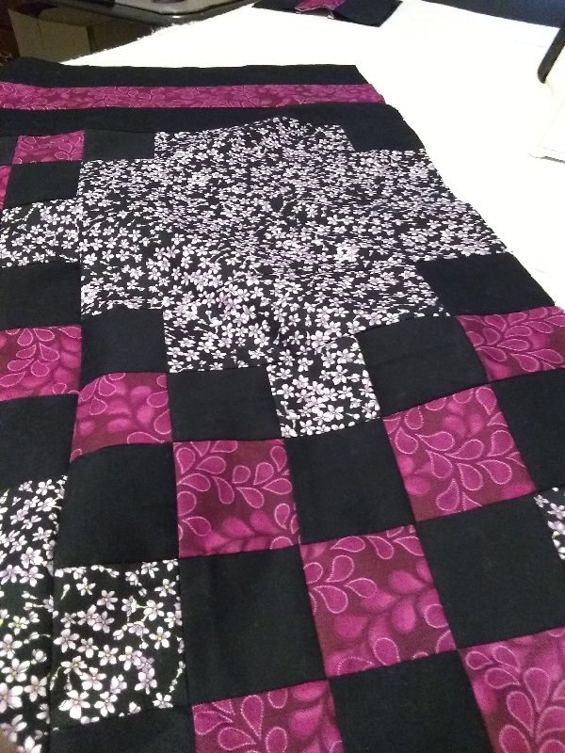
Sew the borders to 2 opposite sides of the quilt and trim even with the quilt edge.

Slide 24
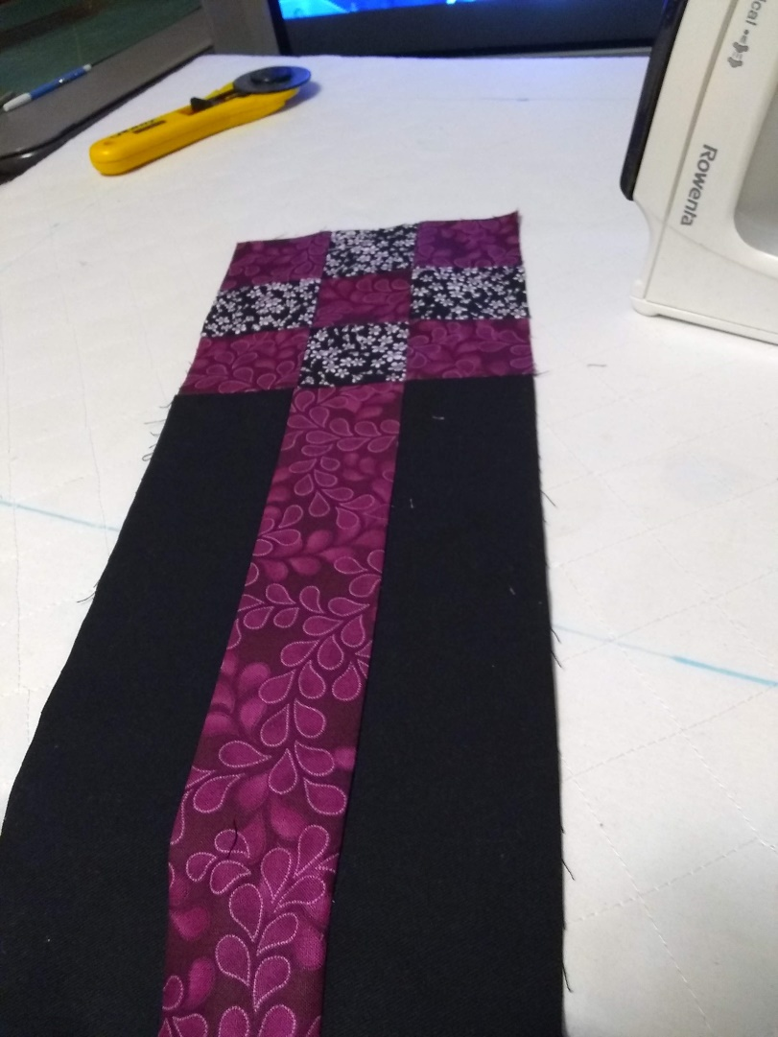
You can then measure the width of the unfinished 2 sides and add ¼” seam allowances to the measurement. Cut the border using the measurement. Sew the corner stones to each end of the border strips before applying them to the finished quilt.

Slide 25
