Slide 1
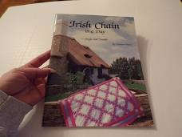
Quilt in a Day Irish Chain

Slide 2
The Irish Chain book by Eleanor Burns and Quilt in a Day is available on line. You can buy a used copy for as little as $5.00. Just Google search.
I did follow the book but found some errors. The instructions were not always clear to me but I have made corrections and have taken pictures step by step to help you. I suggest you might want your own copy of the instructions.
Since we are all isolated for several weeks I thought you may want to take on a new project while waiting for the lap quilt club to resume. I think you will enjoy this quilt.

Slide 3
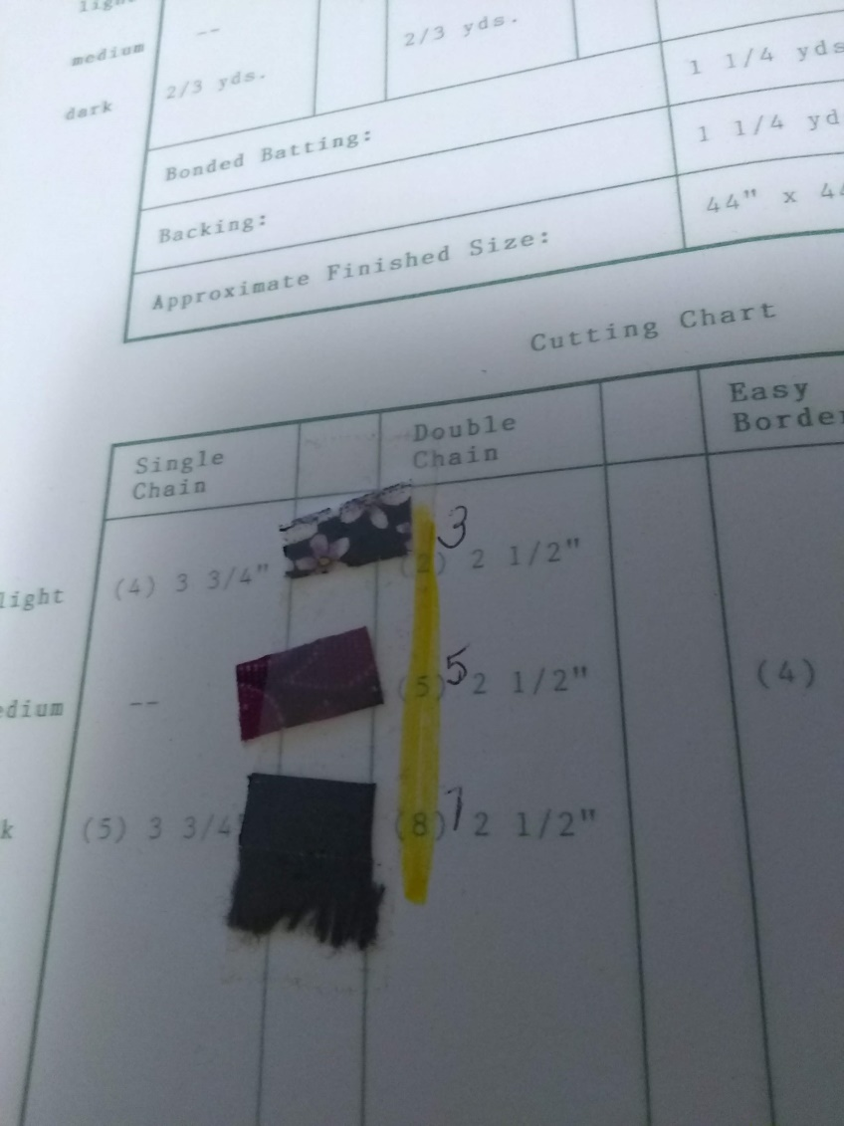
You will need 3 fabrics for the Double Irish Chain! Call them Light, Medium and Dark and paste them in your book to remember which is which. I have picked the baby size quilt. I used fabrics I had in stock and so my quilt is very untraditional. I assigned one light, one medium and one dark.
I thought we could work on the seminole border later. If the virus keeps us longer than a month I might make instructions for you to follow.

Slide 4
Yardage includes seminole border and binding.
Finished quilt is 53” X 53”
Light - 2 yds
Medium- 1 5/8 yds
Dark – 1 ½ yds
Binding – 5/8 yd
Backing – 3 ½ yds (or you can use a double faced quilted back to replace the batting and backing).
Batting – 3 ½ yds or a size larger then the finished quilt.
( you can wait on the backing and batting until you are ready. Unless you want it to match the front.)

Slide 5
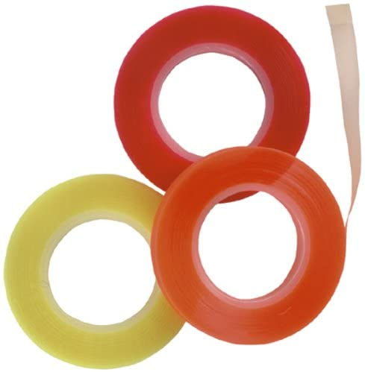
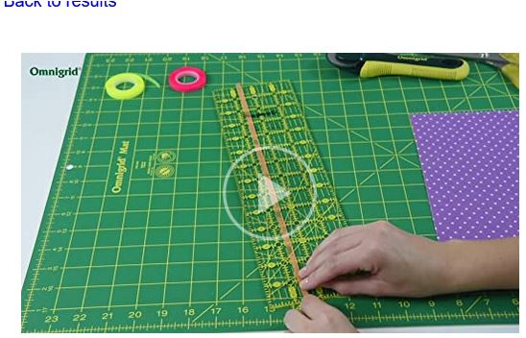
This is a rotary cutter quilt. Most of the strips are 2 ½”. Please cut accurately. You may want to mark your ruler with quilter’s tape to bring your eye to the right cut line. Quilter’s marking tape is made by Omnigrid. Find the tape on line in a google search.

Slide 6
For a double Irish chain you will cut strips of fabric 2 ½” wide across the 45” width of the fabric.
3 - 2 ½” strips of light
5 - 2 ½” strips of medium
9 – 2 ½” strips of dark
Set the additional fabric aside for the borders
You will be sewing 3 groups of 5 strip combinations. Pay attention to light, medium and dark paste up I asked you to make at the beginning. Use a ¼” seam and be accurate, it will pay off later.
Refer to the sewn picture of strips in the next page.

Slide 7
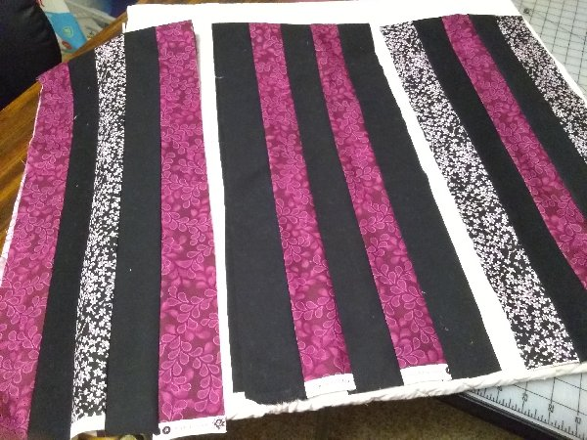

Slide 8
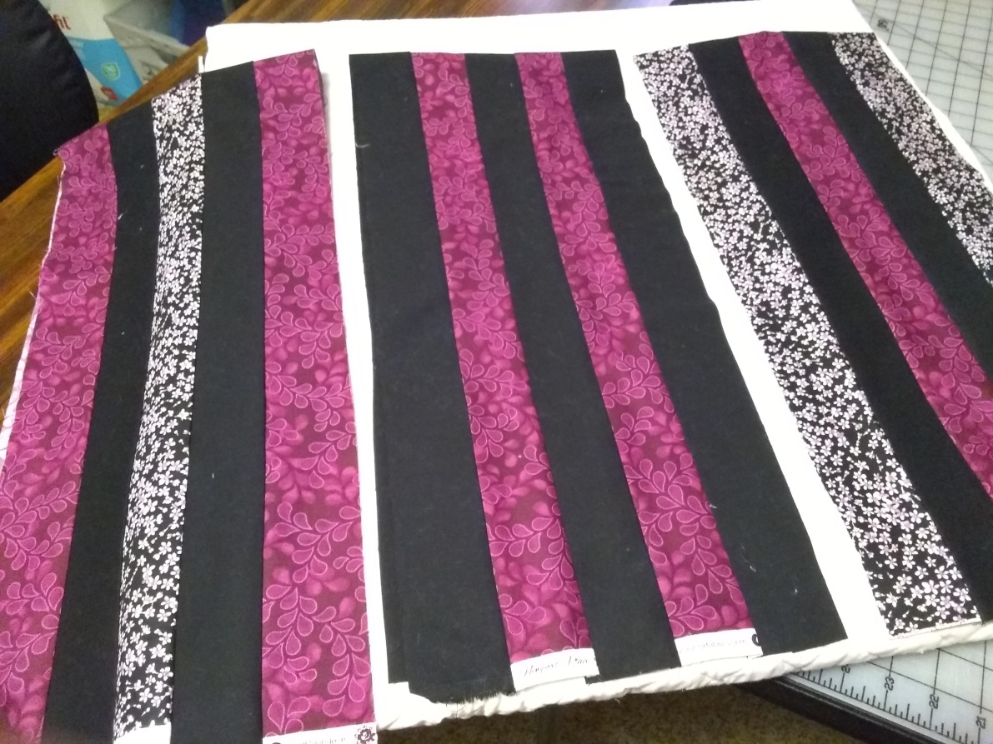
Section 1 is sewn – medium, dark, light, dark, medium
Section 2 is sewn - dark, medium, dark, medium, dark
Section 3 is sewn - light, dark, medium, dark, light
Compare the instructions to my picture-

Slide 9
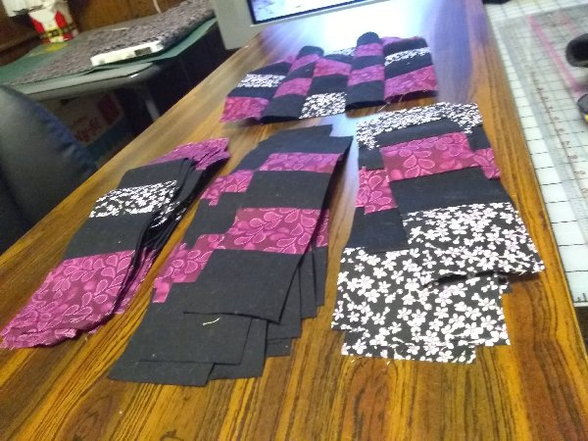
Make sure the strips are pressed to one side and the seam from the right side of the work is opened, not creased. Once the 3 sections are pressed you are ready to cut 2 ½” strips across the sections. You will have 3 plies (sections) of 2 ½” strips. Be careful when cutting as you have just enough fabric to cut the strips.

Slide 10
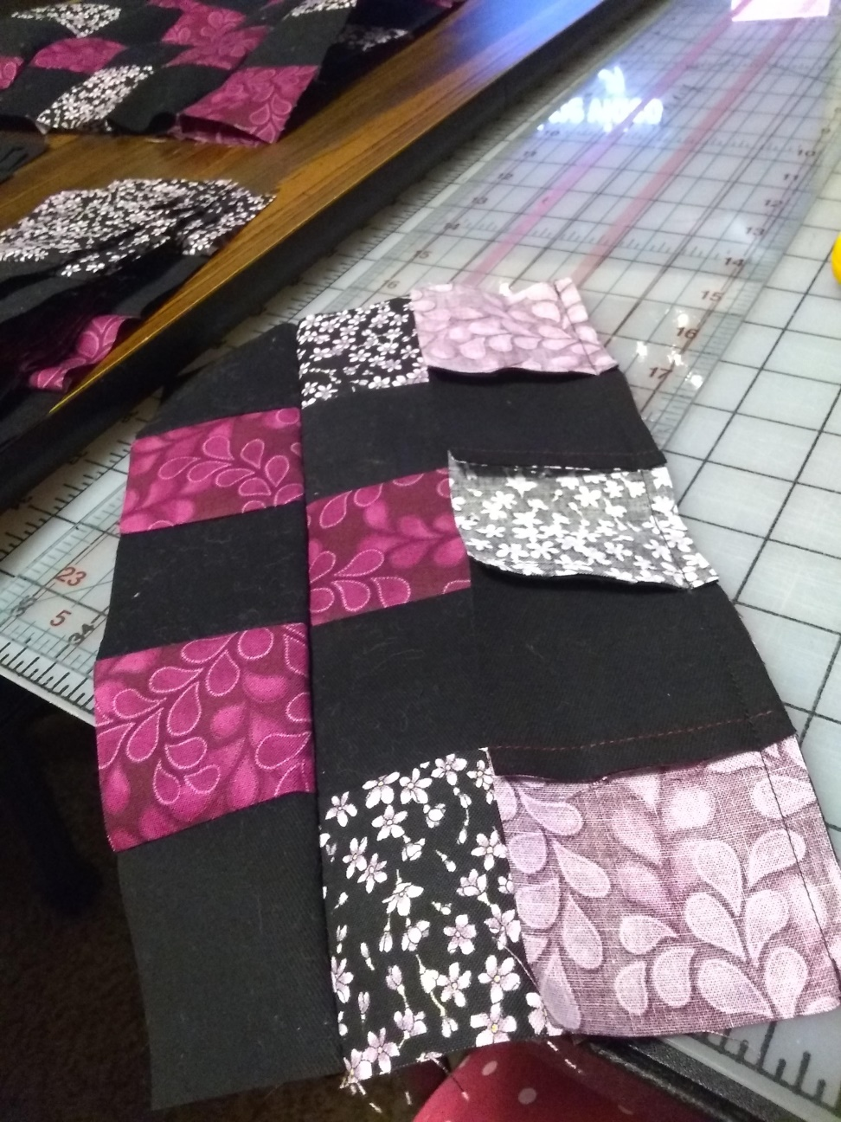
You are now ready to put the strips together to form Block 1. The strips are sewn so the seam is up on one strip and down on the next. This helps lock the strips together and make the sewing more accurate. If on strip is to long to fit, place the longer strip on the bottom side as you piece to help “work it in”.

Slide 11
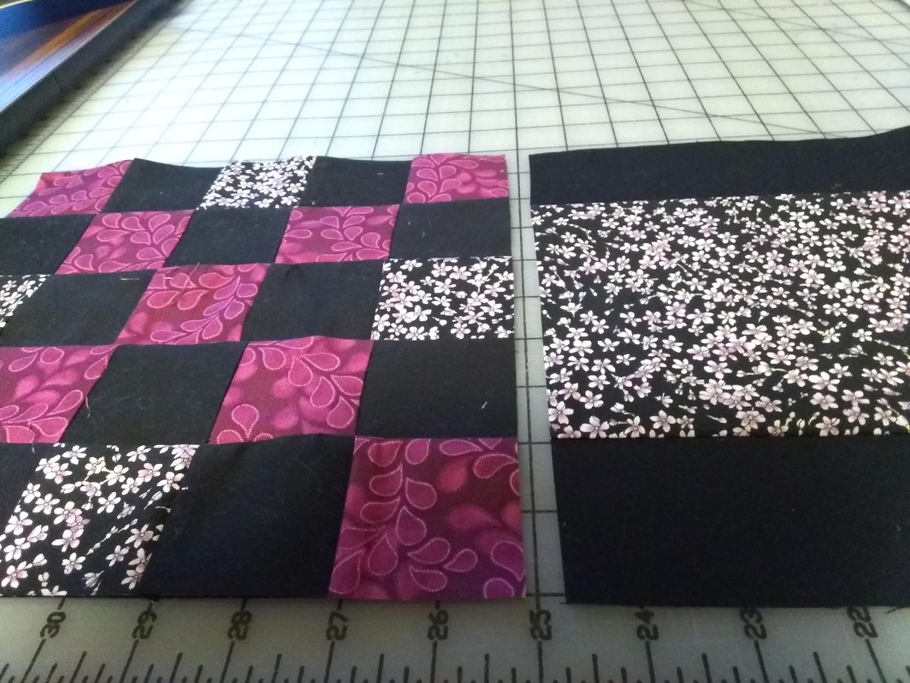
Strip 1, strip 2, strip 3, strip 2 and then strip 1 is how the block is pieced. (Refer back to the 3 sections that were sewn together when thinking about the strip 1, 2 and 3). This creates block 1. You need 8. We will stop the instruction at this point. I will send more in a few days on how to make block 2 so as not to confuse you. The picture show both block 1 and 2.Have fun!

Slide 12
Send me a picture of your progress to show me you understand the instructions.

