Slide 1
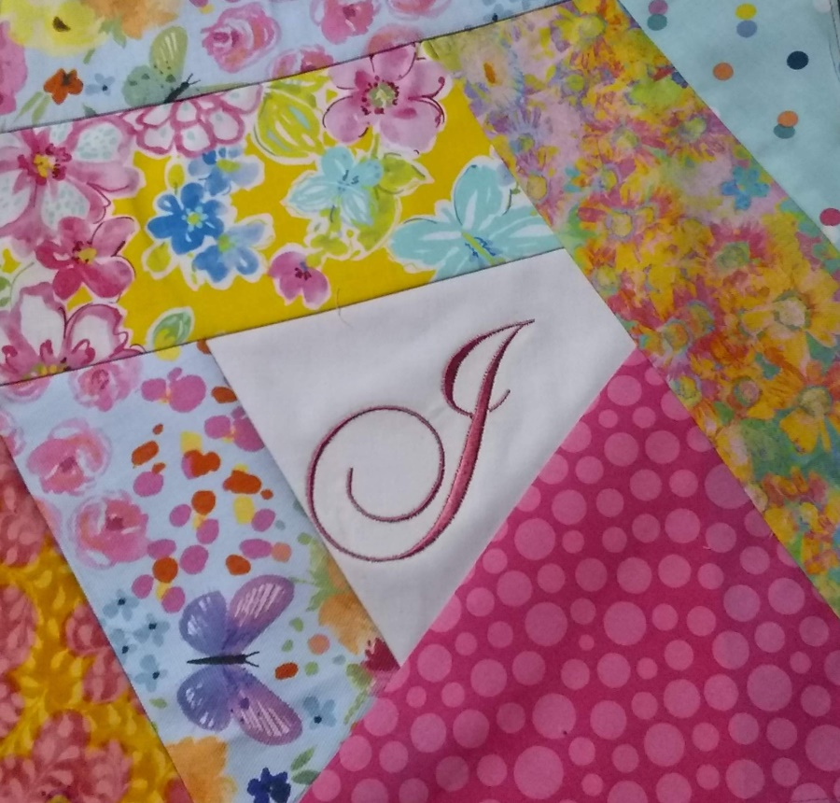
Crazy Quilt

Slide 2
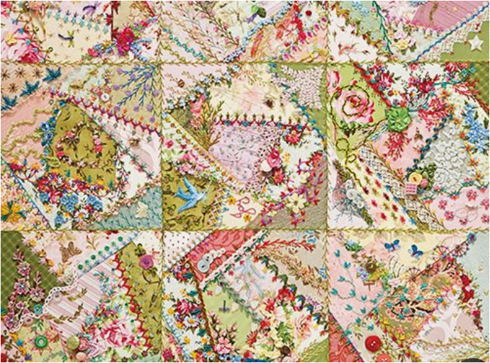
Crazy quilt are a great way to use your scraps!

Slide 3
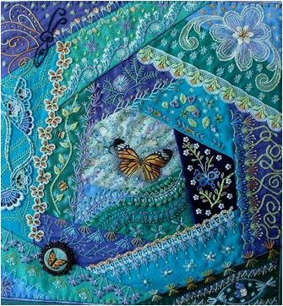
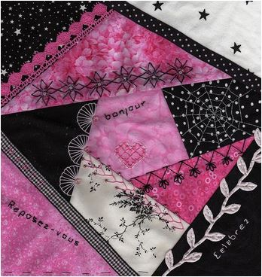
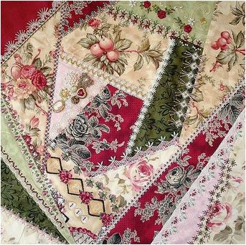
To create a crazy quilt block gather fabrics that create a theme. I usually pick my background color and then choose the scraps I have to compliment the color. You can make any shape. Imagine a Christmas stocking or a hexagon shape or a pillow or even a vest.

Slide 4
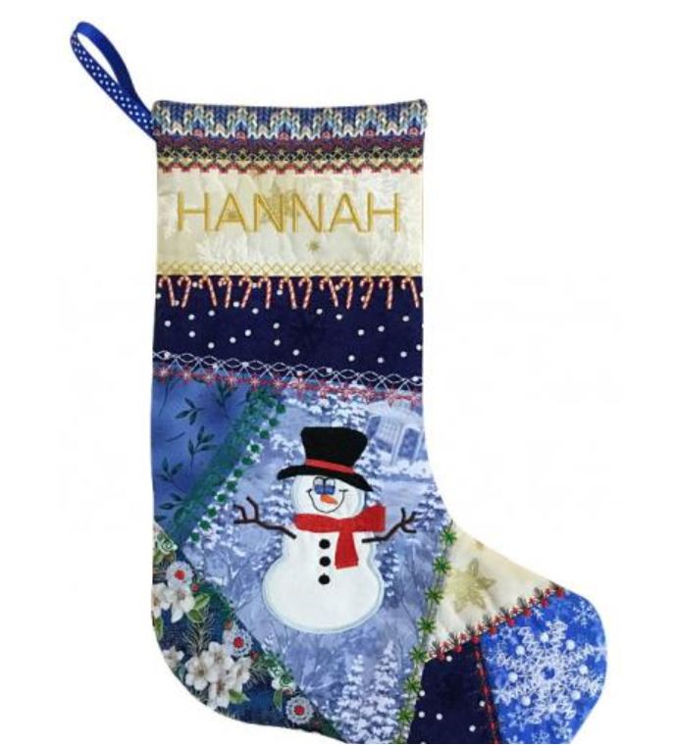
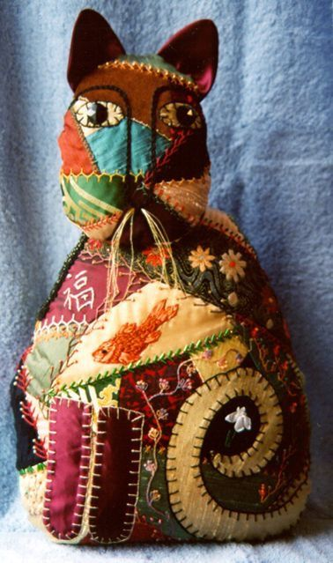

Slide 5
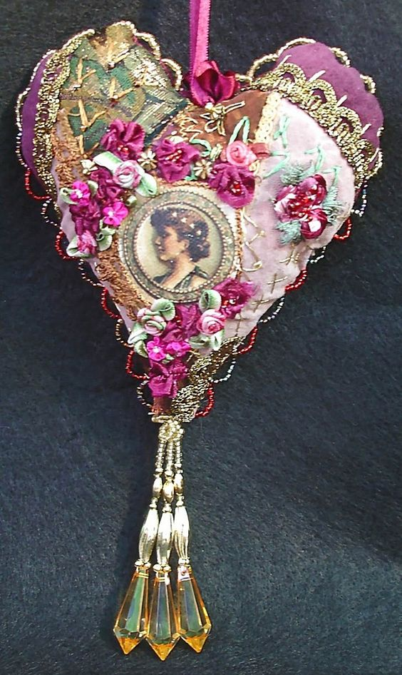

Slide 6
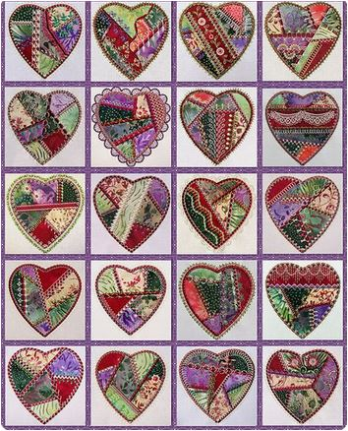

Slide 7
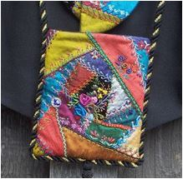
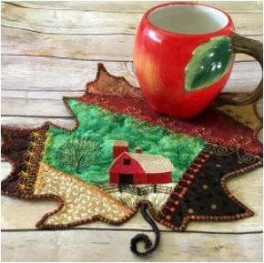
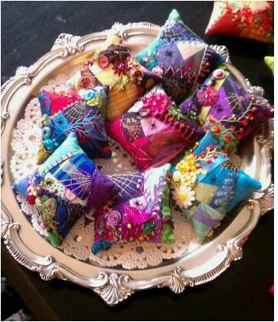
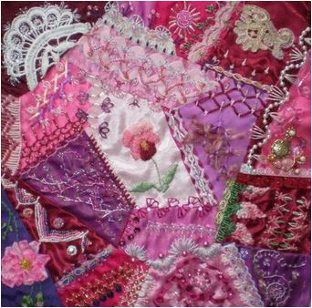

Slide 8
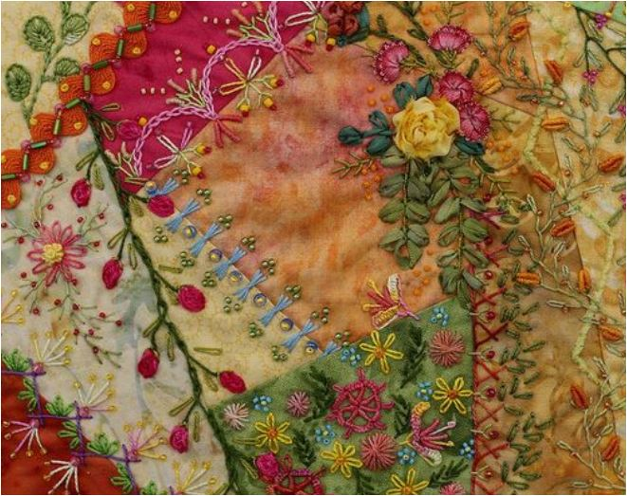
I am working on a 12 1/2" block for my lap quilt, so I started my piecing by cutting a muslin background just a little bigger then my finished block. The finished block will be trimmed to the exact size later. I looked for fabric scraps that were from 4" to 8" wide and about 12 to 14 inches long.

Slide 9
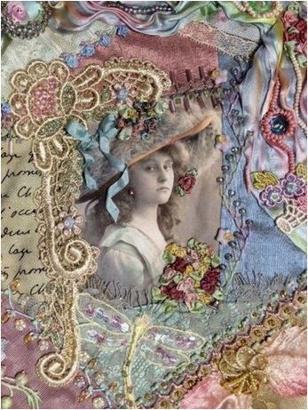
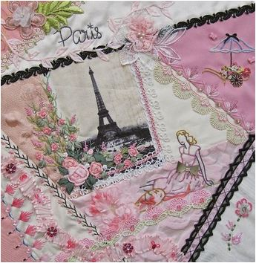
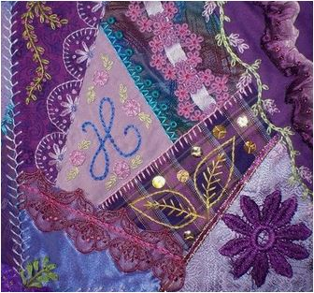
I like to plan a fancy center. On the lap quilt block I used a monogram. I am also planning to use clip art to print angels photo for centers. Embroider flowers for your center. Be as creative as you wish to be.

Slide 10
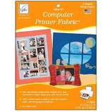



I used a computer printing fabric to make my own center art work. I found the artwork on line. Print your combined artwork on paper before you print the printer fabric.

Slide 11
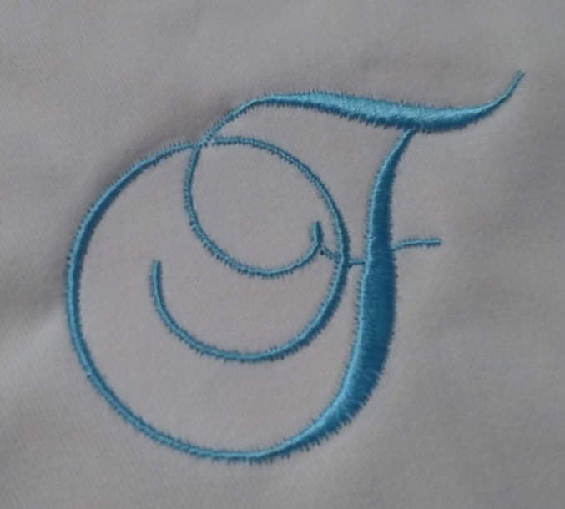
I like monogrammed centers for crazy quilting. I started with a square of fabric for my center block, about 10". Once I monogram the center fabric, I can trim the center block as the mood strikes me. I will give you a shape as a center guide. Draw the center shape over your monogram or center design using a wash away marker. Layout your fabrics before you begin to sew them in place to see how the different prints work together. I used 6 prints to create my block. Decide which print to sew 1st and them start layering the additional strips to build the block.

Slide 12
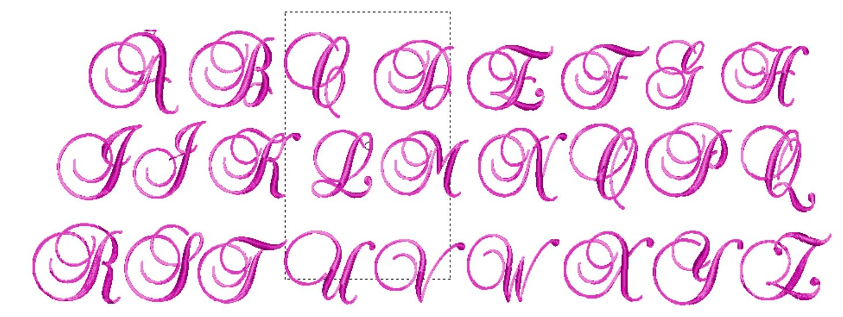
I have created script embroidery machine monograms for you to purchase for a $1.00 each. They are in FHE, PES and JEF formats. If you need another format you can use the conversion software free download from Compucon. These are virtual files and are an instant zip file download.

Slide 14
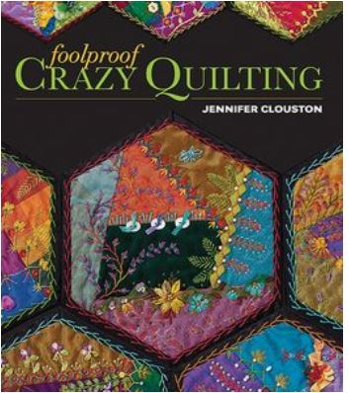
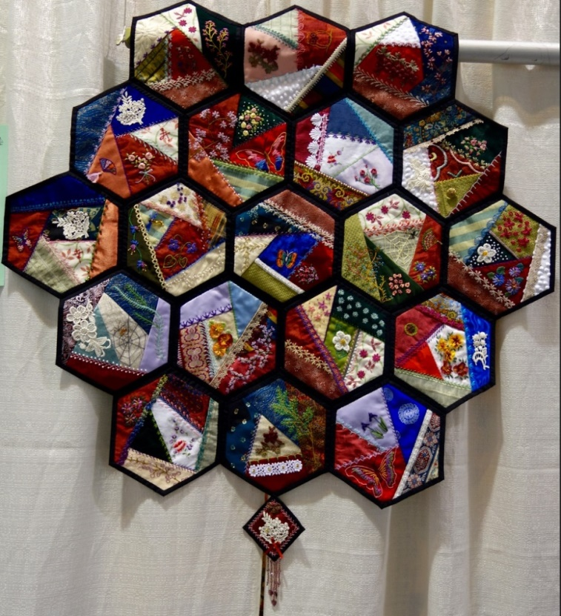
Another idea for Crazy quilting is to make a shape like the hexagon. I thought a paper pieced hexagon would work very nicely. If we have time I will show you in class on August 22th, 2019 at the MAC center. The paper piecing pattern is for sale on my web site for $1.00.

