Slide 1
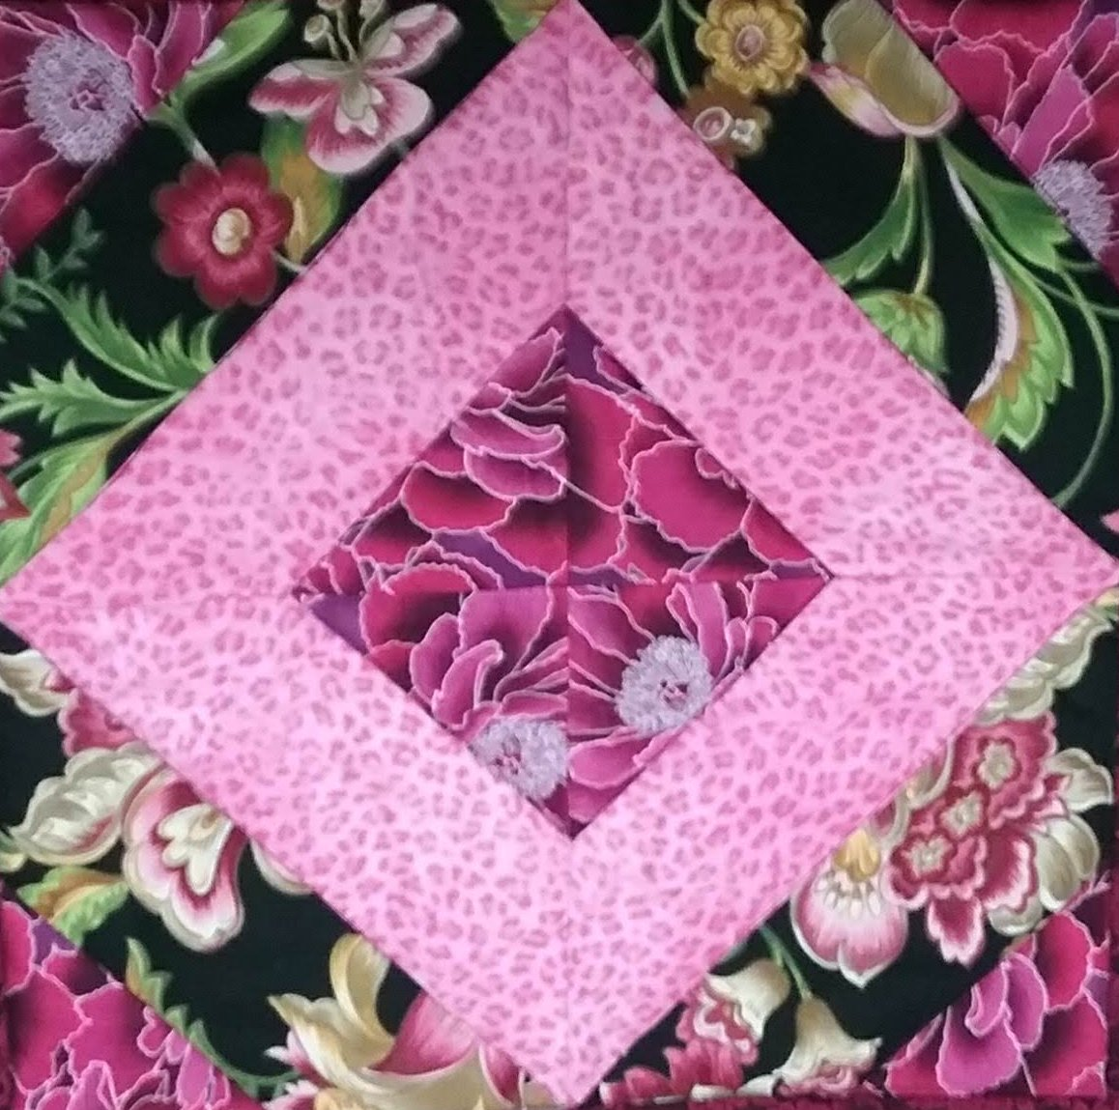
Kings Cross Block

Slide 2
The Kings Cross is a fun block. I am going to suggest we make 2 complete blocks so we can play with the layout. You will need 3 fabrics, a light, medium and dark.
Kings Cross block is on page 15 of the Lap Quilt book. Please cut fabrics for the block using your templates. You will need 3 different fabrics for contrast. The book calls for Triangle H - 8 medium print pieces and Trapezoid A - 4 light and 4 dark fabrics. Cut enough fabrics to piece 2 of this block and we will play with the layout. Please do not sew the block templates before class, thanks!

Slide 3
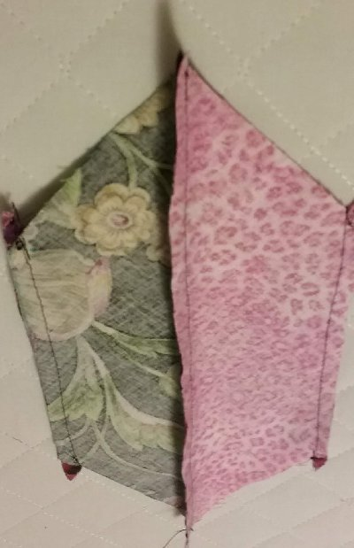
The King’s Cross block is a 4 patch block. You need to start the block by piecing the light and the dark trapezoid A together. Next you piece the triangle H to each end of the trapezoid. Press so all seams go in one direction. You will be making 4 squares for each block.

Slide 4
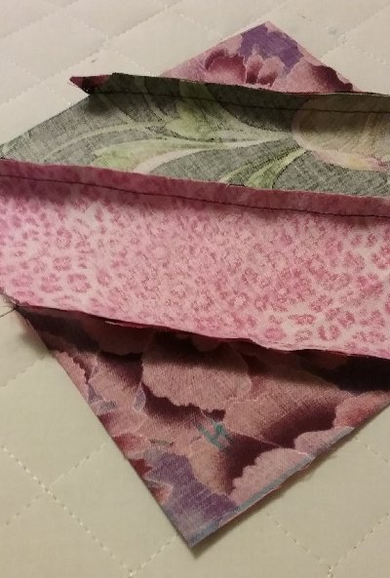

Slide 5
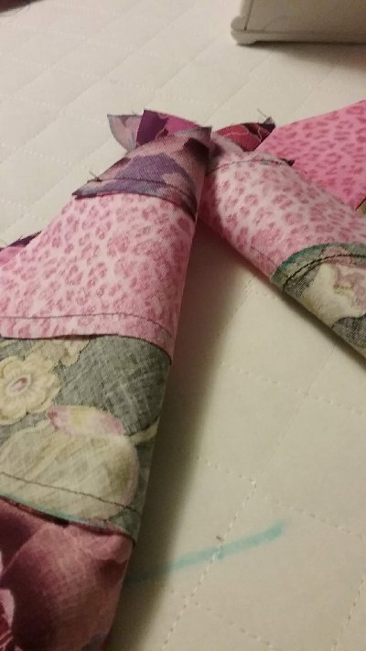
If you press the seams of 2 squares one way and the seams of the other 2 squares opposite, the seams will be easier to match up.

Slide 6
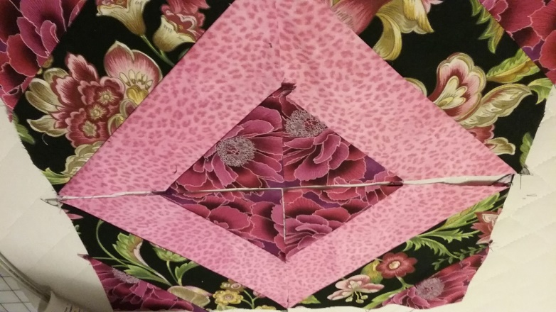
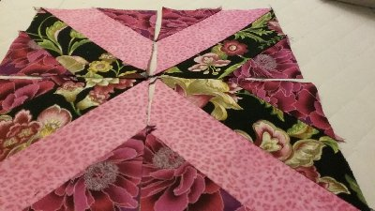
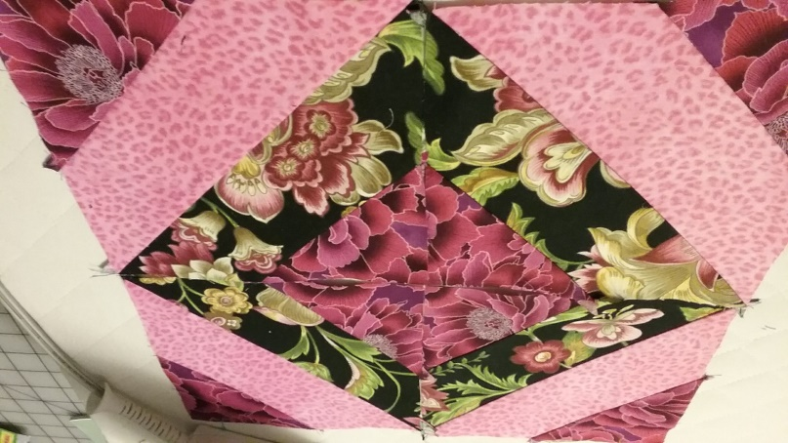
Try different layouts!

Slide 7
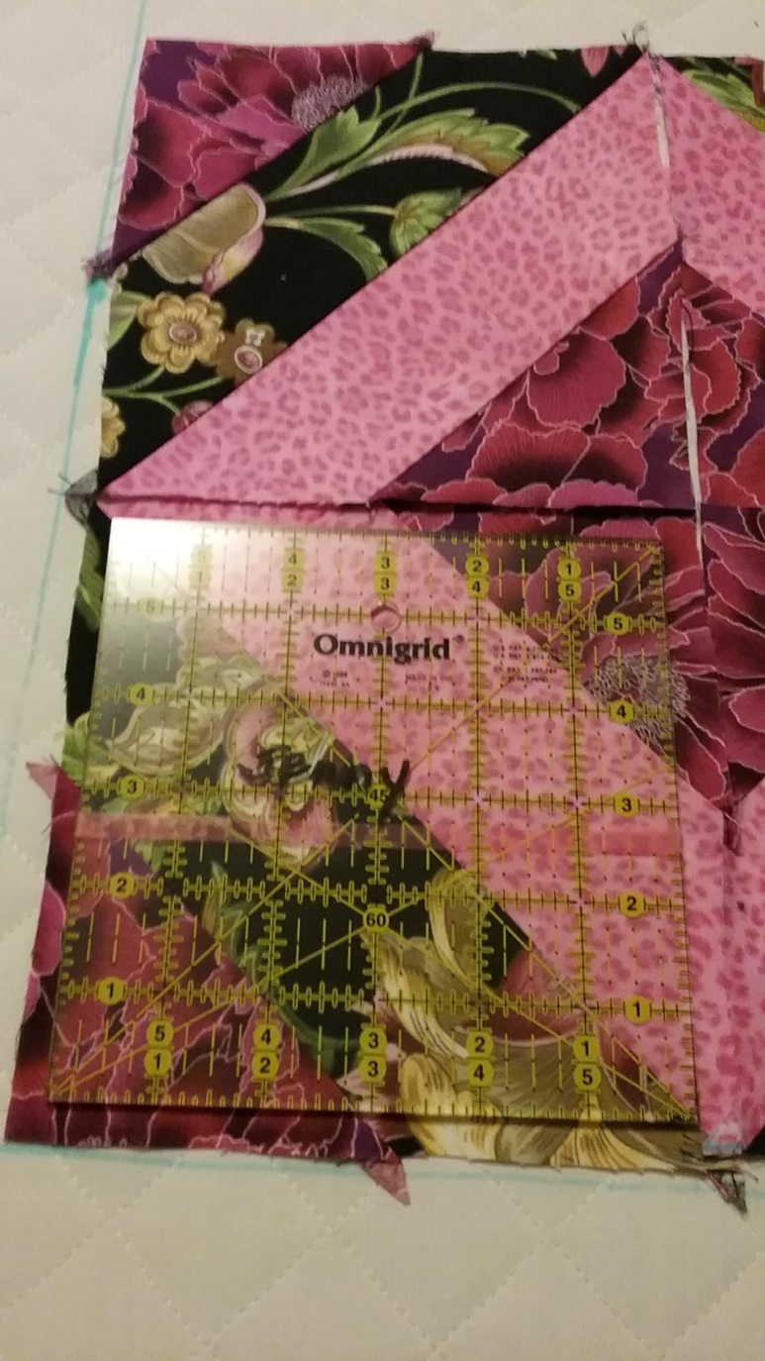
I checked my squares to see how large they were and marked my seams with a 6” ruler.

Slide 8
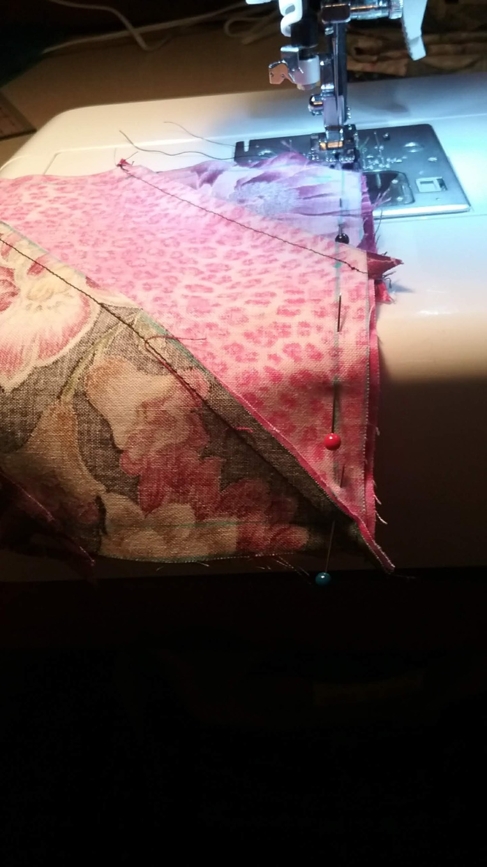
Sew 2 squares together matching up the joints and the marked seams.

Slide 9
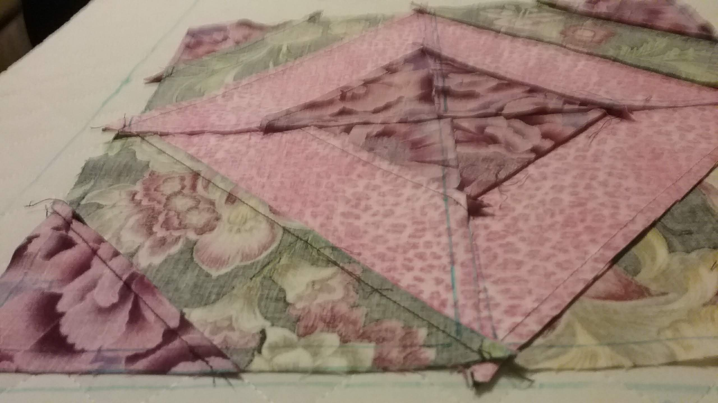
Here is the finished block. From the wrong side you can see where I sewed the 4 patch seams and the joints are pressed in opposite directions to help make the match up of the seams lines easy.

Slide 10
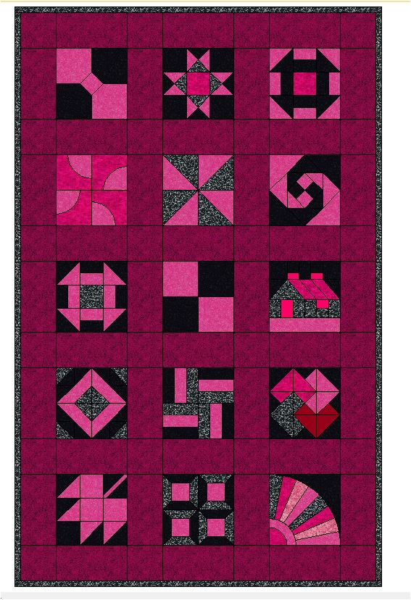
In our November session we will start joining the finished blocks to form the quilt. Make sure you have at least 2 blocks with borders that are quilted so you are ready to learn to join the blocks.
In December we will learn binding.
In 2020 we will be starting some new blocks. You can keep on adding to your current quilt or start a new one.

Slide 11
In 2020 I will start a brand new 2nd Thursday Lap Quilt group for those that missed the fun in 2019. Our 2020 January session will cover templates and fabric requirements for a brand new Lap Quilt by Georgia Bonesteel. We will meet at 1030 South Schumaker Dr in Salisbury, MD the 2nd Thursday of every month from 2:00 till 4:00pm. Our 1st session is January 9th. I suggest you enroll on line for the 1st session so I know how many to expect. The fee is $5.00 per month.
Our current lap quilter’s are welcome to join the group. Please enroll in advance as space is limited.
More later on what you need to bring to your very 1st session.

