Slide 1
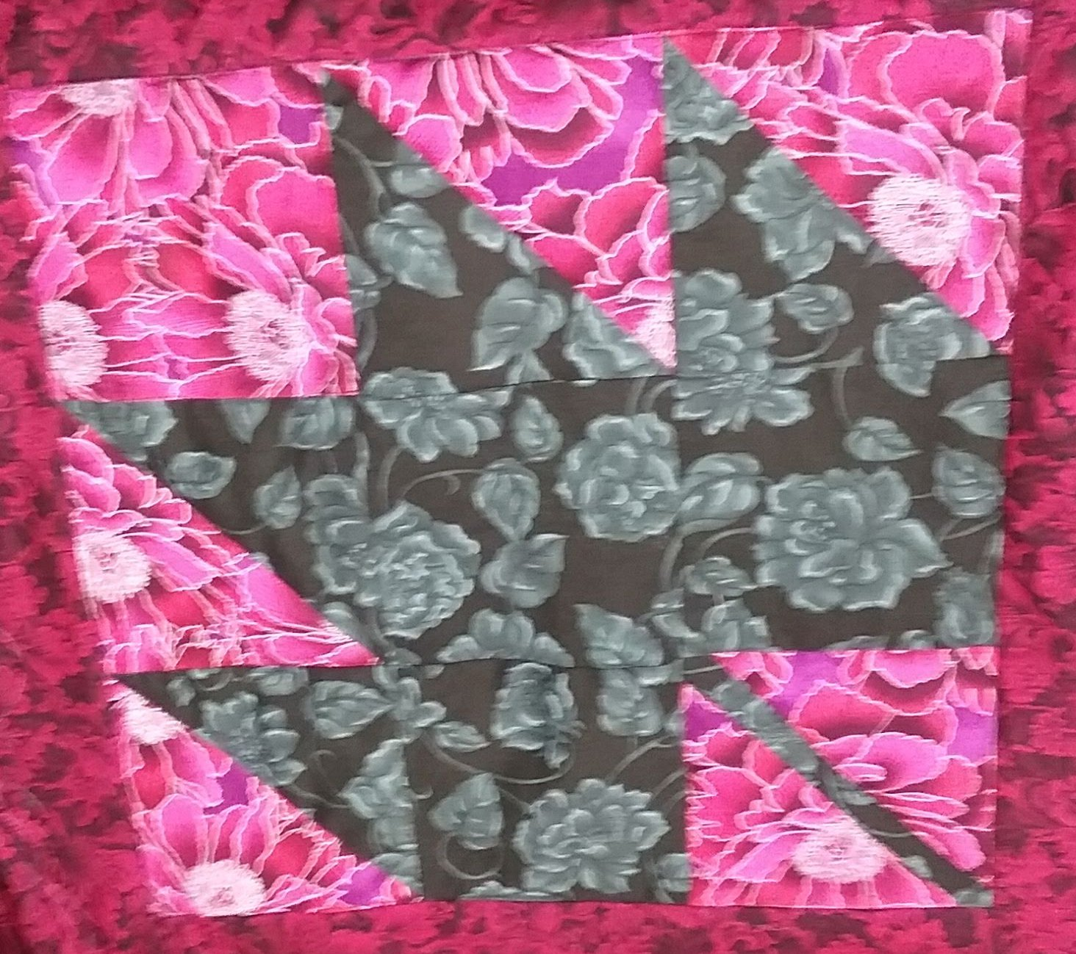
Lesson 6 - patch blocks

Slide 2
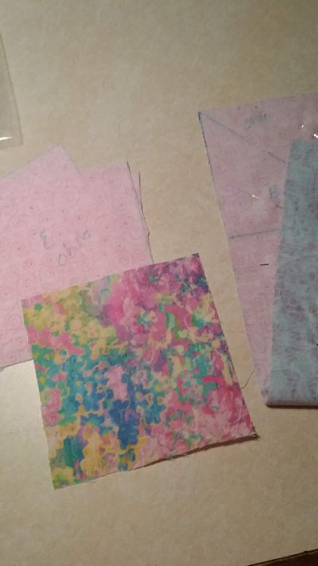
The 9 patch blocks are all designed with 3 blocks across and 3 blocks up and down! Most of these blocks can be drawn using the templates called for in the Lap quilting book plus a drawn grid for easy piecing.
The Ohio Star takes 3 contrast fabrics, The Shoo Fly and Churn Dash and the Maple leaf take 2 contrast fabrics.

Slide 3
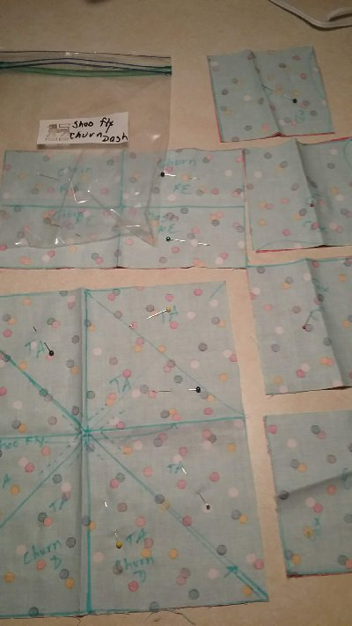
I drew the grids for the Churn Dash and Shoo Fly using the same fabrics. Fabrics are placed right sides together so I can draw the template on the wrong side. I label the drawn template and the block on the fabric. I will stitch ¼” seams on both sides of the angle lines.
On some templates I will need to sew across one straight edge.
Example: Shoo Fly requires 4 light and 4 dark Triangle A.

Slide 4
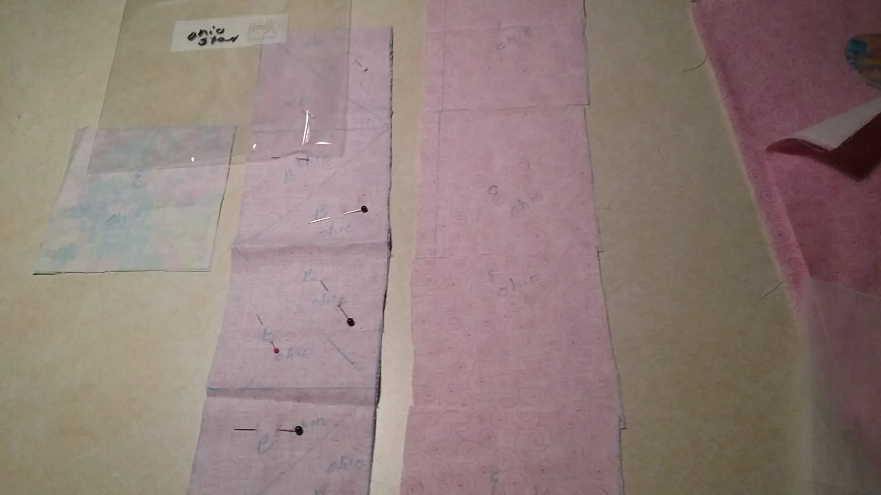
Here is the Ohio Star. It requires 1 print and 4 light square E. 8 dark and 8 light triangle B. By pinning the light and dark right sides of the triangle fabrics together, I only have to draw 8 triangles. If I sew ¼” on each side of the center drawn angles I will piece the light and dark triangles together in one step. All I need to do is cut the angle line and press the seam to one side.
( notice I store the drawn blocks in marked baggies until I sew them. Each square is also pinned.)

Slide 5
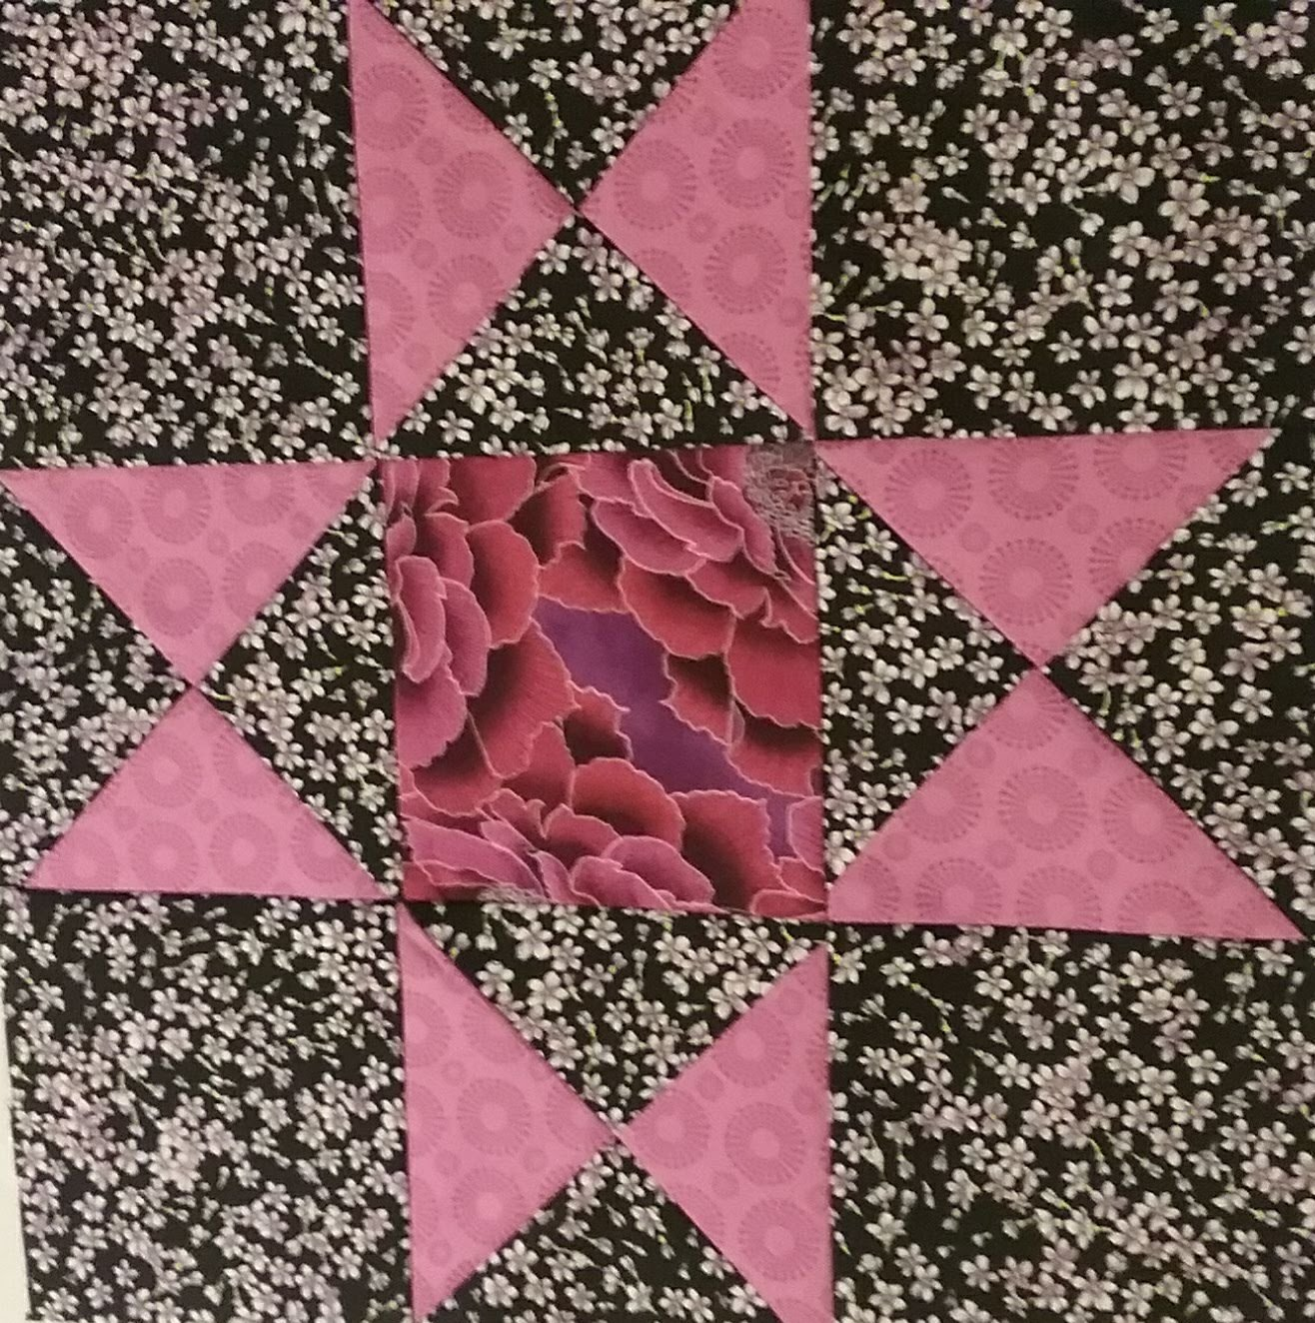
Ohio Star

Slide 6
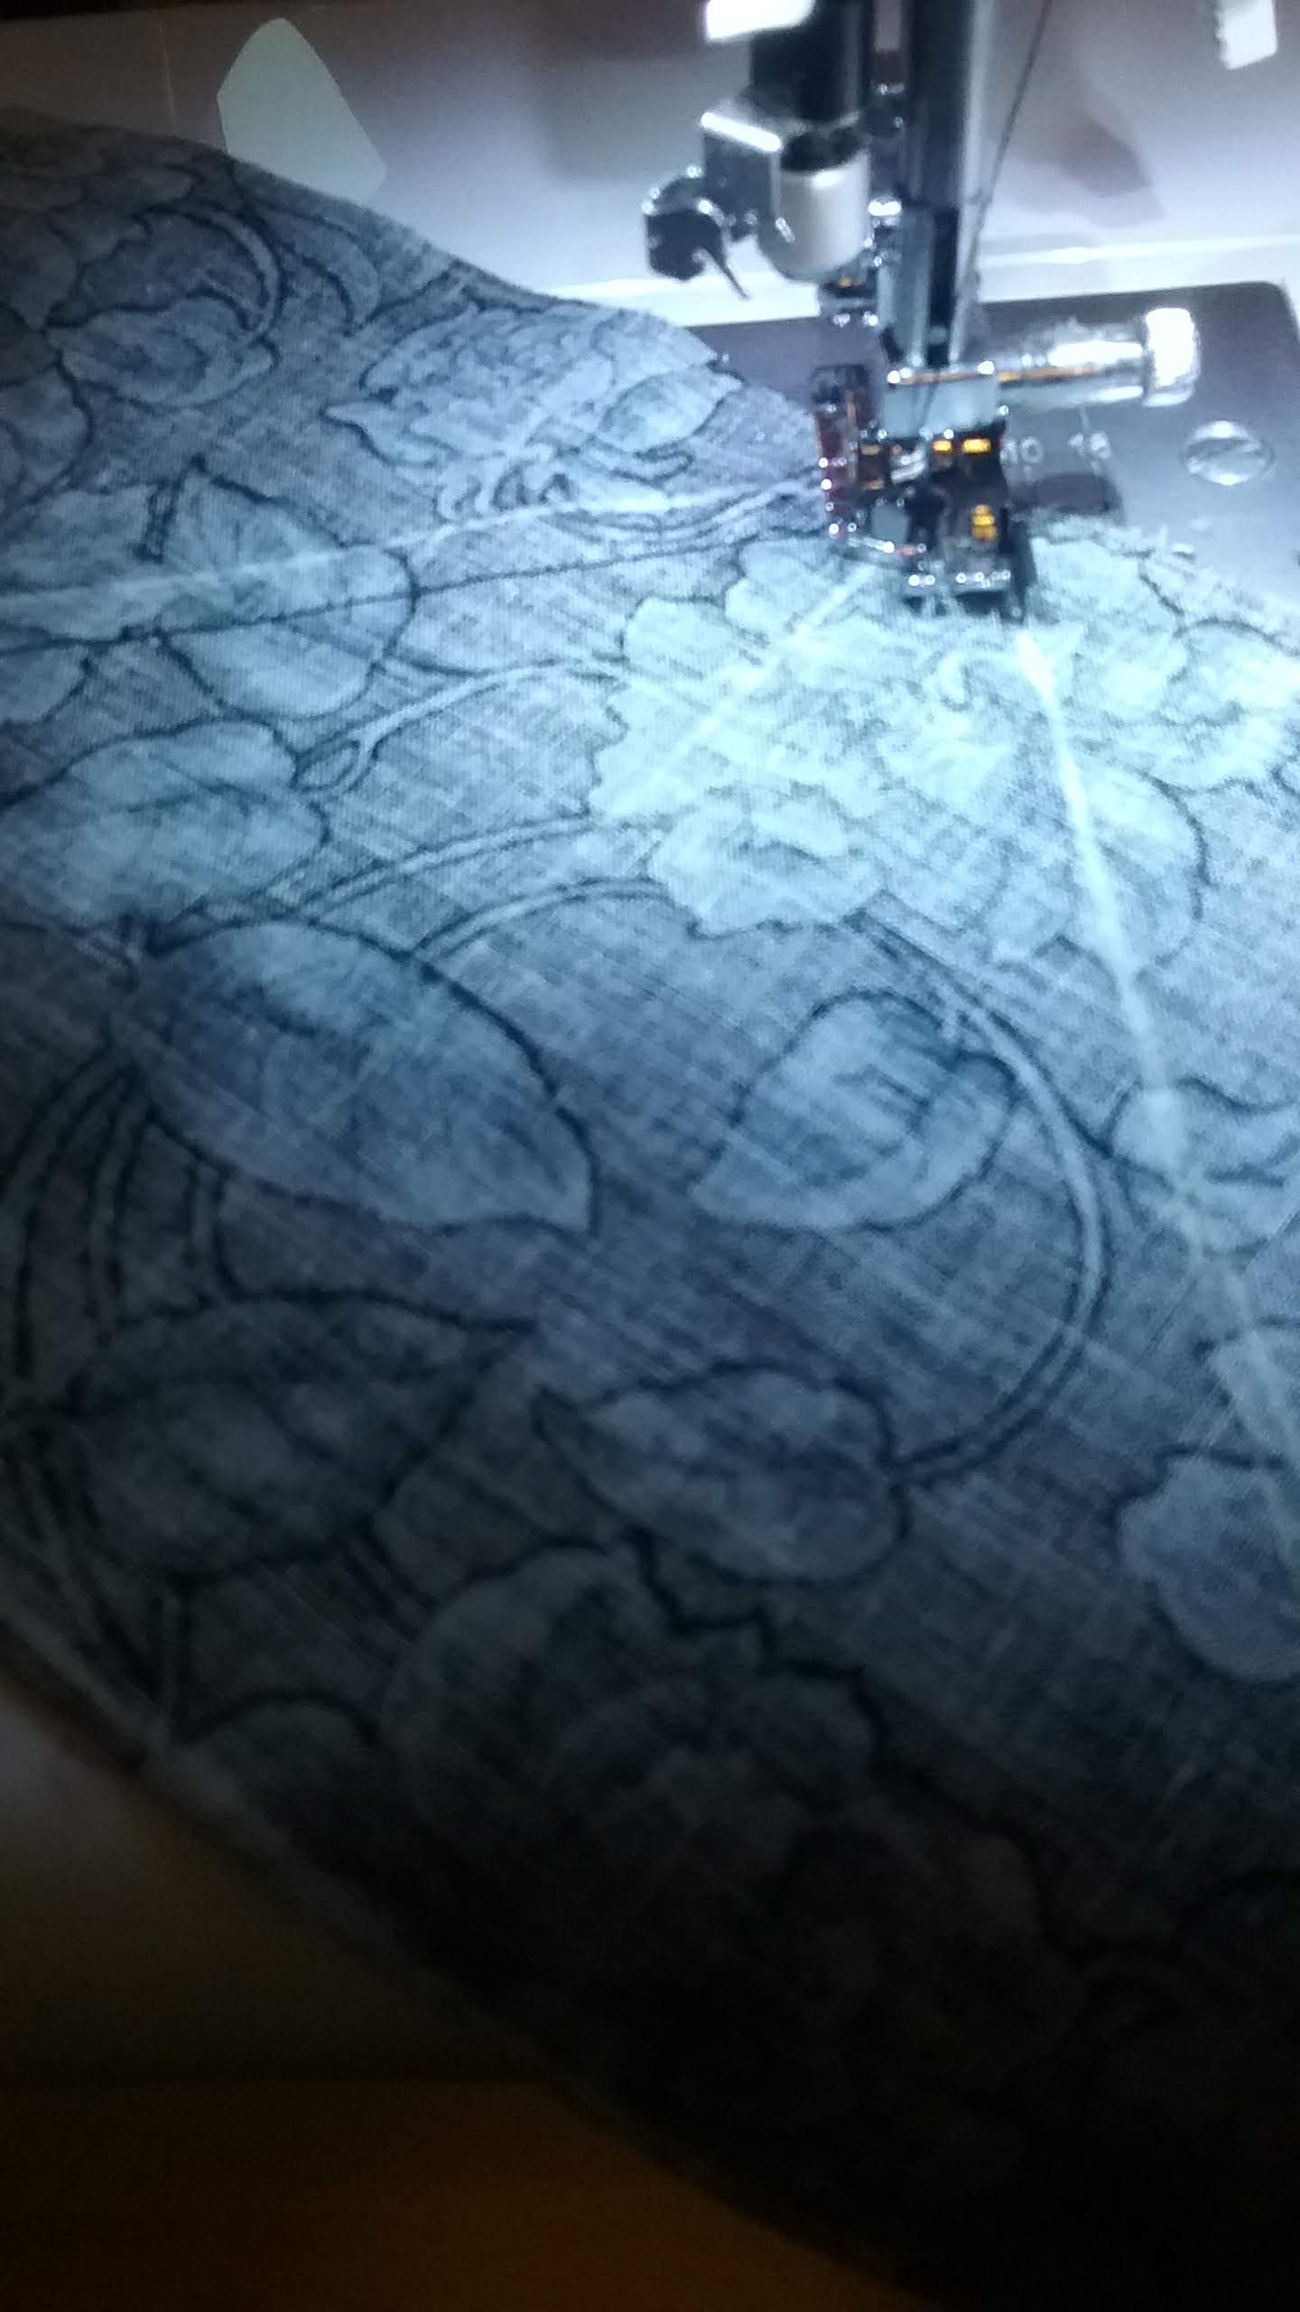
Here I am sewing the Maple Leaf angles ¼” from the drawn line. Notice I butted the triangles to each other when drawing them so I could pivot and sew continuously.

Slide 7
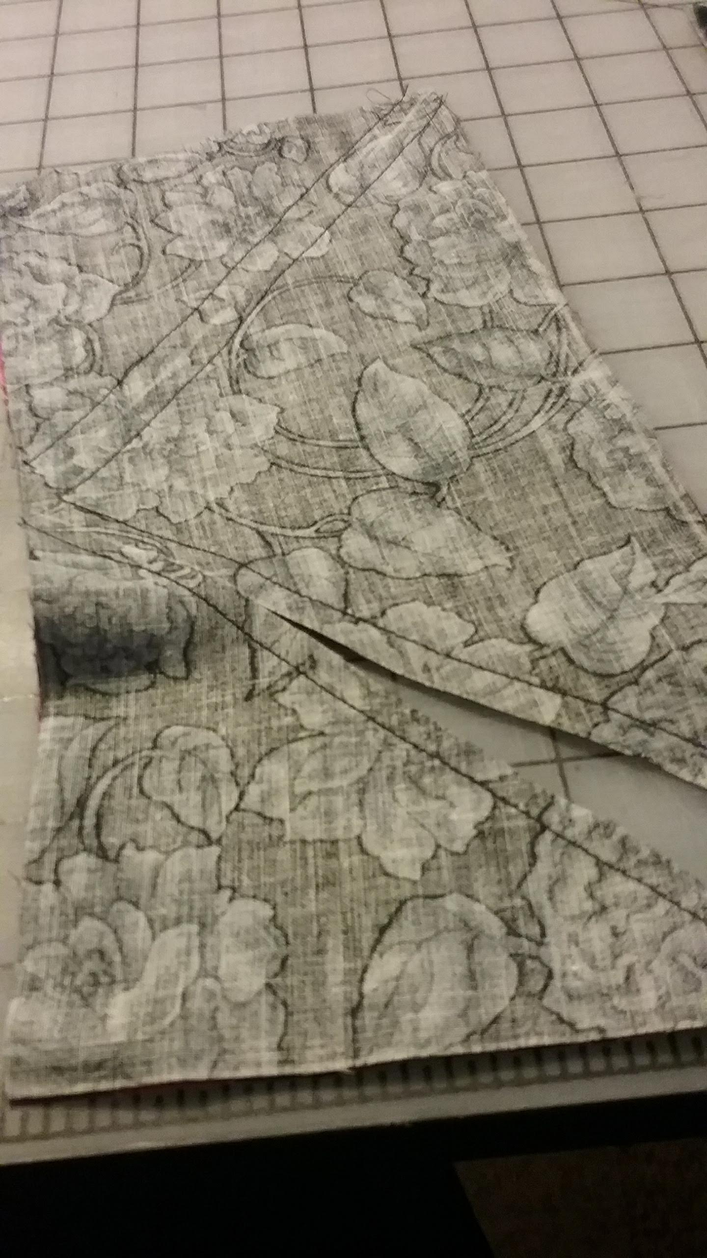

Slide 8
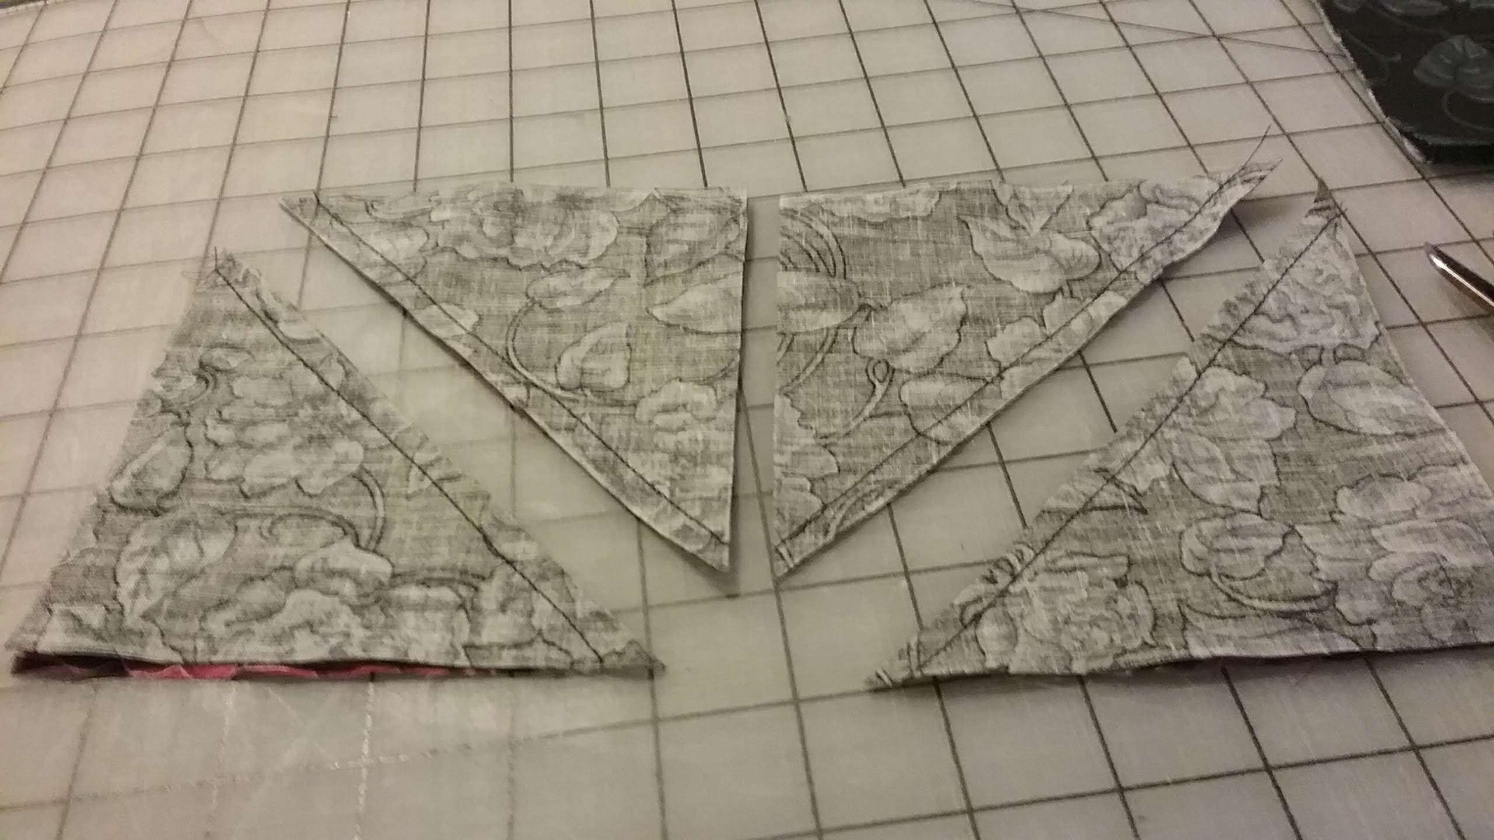
Here is the Maple leaf triangles. They have been cut after sewing on each side of the angle line. I need 4 dark and 4 light Triangle A. Once opened you will see both triangles.

Slide 9
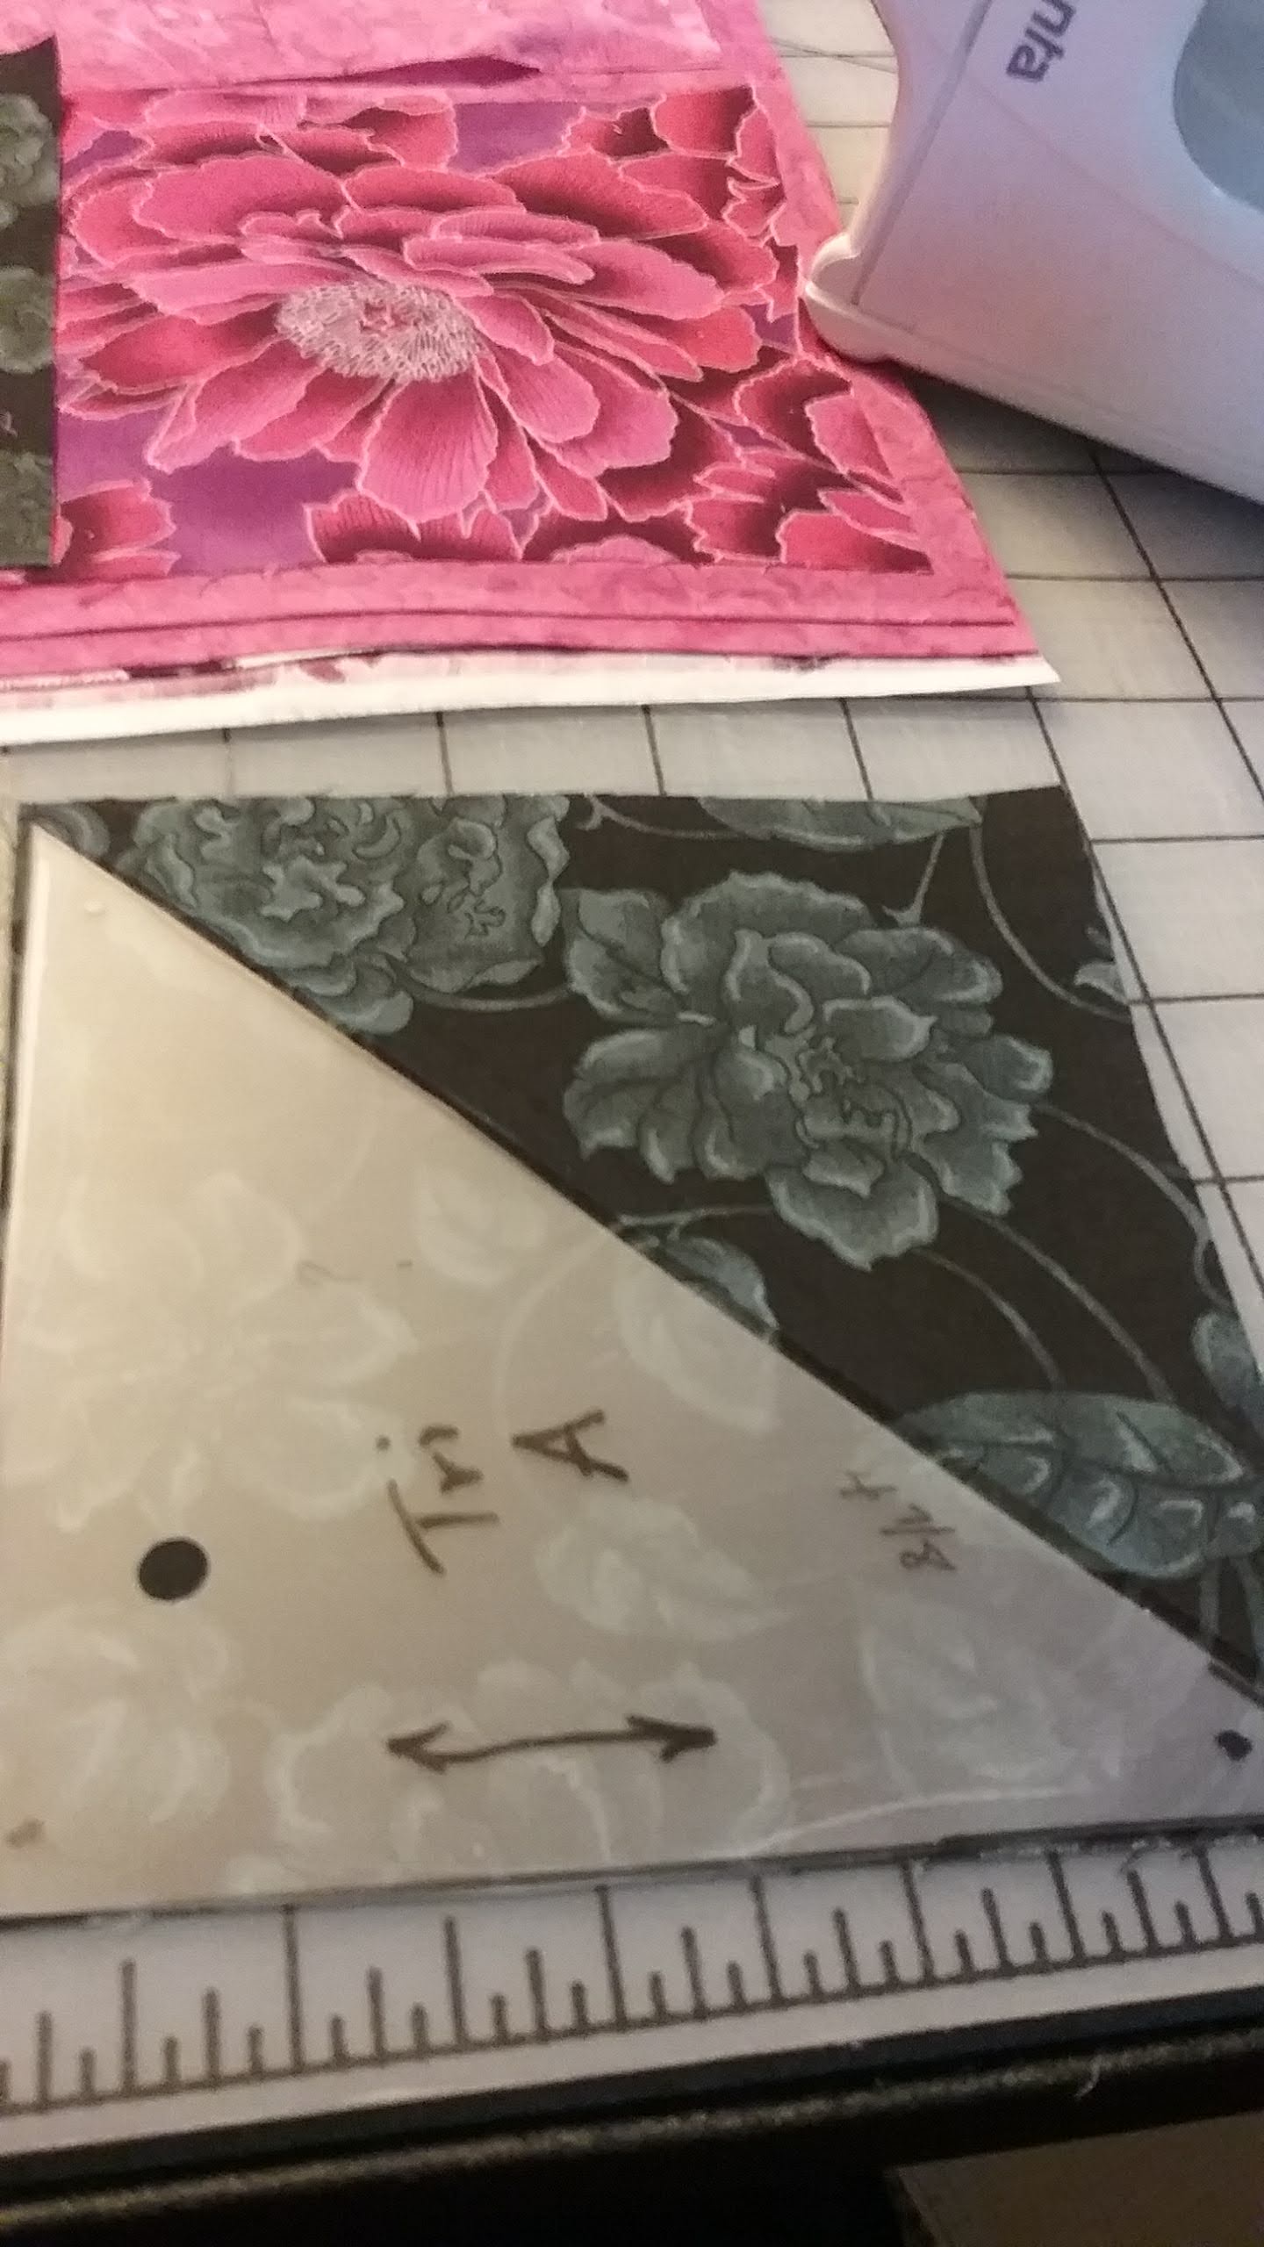
To cut the stem I drew 2 triangle A side by side.

Slide 10
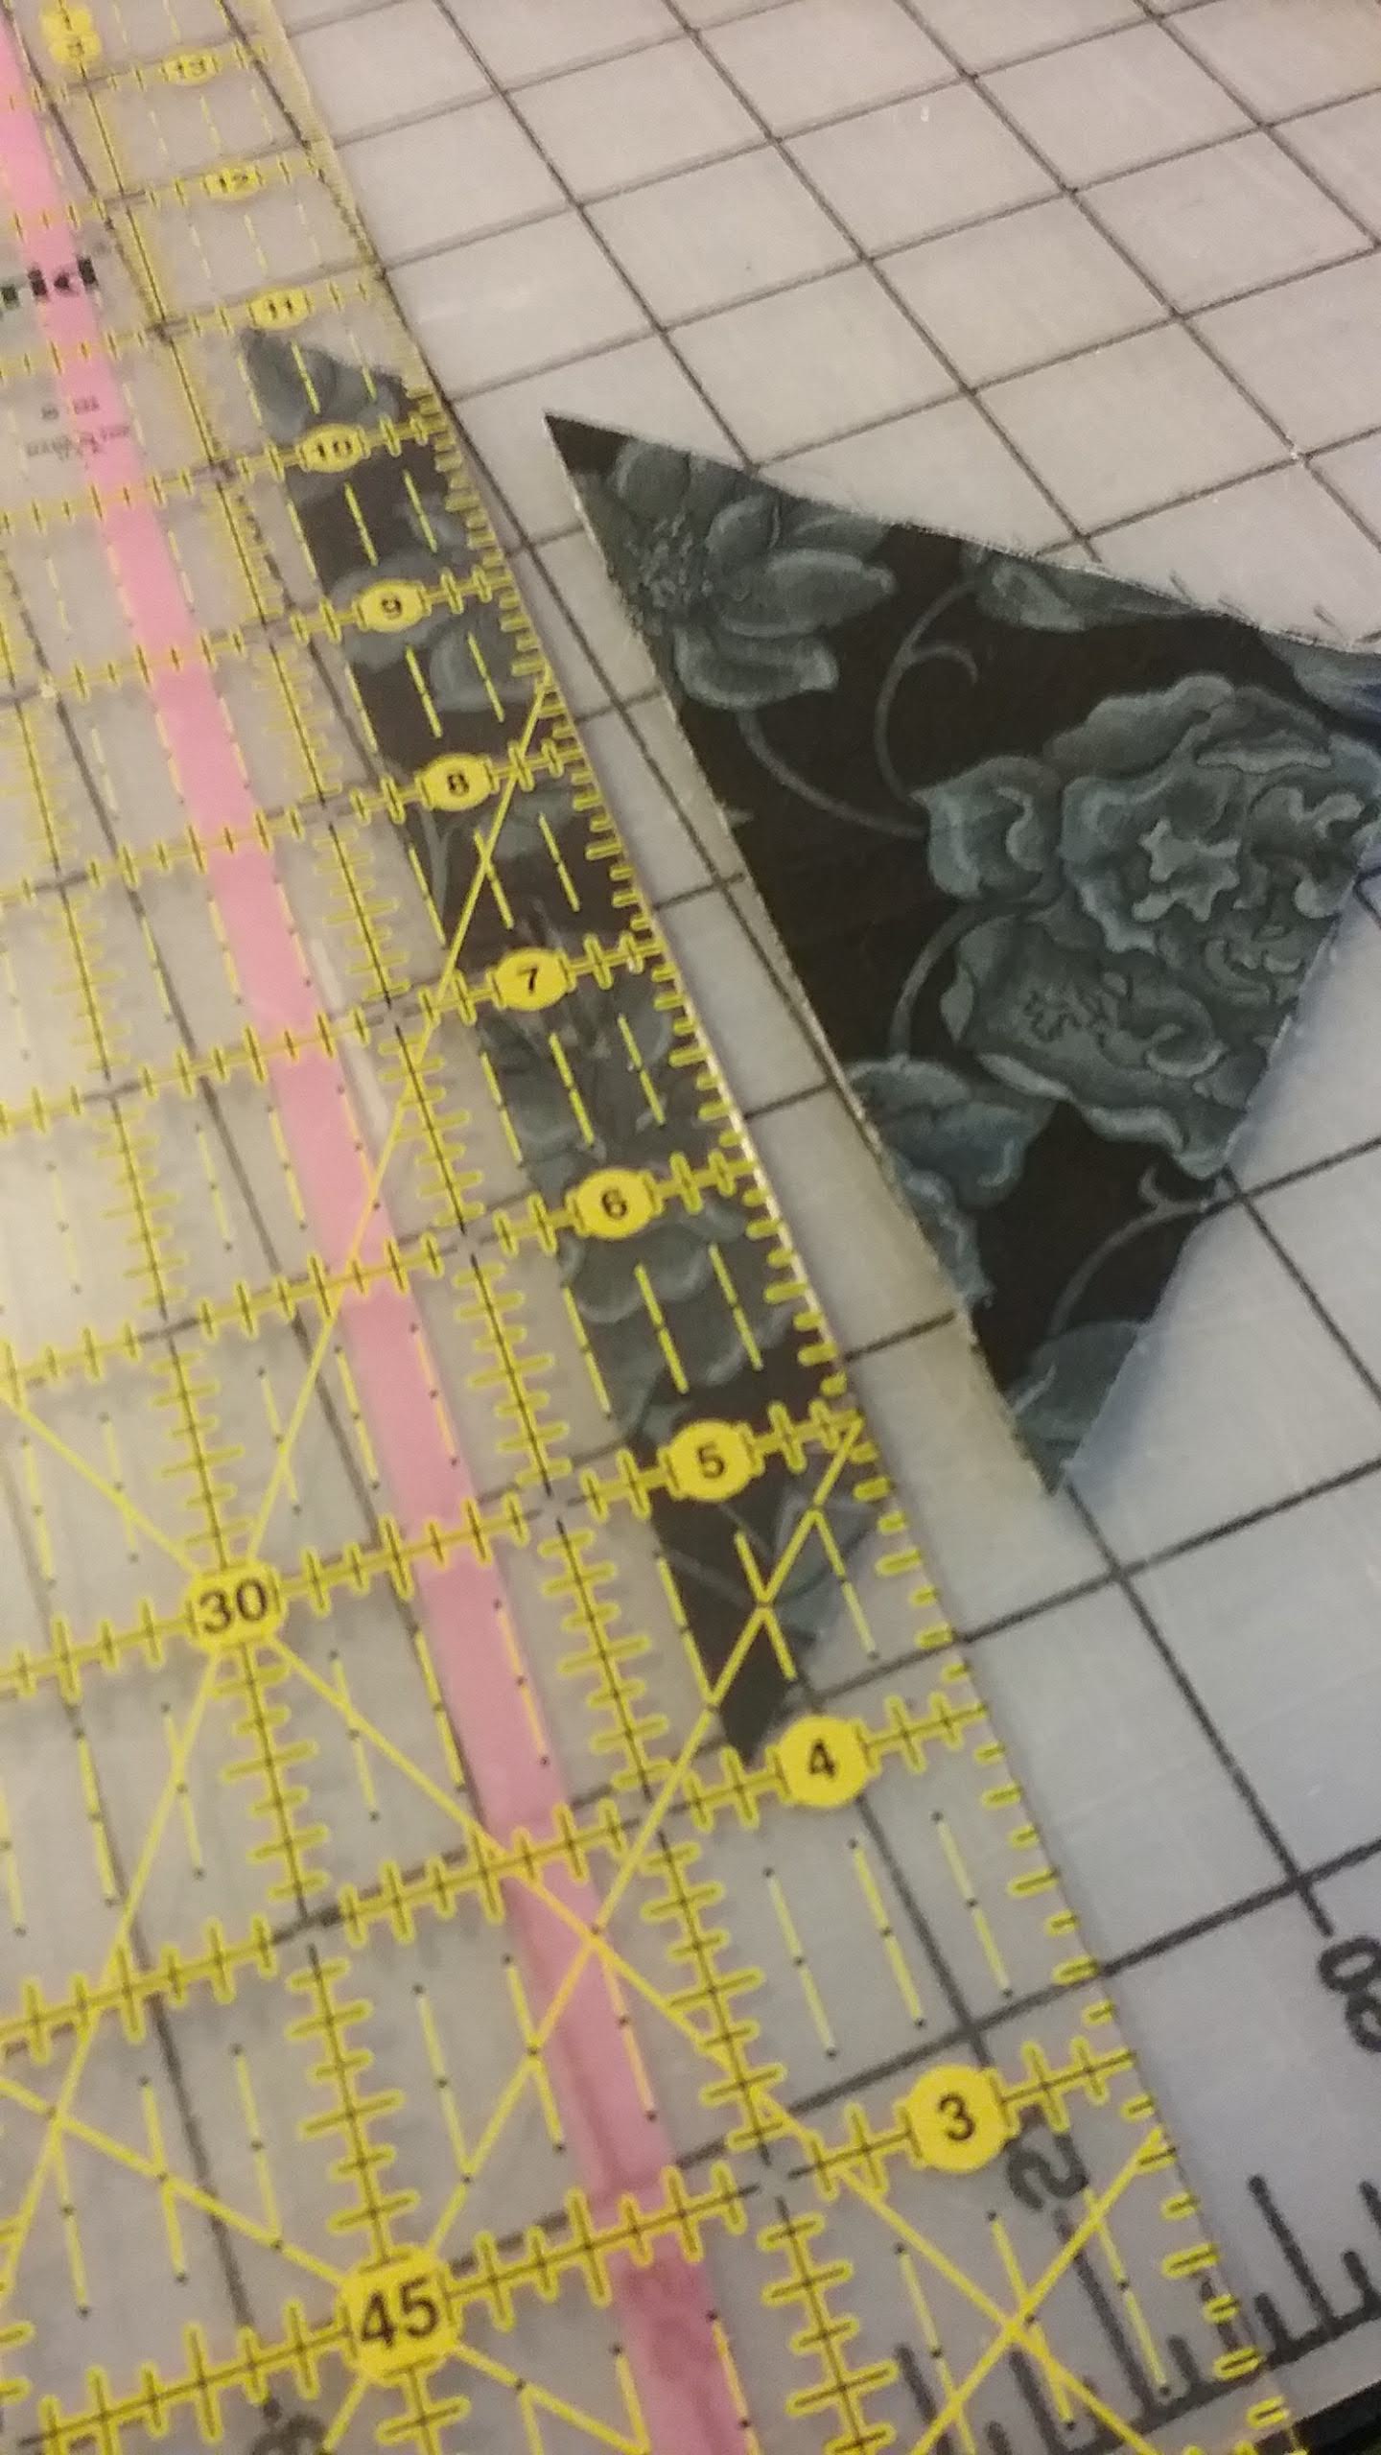
Fold the square in half on the diagonal. I cut a ¾” strip across the folded end of the formed triangle.

Slide 11
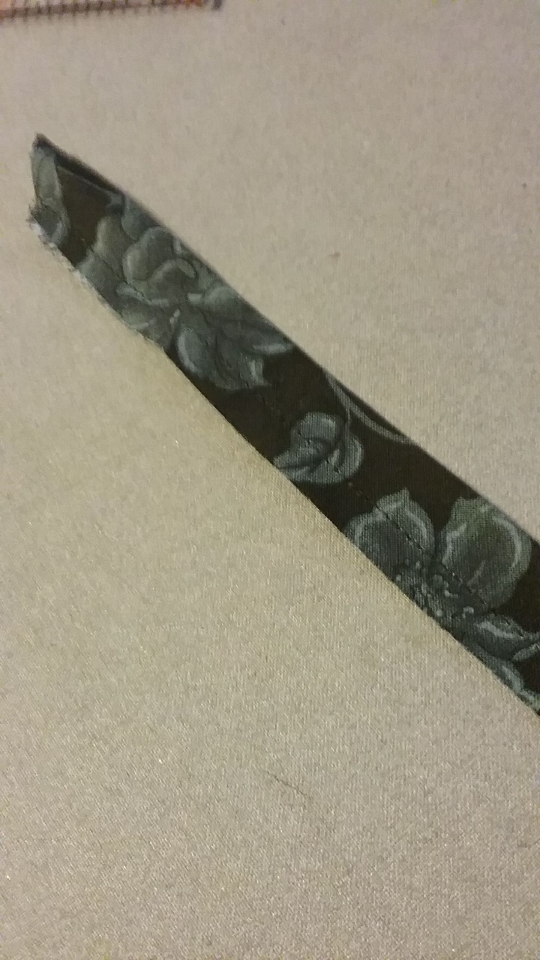
I folded the strip in half, wrong sides together and sewed a 1/8” seam. I pressed the strip so the seam was placed on the back side of the strip.

Slide 12
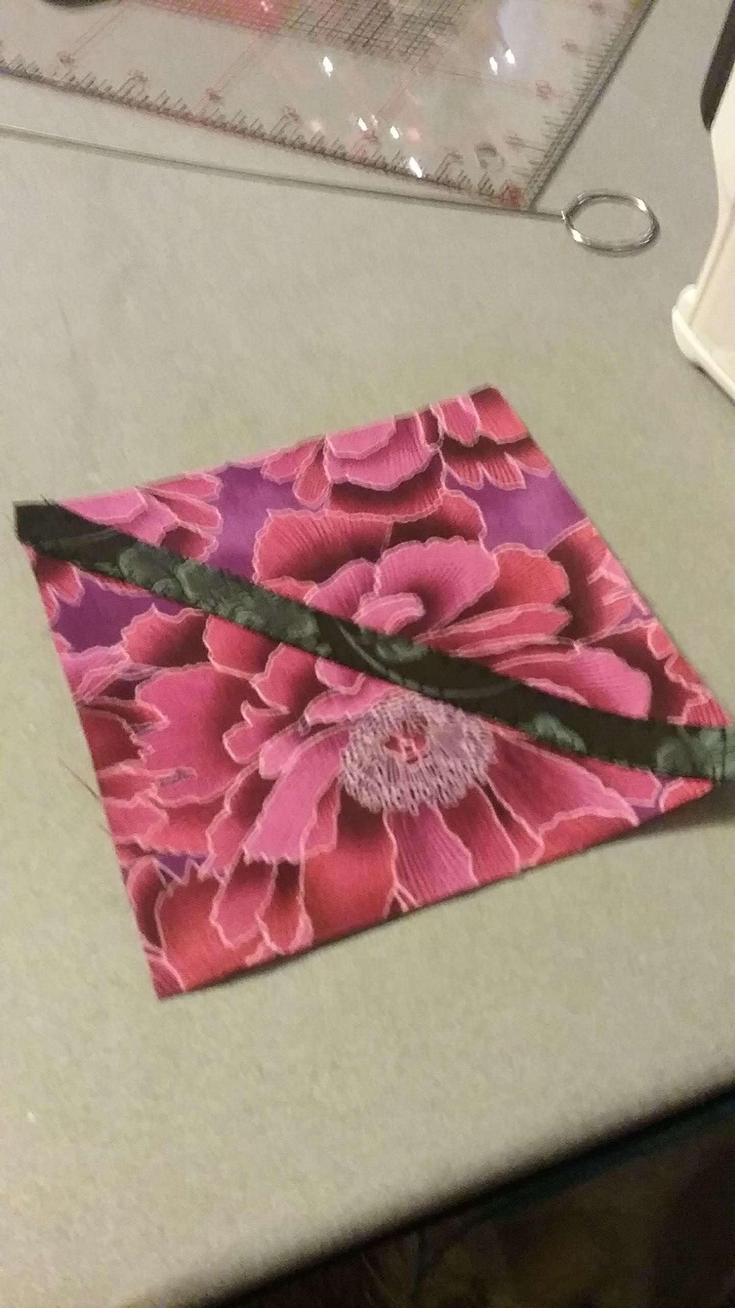
Place the strip diagonally on one light block square E and applique in place using the blanket stitch. Continue to piece the nine patch following the Lap Quilt book layout.

Slide 13
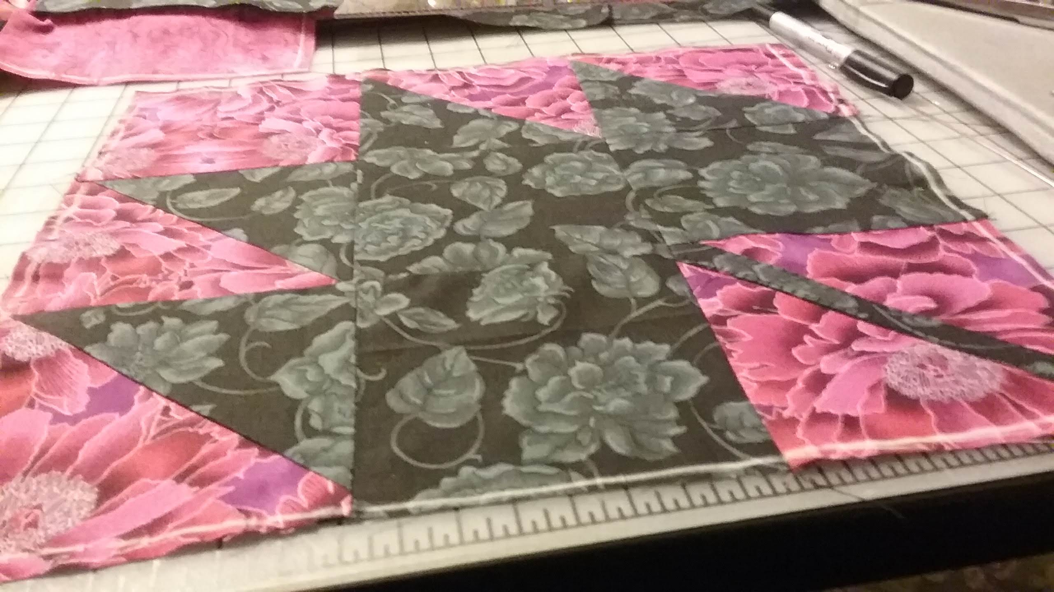
The finished 9 patch Maple Leaf

Slide 14
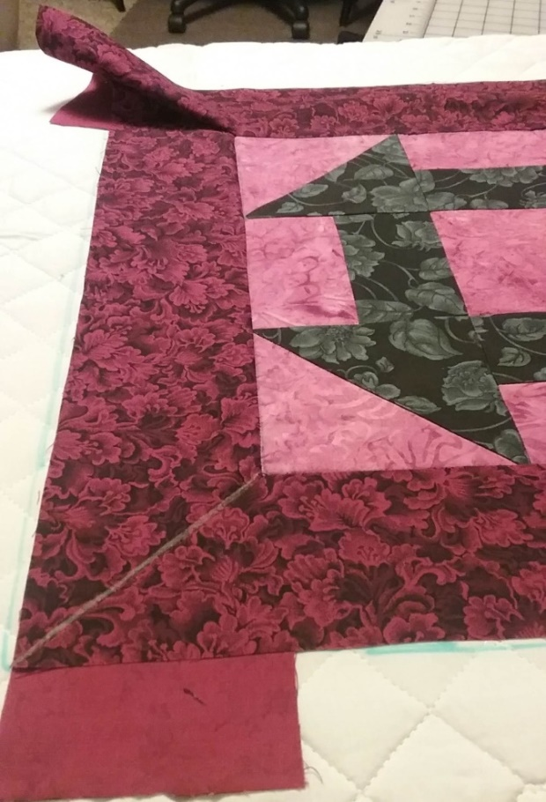
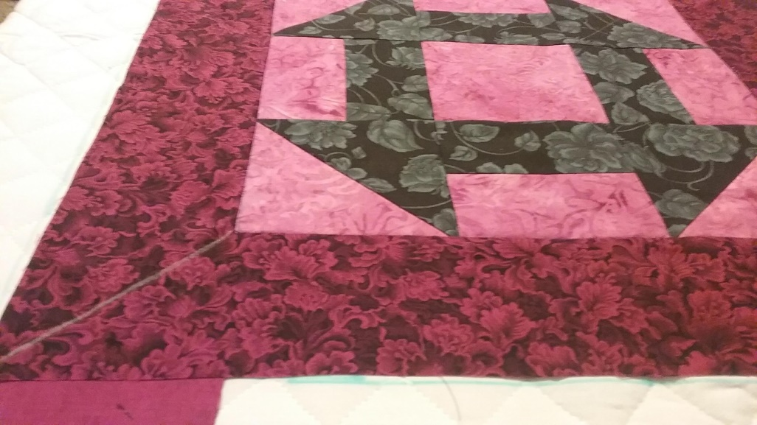
Churn Dash is pieced from 4 light and dark triangle A and 4 light and dark Rectangle E and one Square E light. Look at the block and see if you can pick out the 9 patch parts.

