Slide 1
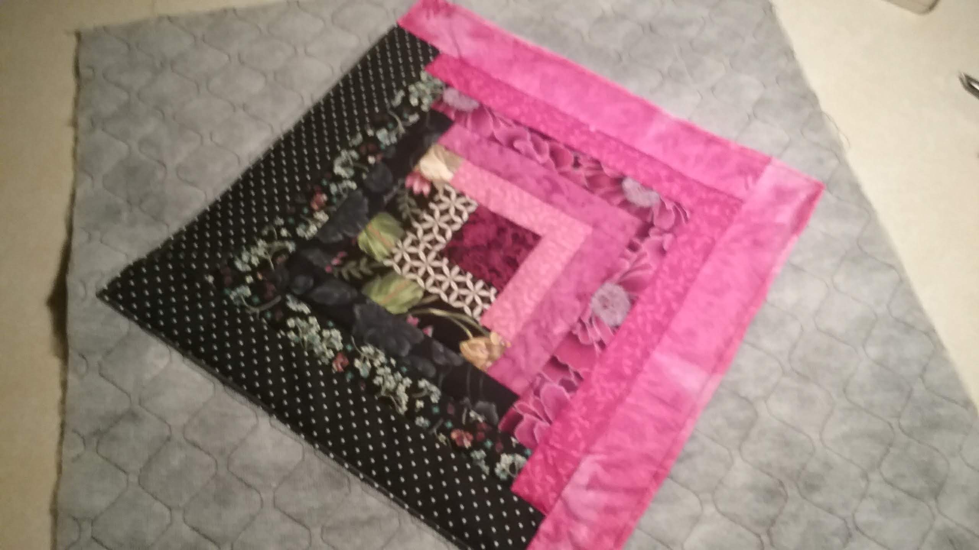
Log Cabin

Slide 2
The log cabin consists of 1 center square, 5 light and 5 dark strips.

Slide 3
Strips are cut from rectangle B which is 1 ½” wide and square G which is 2 ½”. I cut the center G square and cut strips across the width of the fabric 45” X 1 ½” wide for the sides.

Slide 4
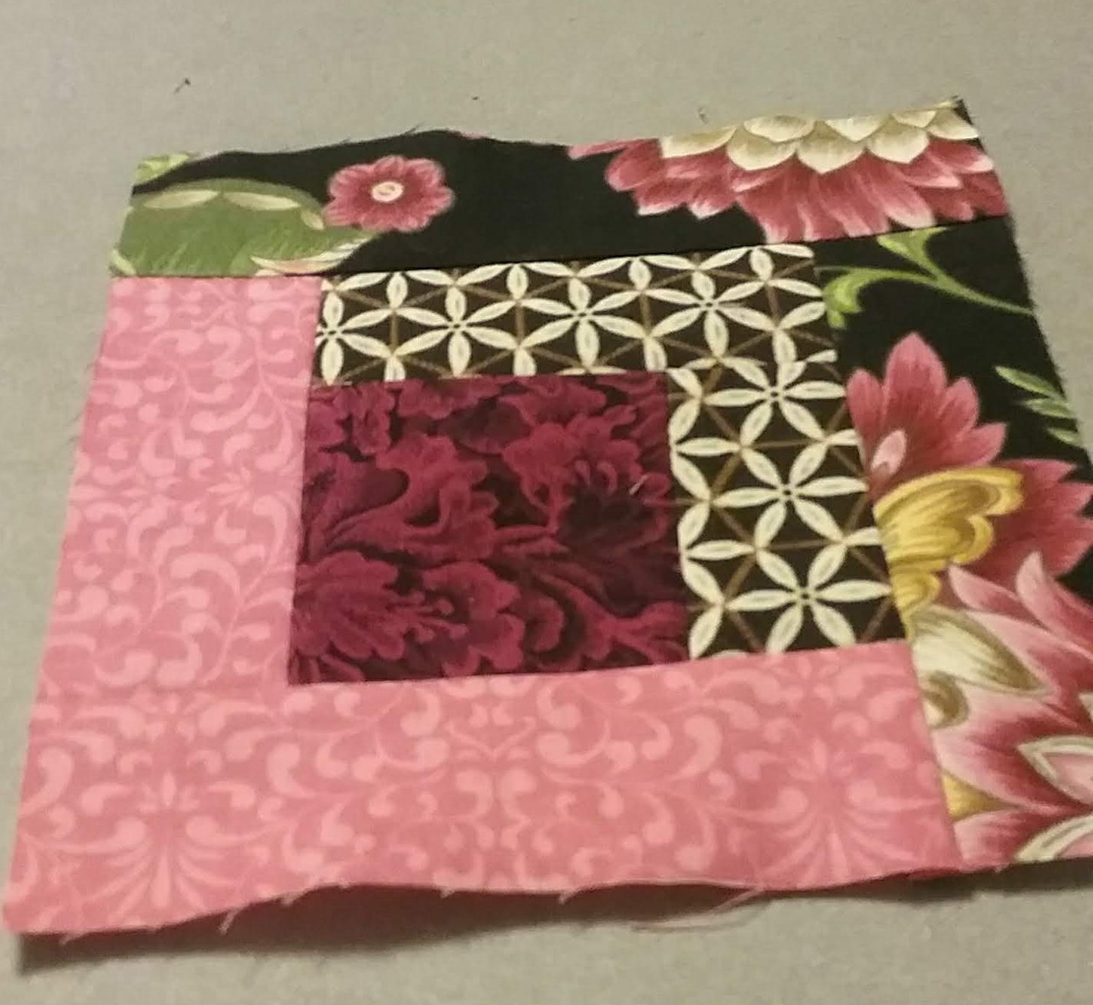
We will start with the center block and work around it to form the log cabin. On this picture I show that I started with the 1st dark and pieced it to the center, right sides together. I then sewed the 1st dark to the center and 1st dark side by turning the block. Next I rotate the block and add the 1st light, then add the 1st light again. Next I rotate the block and sew the 2nd dark , rotate the block and sew the 2nd dark again. I continue….

Slide 5
I made a 2 ½” strip X 45” (Size of square G) face up and place the strip for 1st dark ( 1 ½”) right side together. Stitch the strip with a ¼” seam to start the log cabin. This method will create several blocks. Cut the strip into 1 ½” strips and press seam to dark side.

Slide 6
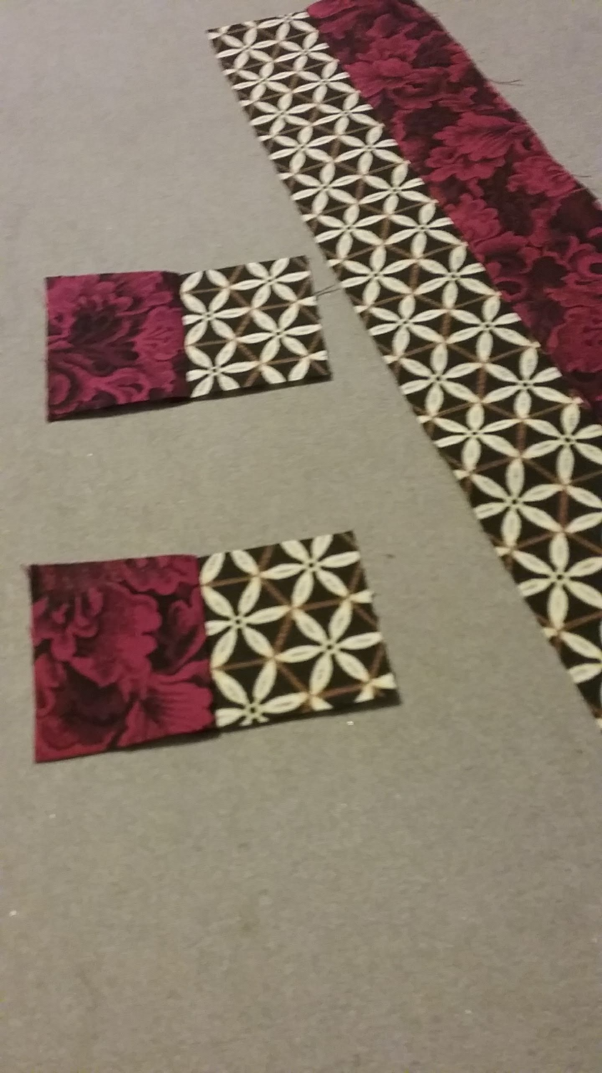

Slide 7
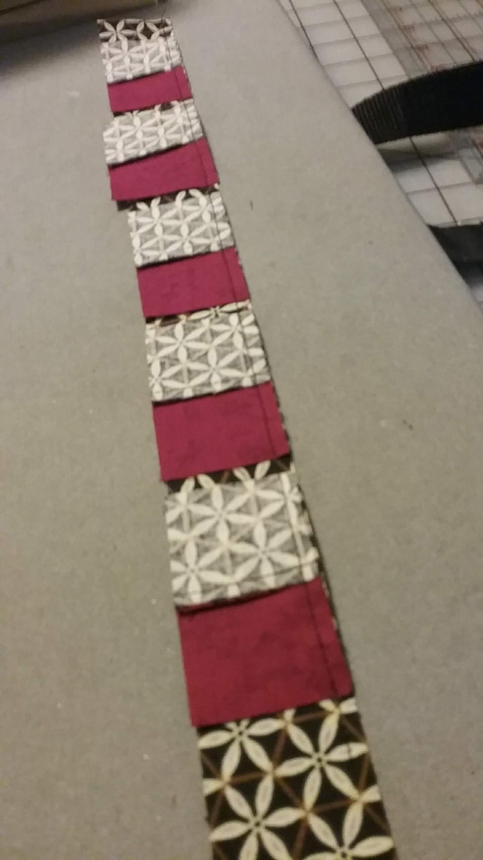

Slide 8
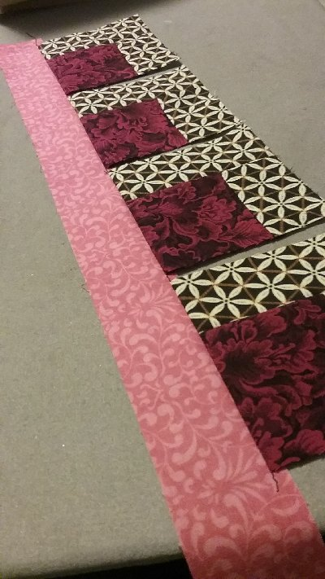

Slide 9
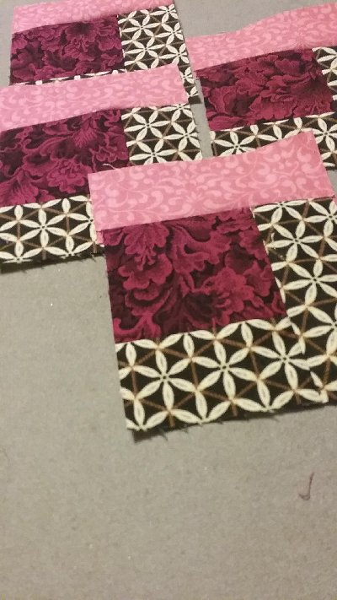

Slide 10
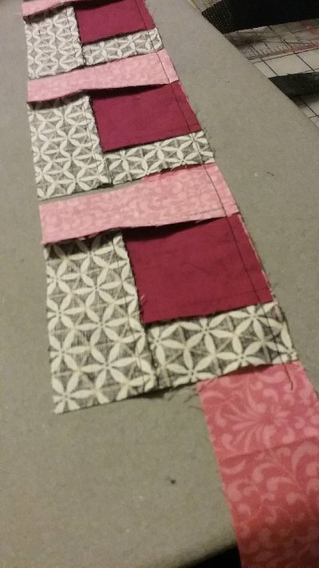

Slide 11
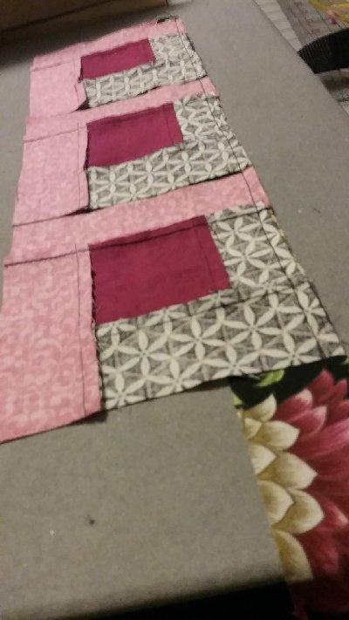

Slide 12
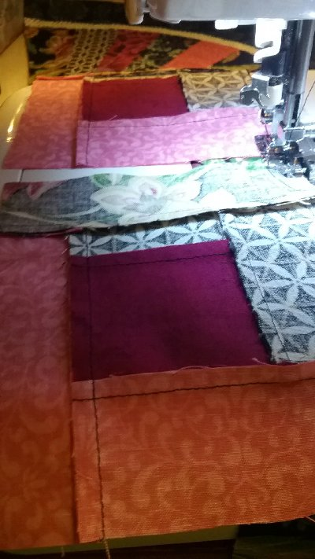

Slide 13
2nd dark is sewn

Slide 14
Sewing the 2nd light strip in the 2nd position.

Slide 15
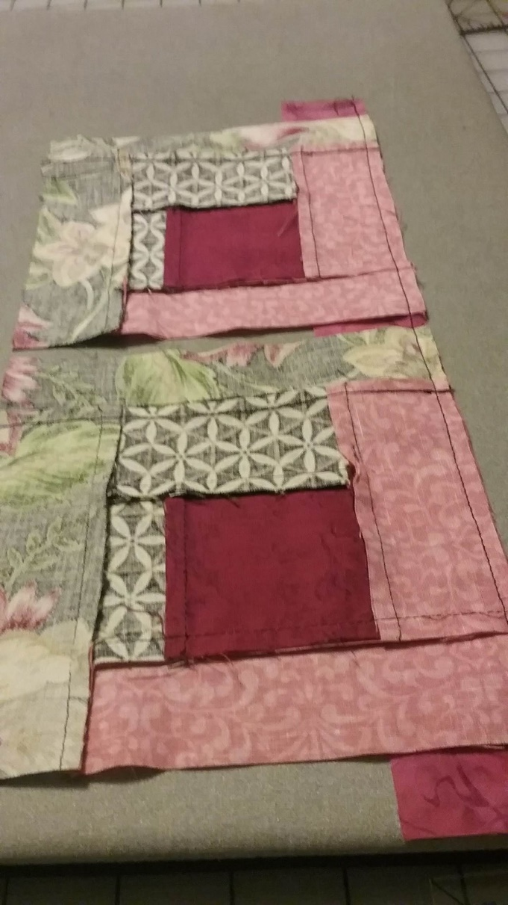

Slide 17
Before you sew the last round of strips to the main block, check the measurement of the main block with a square up ruler. I found I needed to make the last strip a little wider to end up with a 12 ½” square when the log cabin is complete.

Slide 18
