Slide 1
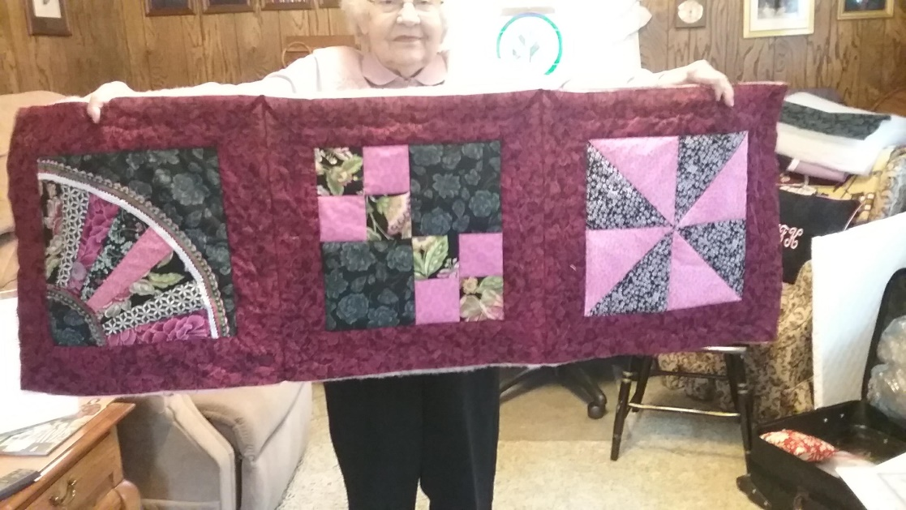
Lap Quilting
Putting the quilt together

Slide 2
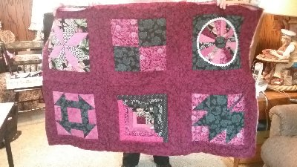
After you have pieced your quilt blocks, bordered and quilted them, the next step is to layout the quilt and start assembling the quilt. In our November and December sessions we will talk about the process of assembling the blocks into rows. The rows are then assembled to create the quilt. My quilt was a twin. I needed 3 blocks across and 5 rows to complete the twin size. If you are not finished making a quilting blocks, pick 2 blocks or a row to assemble. The nice thing about lap quilting is that we can continue to add blocks to the quilt until the size we need is achieved.

Slide 3
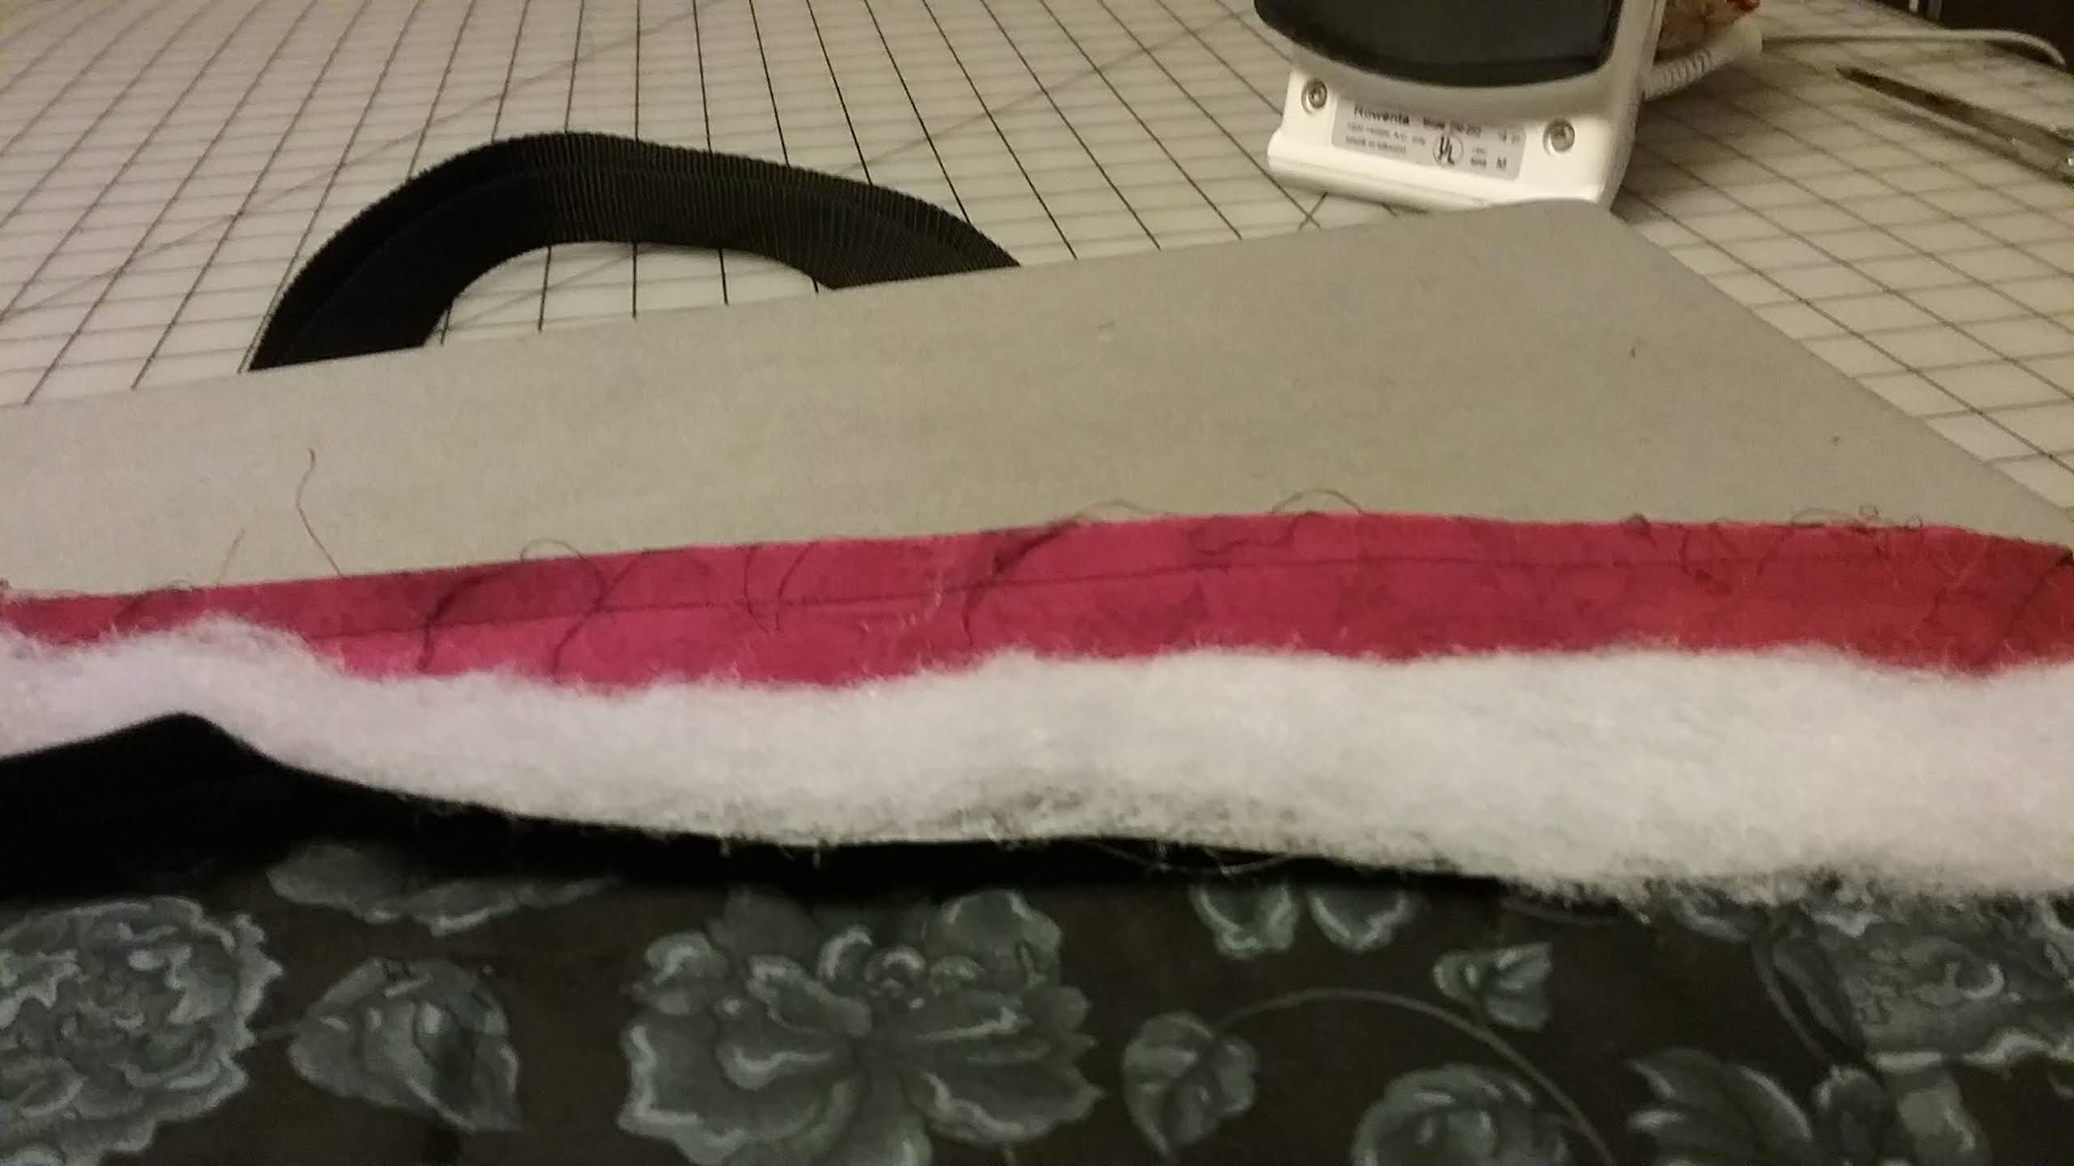

Slide 4
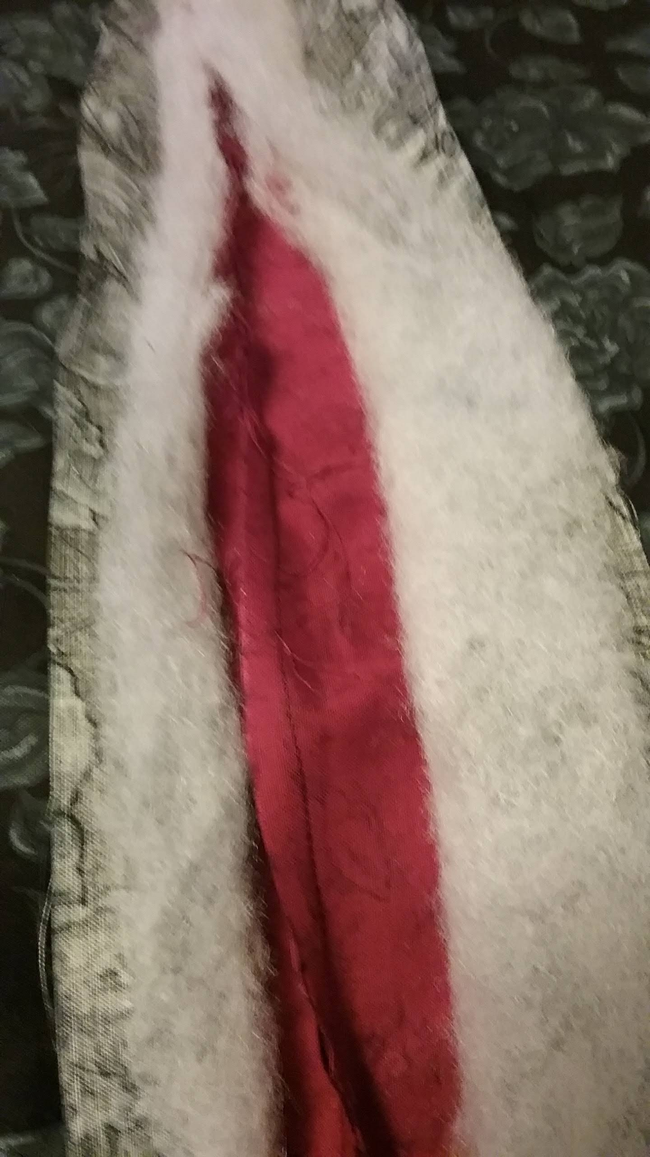
You will be joining the block top layer to form each row

Slide 5
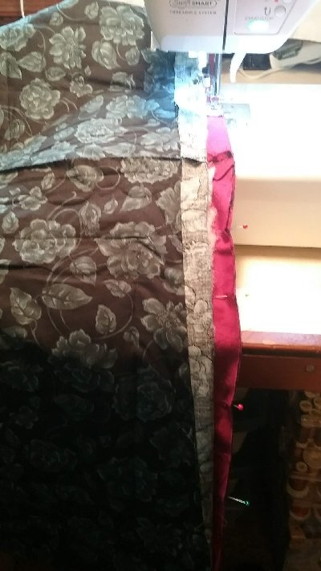
This is a picture of the top seam being sewn. Two rows are being joined to assemble the quilt top.

Slide 6
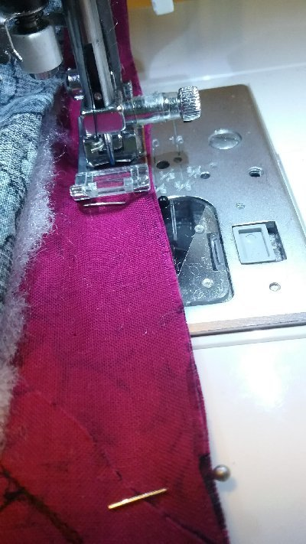
When you join the top blocks together make sure you use a regular presser foot to form your ¼” seam. You will need the stability of the all purpose foot to help feed the fabric. I adjusted my needle position to help with the seam allowance. As long as my seam allowance is uniform I am good.

Slide 7
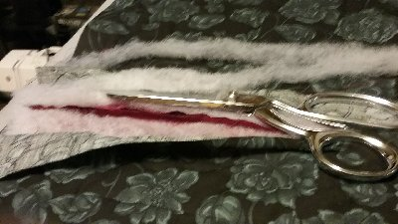
Once you sew the ¼” top block seam you will need to trim the batting seam allowance so the batting butts at each seam. You do not want the batting in the seam.

Slide 8
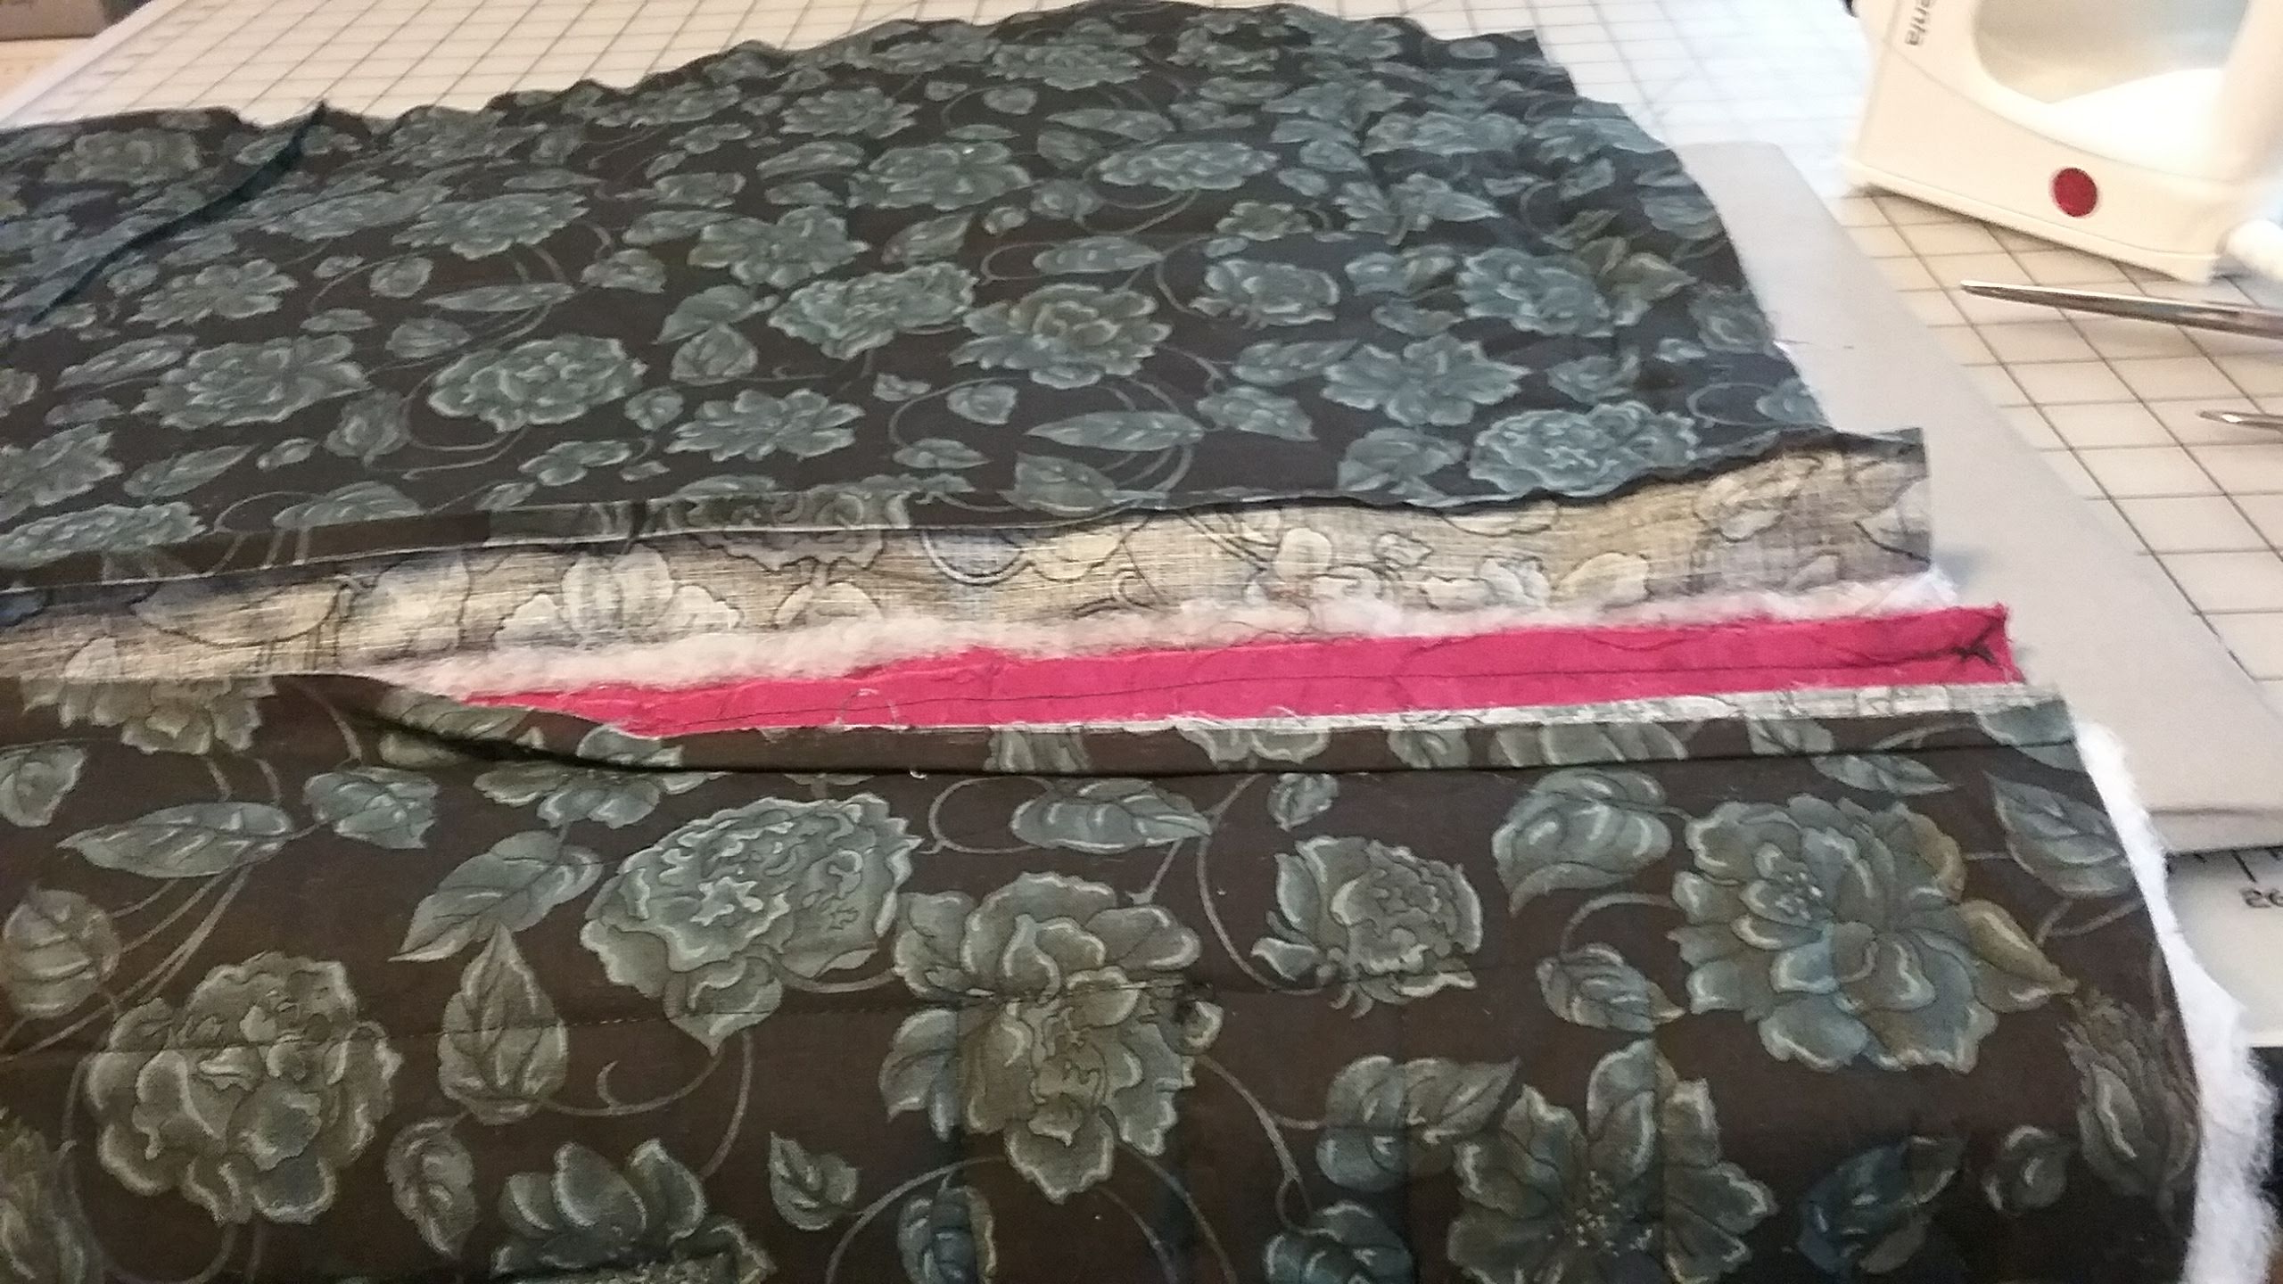
Make sure you carefully press the seam allowance open.

Slide 9
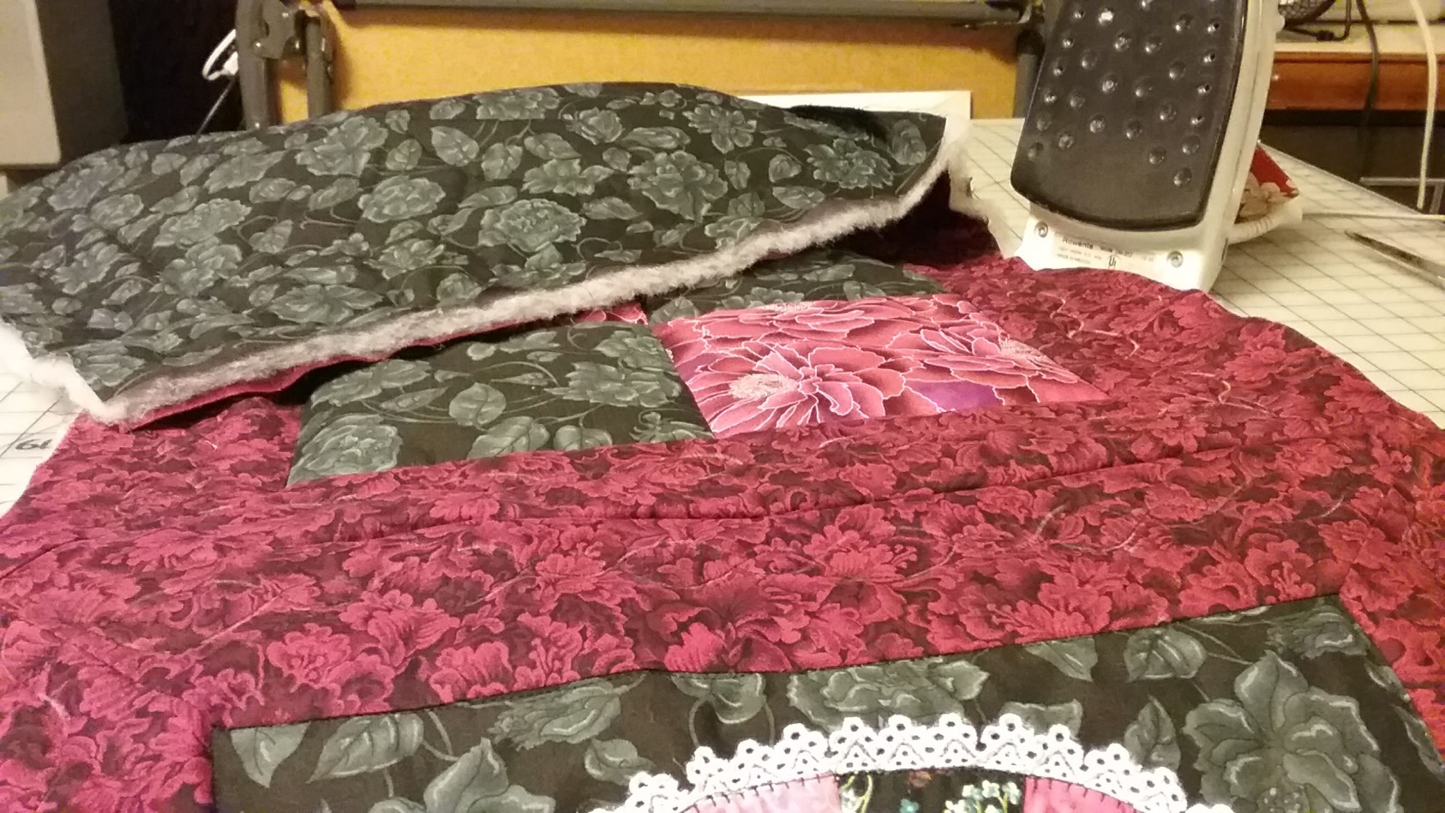
Make sure the front of the quilt lays flat before you sew the back over lap. I steam pressed my quilt from the front before I sewed the back seam.

Slide 10
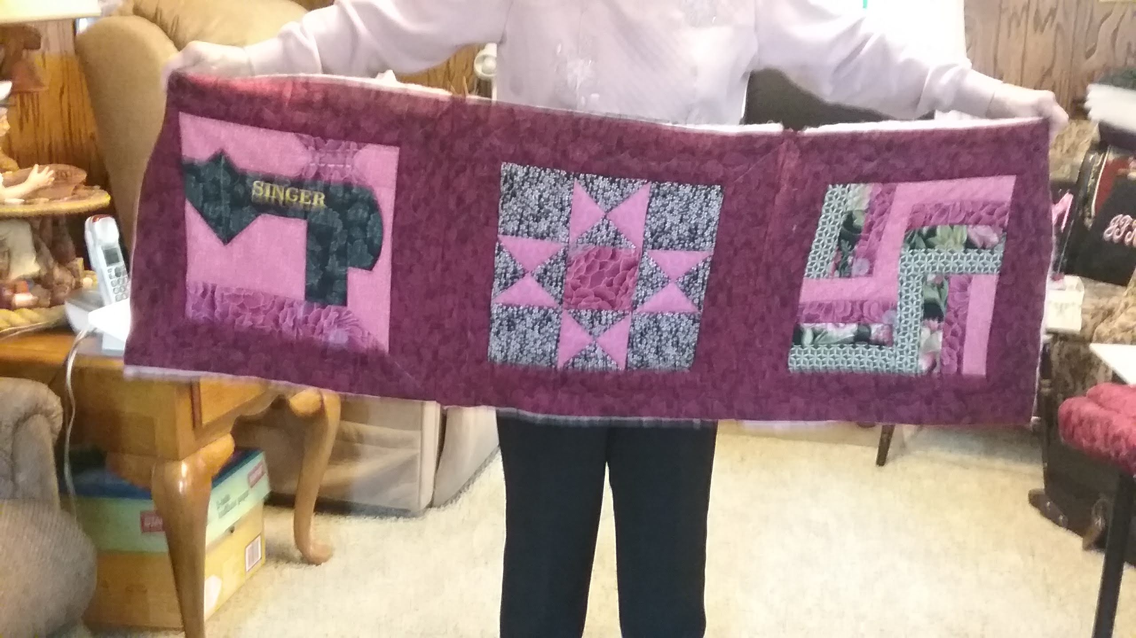
Finish the row by joining the tops. Trim the batting. Pin
Either hand sew the overlap seam at the back of each block or use a narrow zig zag to finish the overlap.

Slide 11
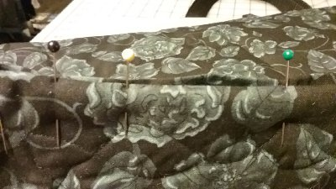
I was in a hurry to assemble my quilt so I used a narrow zig zag to put the back layer together. The whip stitch by hand is still the preferred method. Make sure the back layer is free of the front layer and batting. You will not be able to assemble the row seams if the layers are not separate.

Slide 12
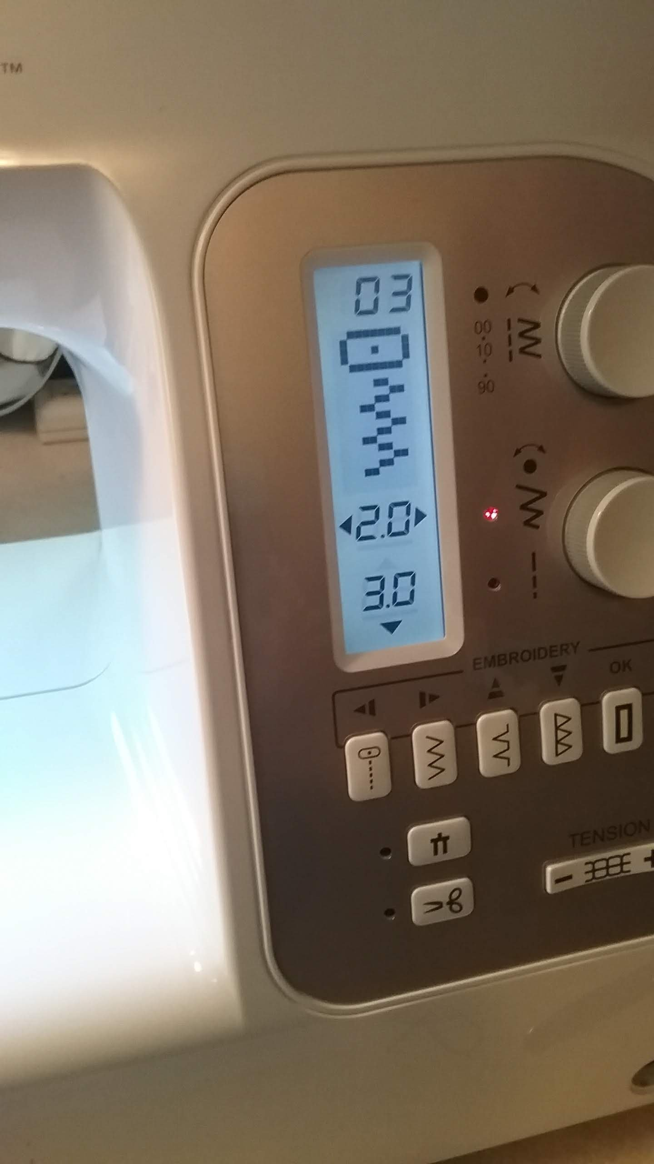
I set my zig zag stitch to a narrow 2.0cm width and 3.0cm length.

Slide 13
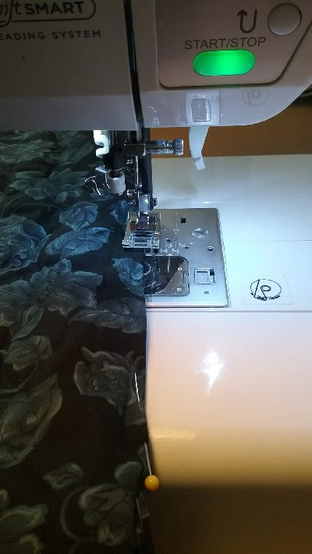
Press the back seam allowances under ¼” on one side and pin the seam closed on the back over lap. Always check the right side to make sure the top is laying flat. Make sure you are only zig zaging the lining. I am sewing the narrow zig zag to close the back overlap.

Slide 14
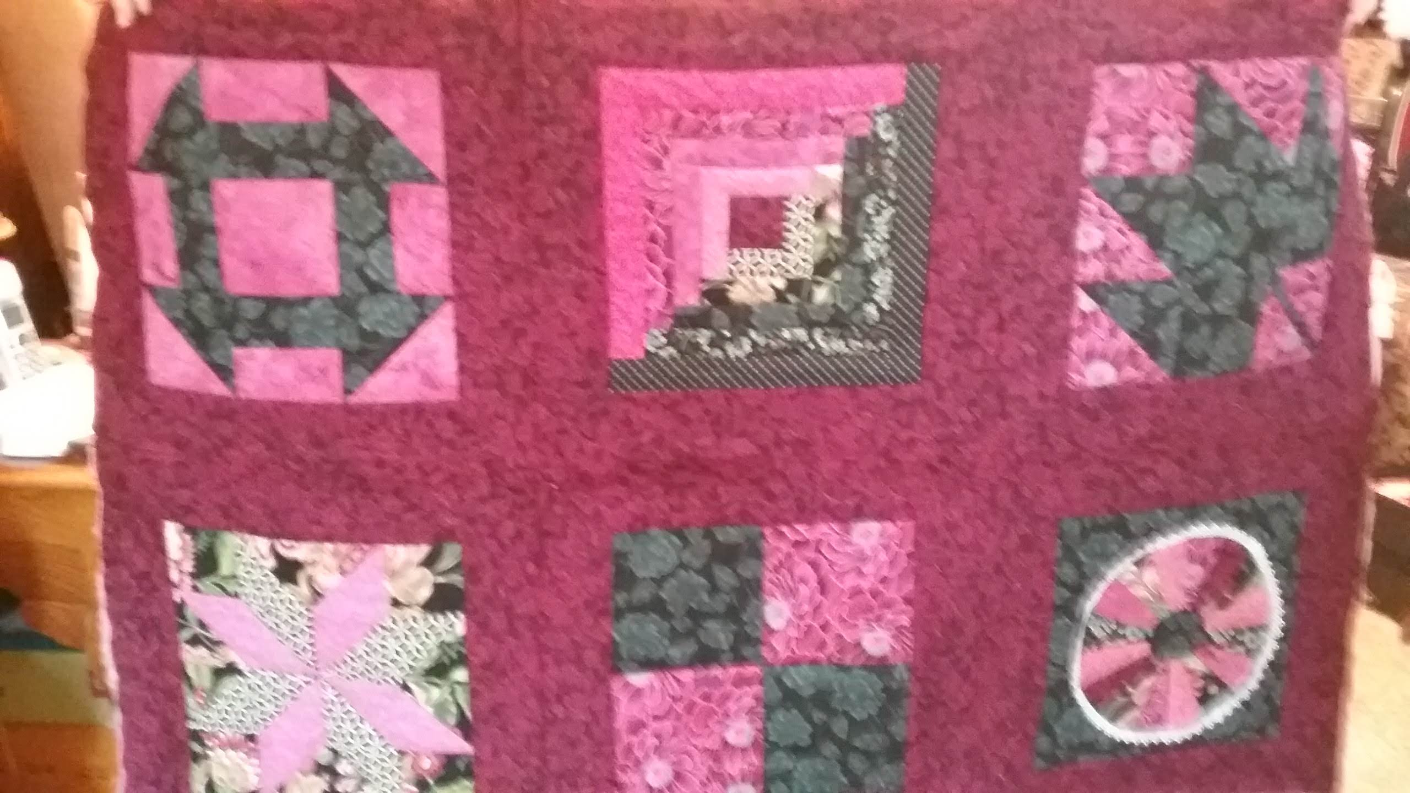
Complete the rows. You can start assembling row by row.

Slide 15
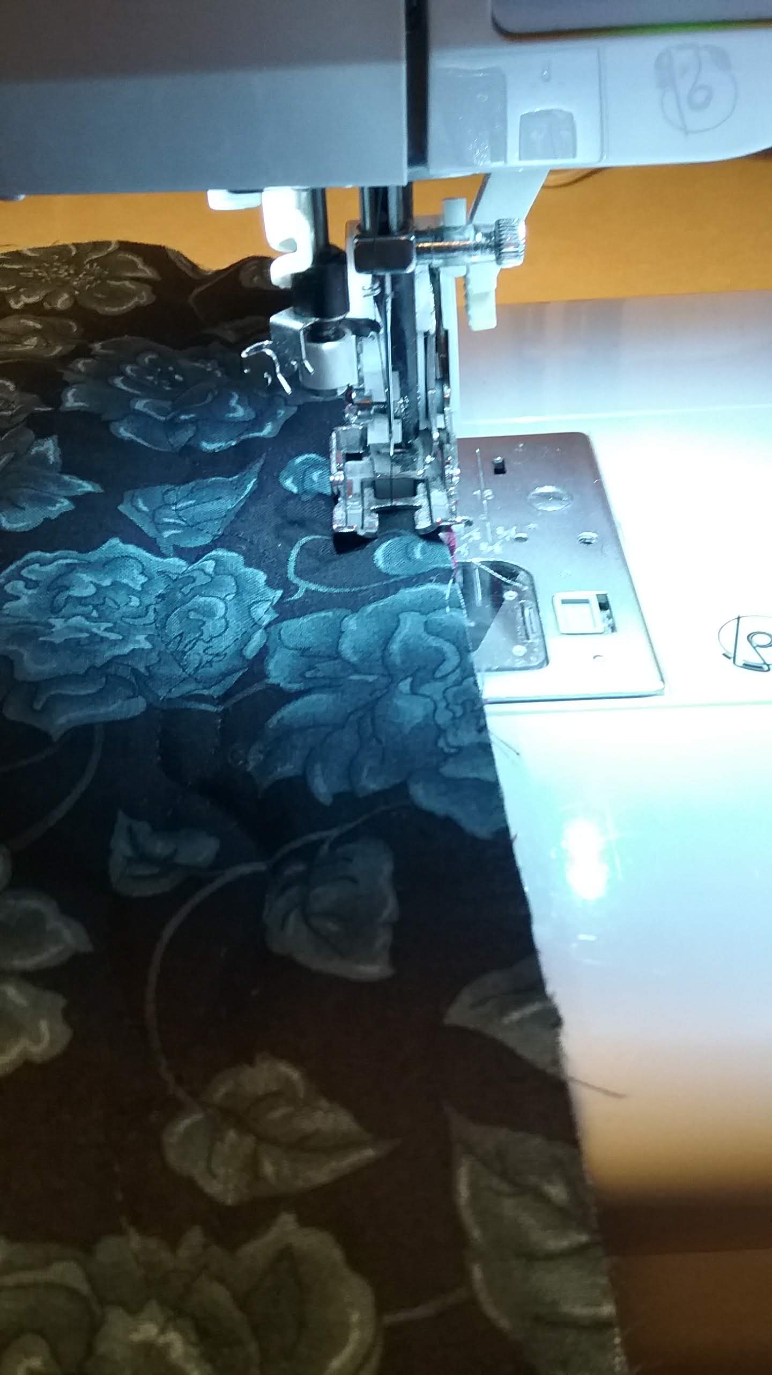
Use a walking foot and a straight stitch to sew ¼” from the out side edge of the quilt before you apply the binding.

Slide 16
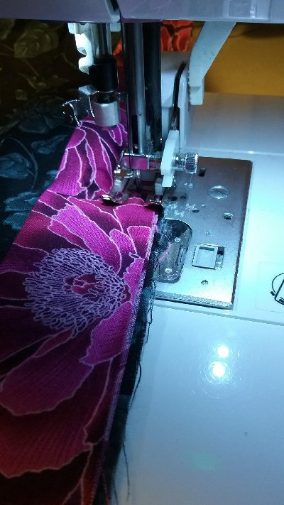
I pieced my 3” X 45” binding end to end and then pressed the strip in half wrong sides together.
Fold under a ½” at one end of the binding end to start the binding application. Over lap about 1 ½ to 2” to end the binding. Press the folded edge to the right side and steam press in place. Top stitch close to the folded edge.
I will show the corner mitering in class.
Use the width of the walking foot to sew the folded binding to the quilt edge.

Slide 17
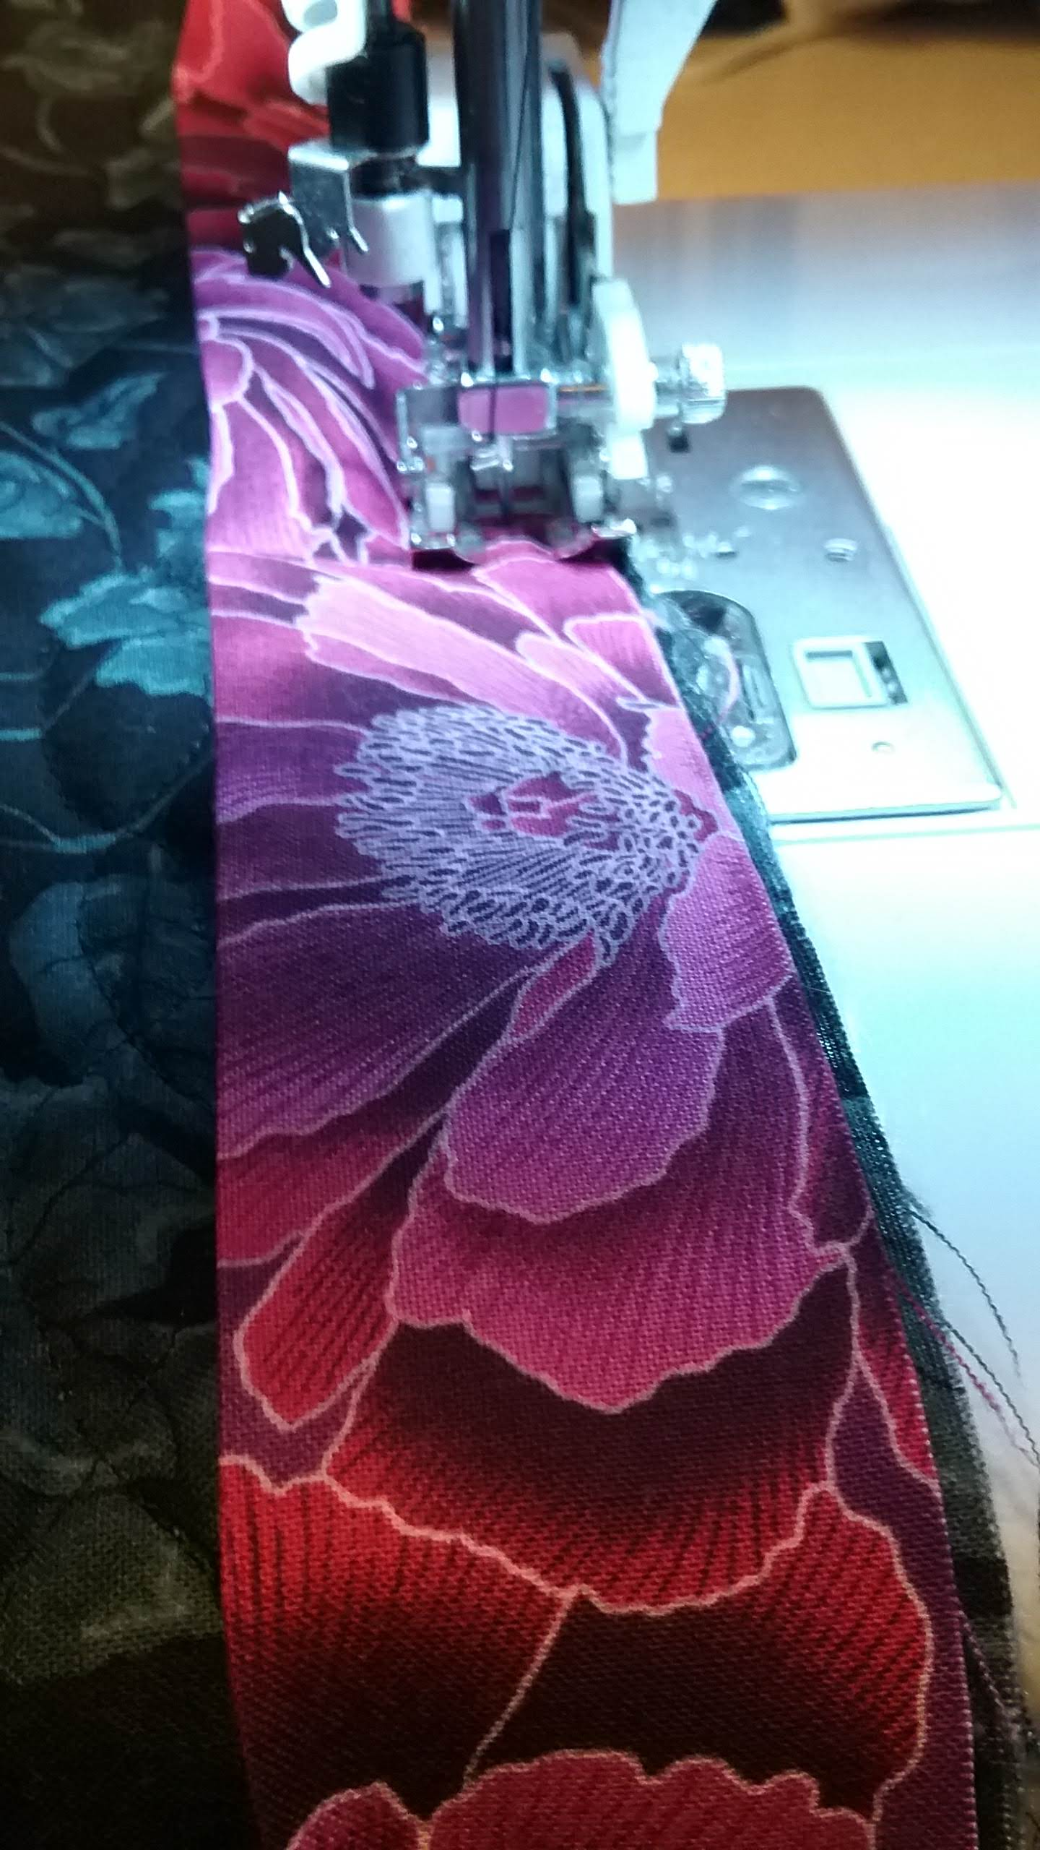
Once the binding is sewn to the edge of the quilt, press the folded edge to the right side and finish the binding with a straight top stitch.

