Slide 1
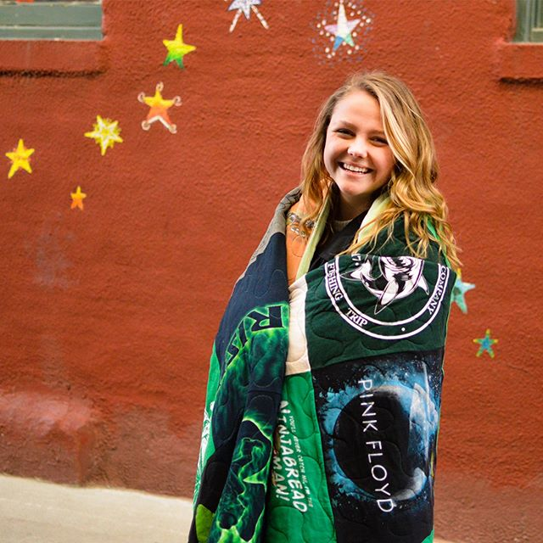

Learn How Sew a Tee Shirt Quilt!

Slide 2
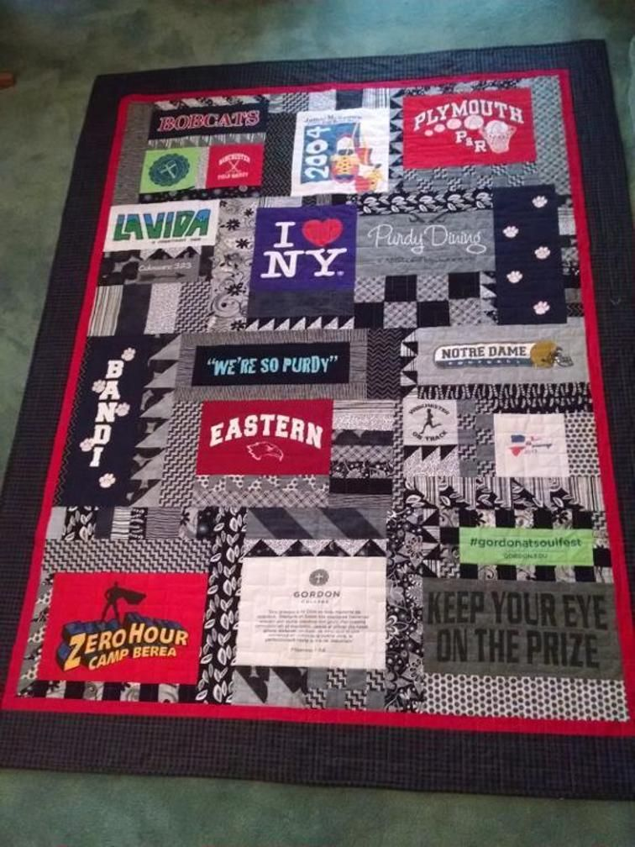
Quilting is fun and easy !
All you need to know is how to use the straight stitch on your machine!

Slide 3
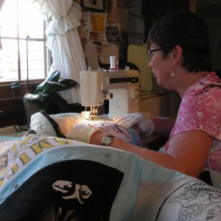

Slide 4
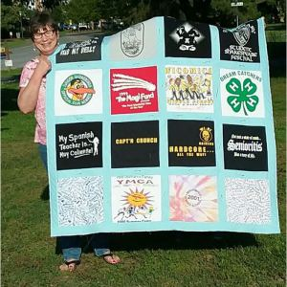

Slide 5
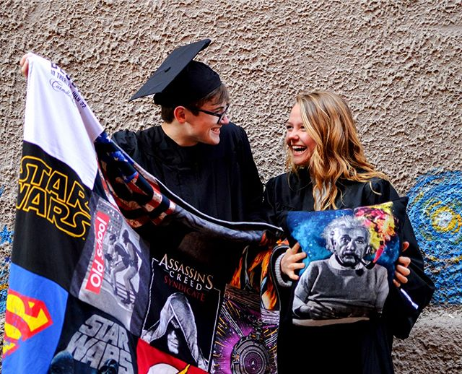
Tee Shirt Quilts are great for the graduate, remembering a vacation or a special event or a special group of friends. Sports fans love them. This is a special gift.

Slide 6
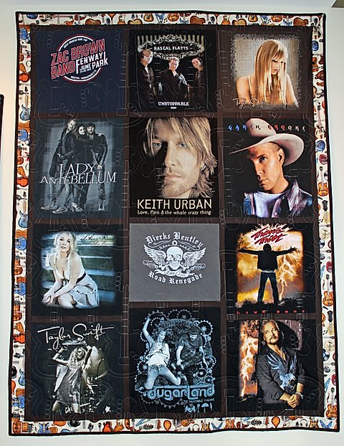

Slide 7
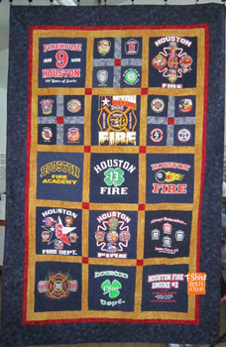

Slide 8


Slide 9
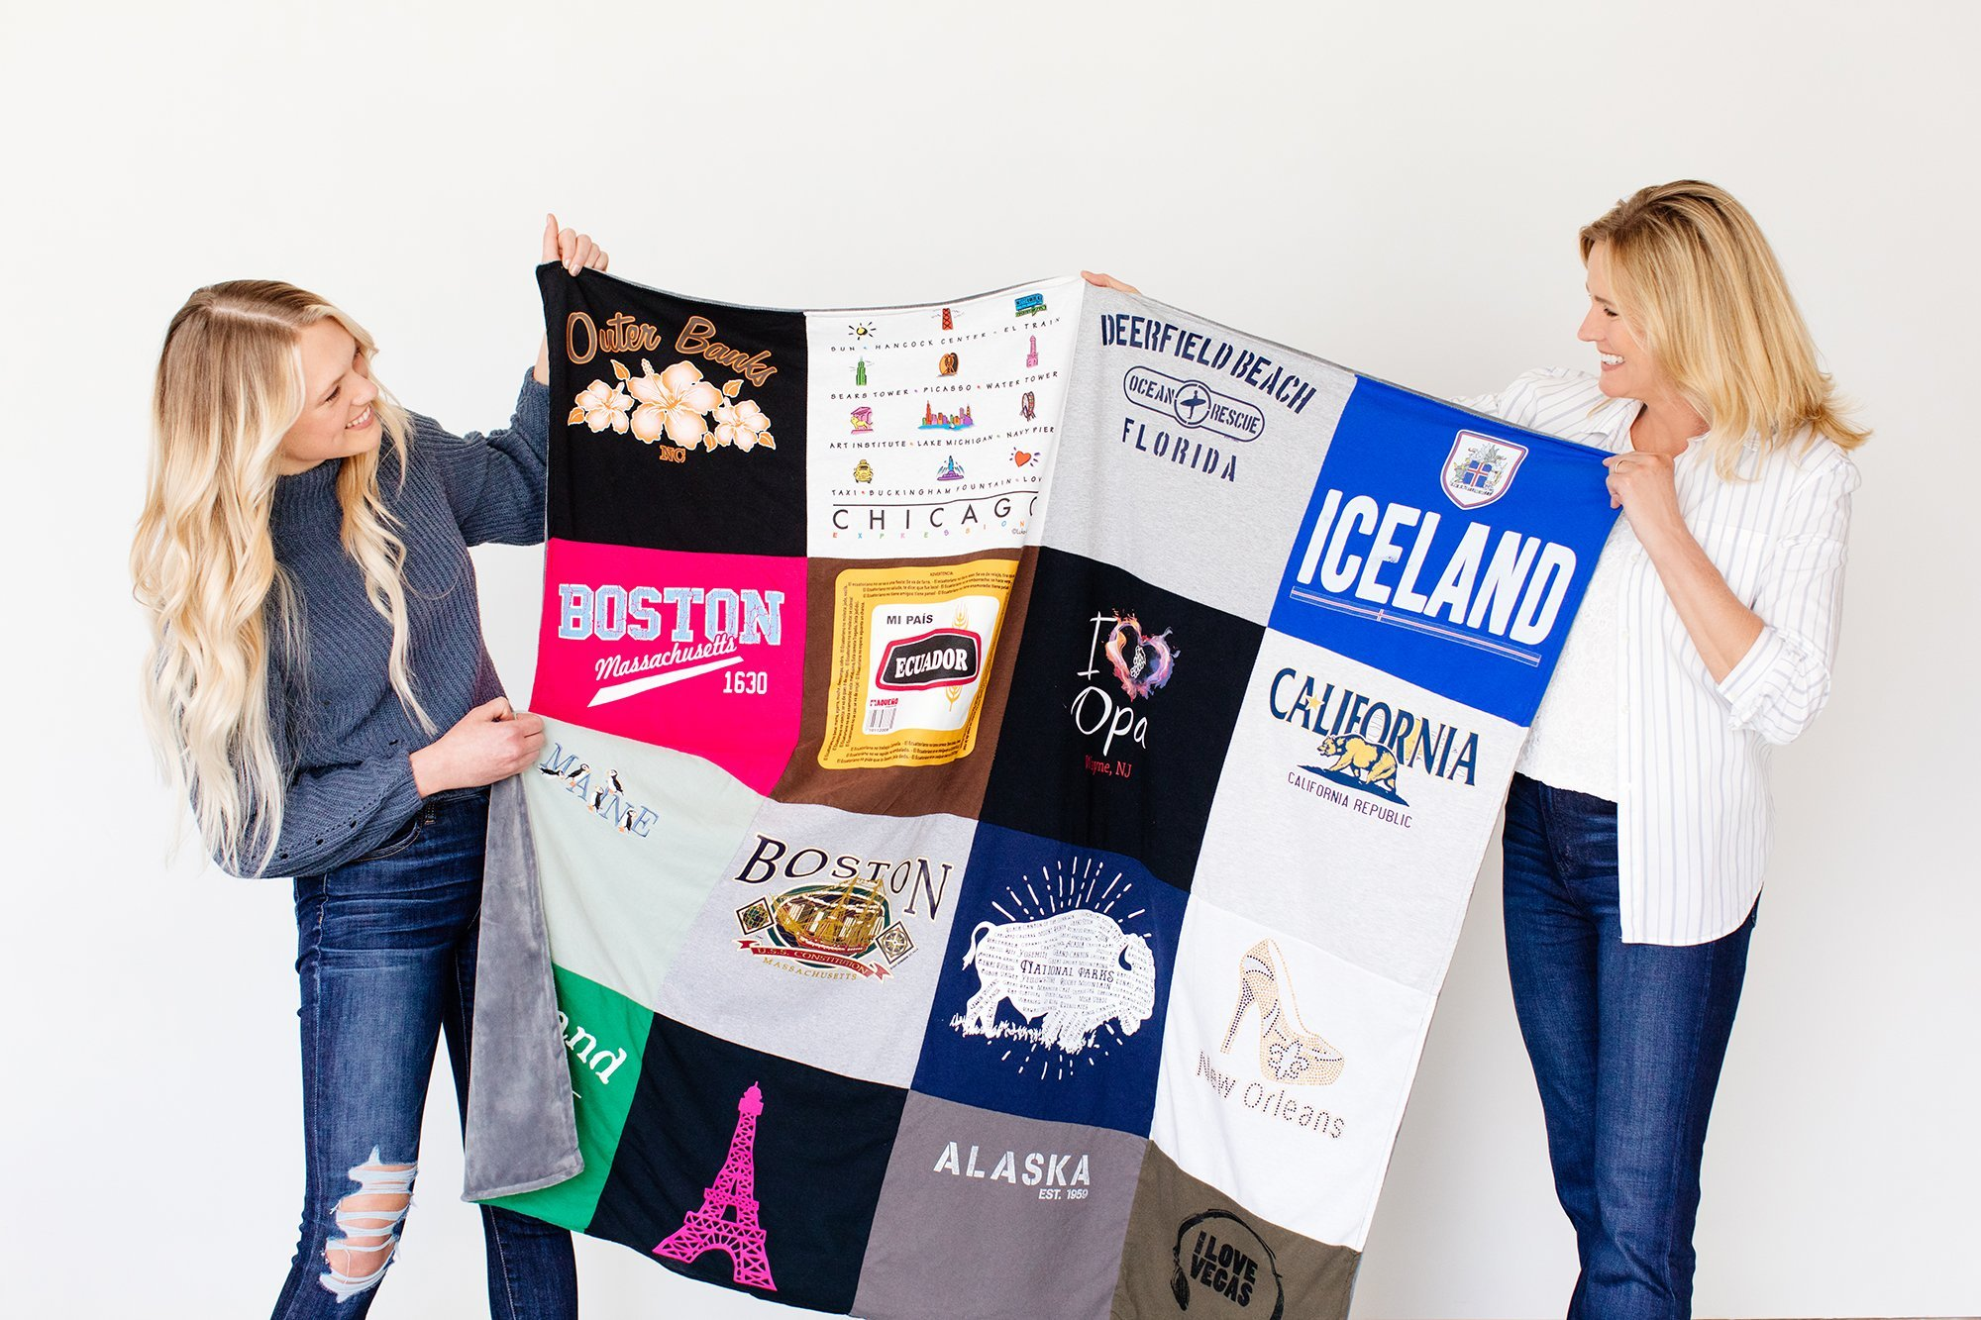

Slide 10
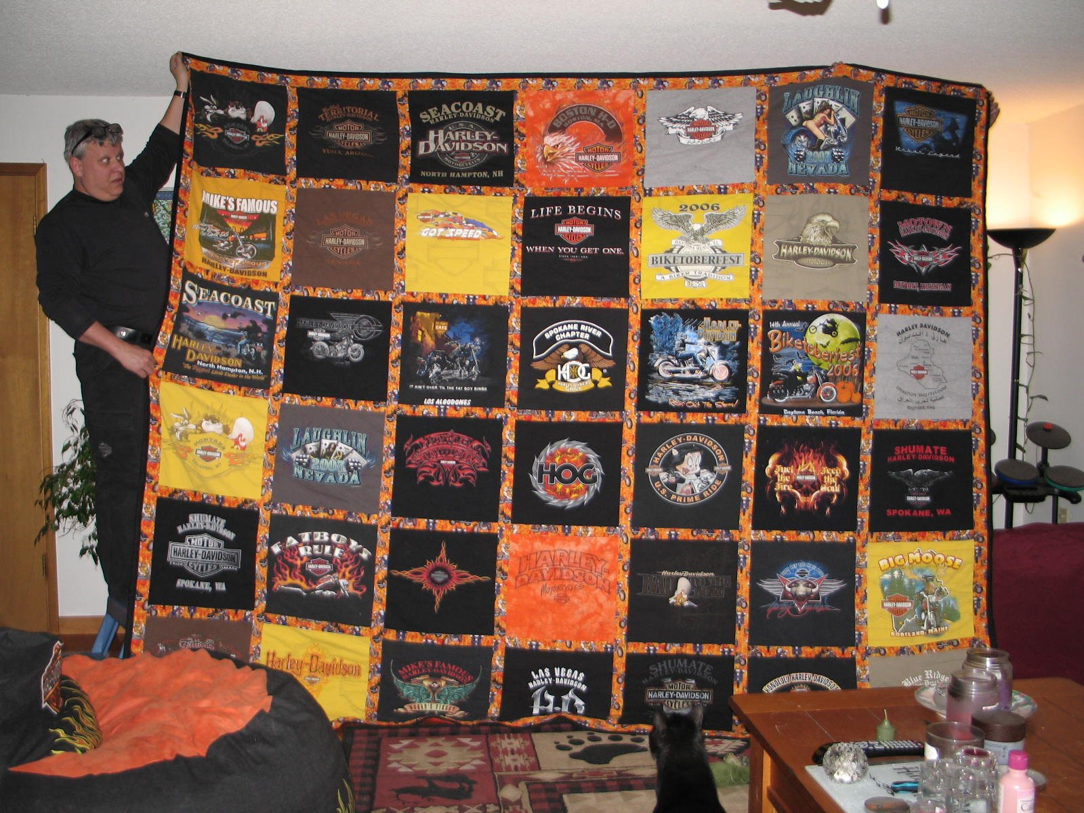
You are only limited by the number of tee shirts you have.

Slide 11
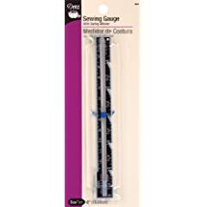
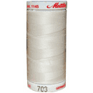
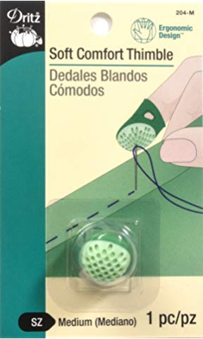
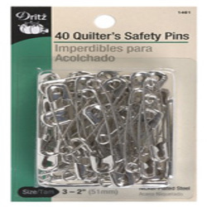
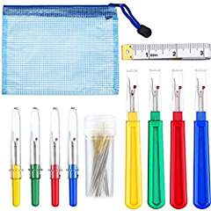
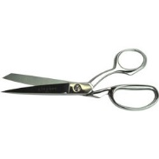
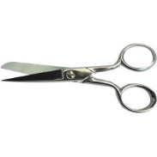
Here is a list of other supplies you will need. I will cover how you will use them as we talk about technique.
Good sharp scissors and trimmers
Seam gauge
Thimble
Seam ripper
Safety pins
Steam iron and pressing mat
Thread in a neutral shade

Slide 12

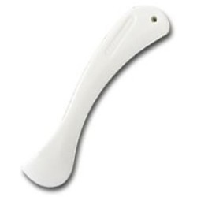
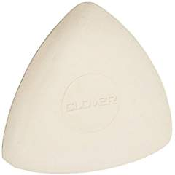
Fabric markers like a wash away pen
Clover chalk in white for dark colors
Seam presser
Good see thru rulers and squares

Slide 13
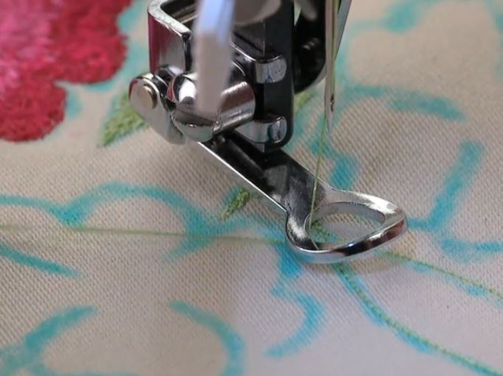
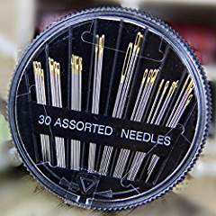
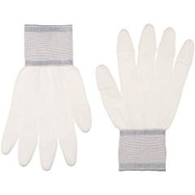
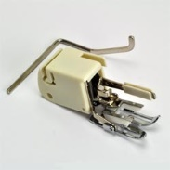
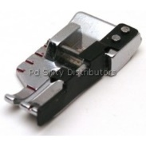
Walking Foot
¼” foot
Free motion foot
Quilter’s gloves
Hand sewing needles assorted
Hand quilting needles – start with size 7 between
Template plastic and permanent marker
highlighters
Layout area

Slide 14
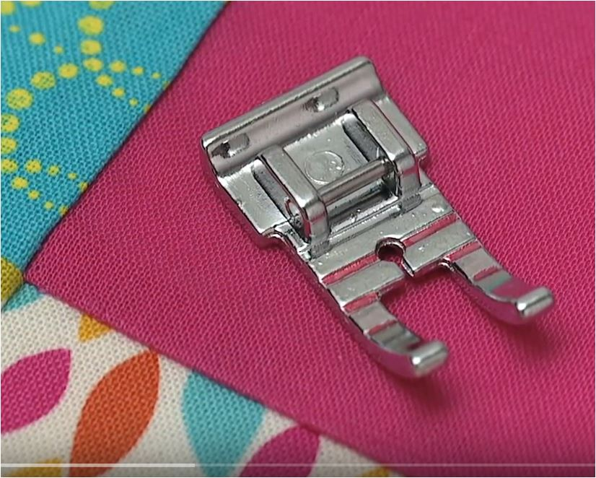
The ¼” foot is a great guide foot to get accurate ¼” seams. ¼” is the standard use to piece patchwork. There are many styles of ¼” feet and they all offer a guide for you to sew a perfect ¼”. Here is how it works.
When doing any type of patchwork or strip piecing you will need a guide to help you.

Slide 15
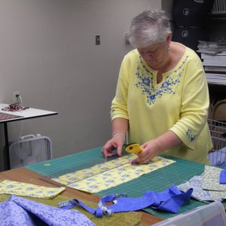
Rotary Cutter
A quilter’s best friends are a good machine, a wonderful steam iron and a rotary cutter plus a 24” X 6” ruler and at least a 24” cutting mat. Safety pins, clover chalk, and straight pins come in a close second.
To cut your tee shirt squares or strips of fabric accurately you need the rotary cutting system. For strip piecing, binding and borders, it is a must.

Slide 16
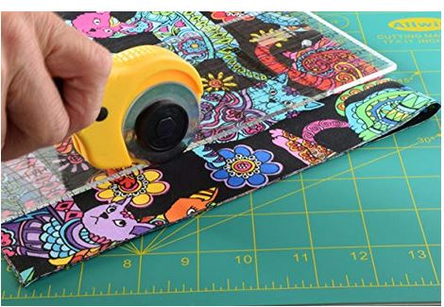
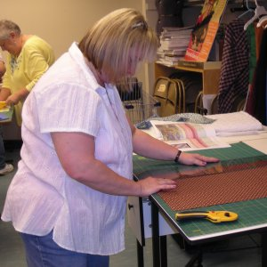
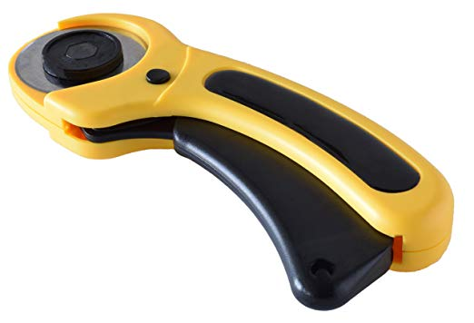
Here is a picture of the rotary cutter, ruler and mat. All are essential in using the cutting system. The rotary cutter is surgically sharp so it is important to follow all the safety rulers.

Slide 17
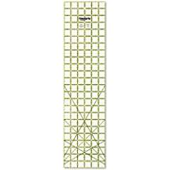
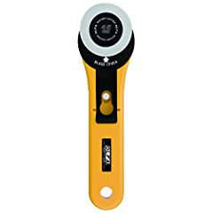
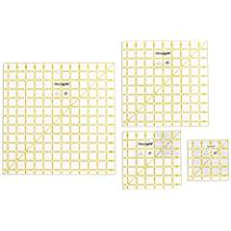
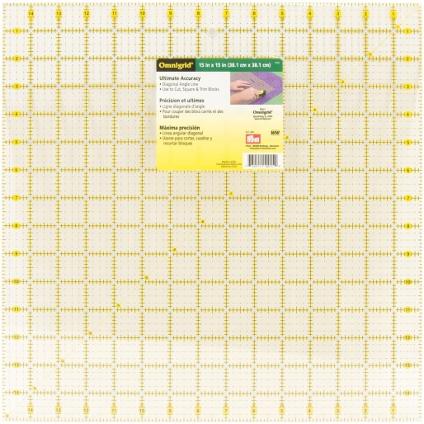
15” square rulers and 12” or 12 ½” and 6” and 6 ½” plastic see through rulers come in handy. Most rulers are marked every 1”, ½” and ¼”. Ruler also have a 45 and 60 degree angle markings for triangles. 24” x 6” rulers are perfect for the rotary cutter. You will need a 24” X 18” mat for cutting with the rotary cutter.

Slide 18
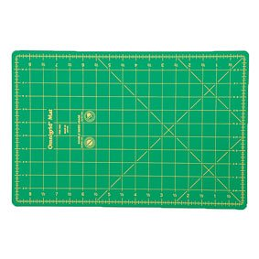
You will need at least a 24” X 18” mat

Slide 19
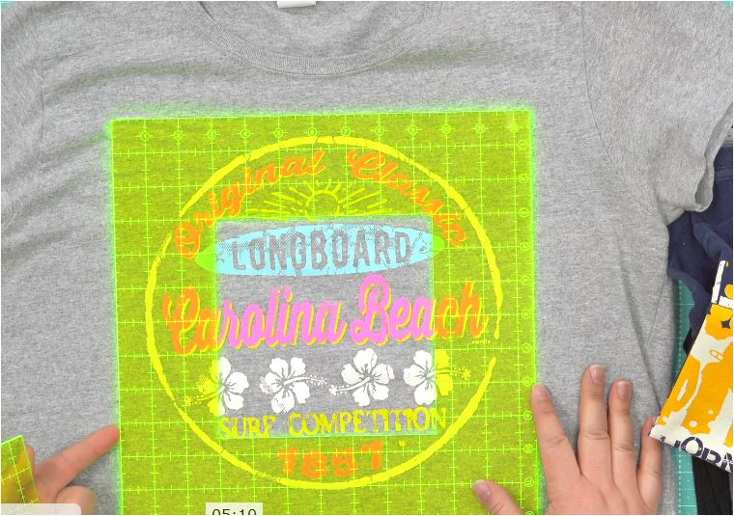
Once you sort the tee shirts you will see what size blocks you need to cut. Some tee shirts have writing or designs that extend up to 15”. Some designs are small. That is why sorting is a good idea. Make a plan.

Slide 20
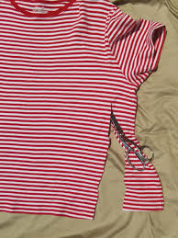
Trim off the sides, neckline and sleeves of the tee shirt. It is easier to use a rotary cutter and mat for this procedure.

Slide 21
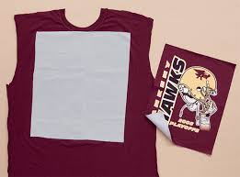
Check the tee shirt for the size block you need to work with and cut the tee shirt larger than the ruler so you can press the interfacing on the back of the block before you cut the block to the finished size.

Slide 22
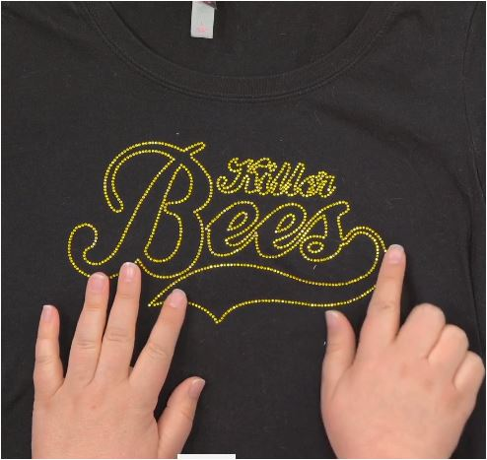
Some tee shirts have rhinestones and buttons as decoration so be careful the objects will not get in the way of sewing the block. Striking these items will break needles.

Slide 23
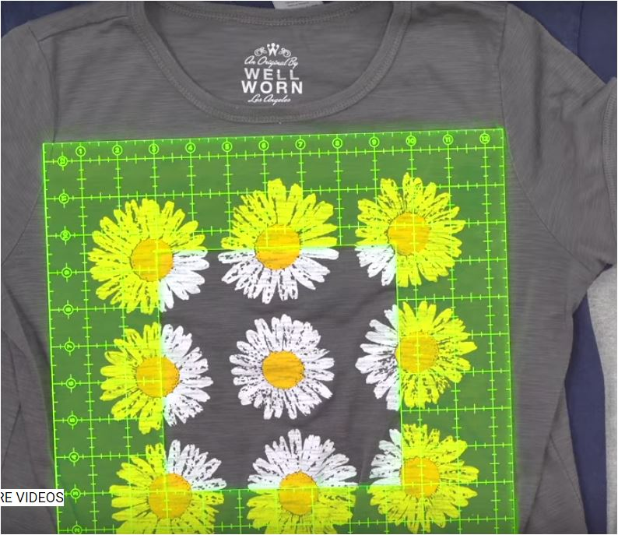

Slide 24
Pick a size for your tee shirt square that works with the designs you see on the shirt. Here is a childrens quilt that was planned using 5” squares and a charm pack of cotton 5” square to match for piecing.
Most blocks are cut 12”,12 ½ “or 15”. You can plan to sew the quilt with just tee shirt blocks or you can add lattice, corner stones and borders.

Slide 25
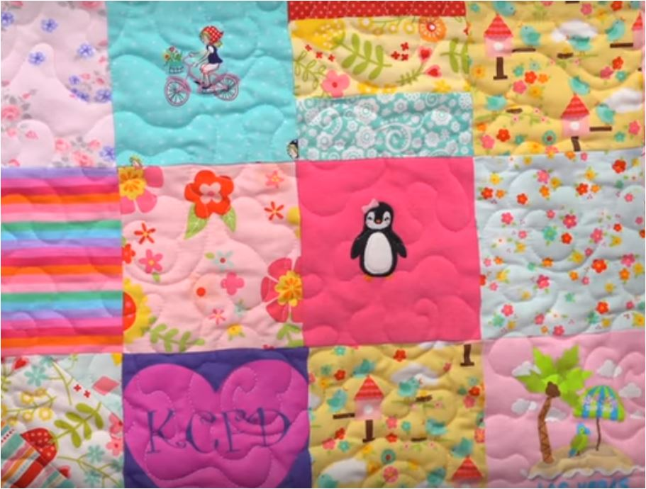
Use onies to cut into 5” squares and then piece the 5” squares in 9 square blocks and then put the quilt together.

Slide 26
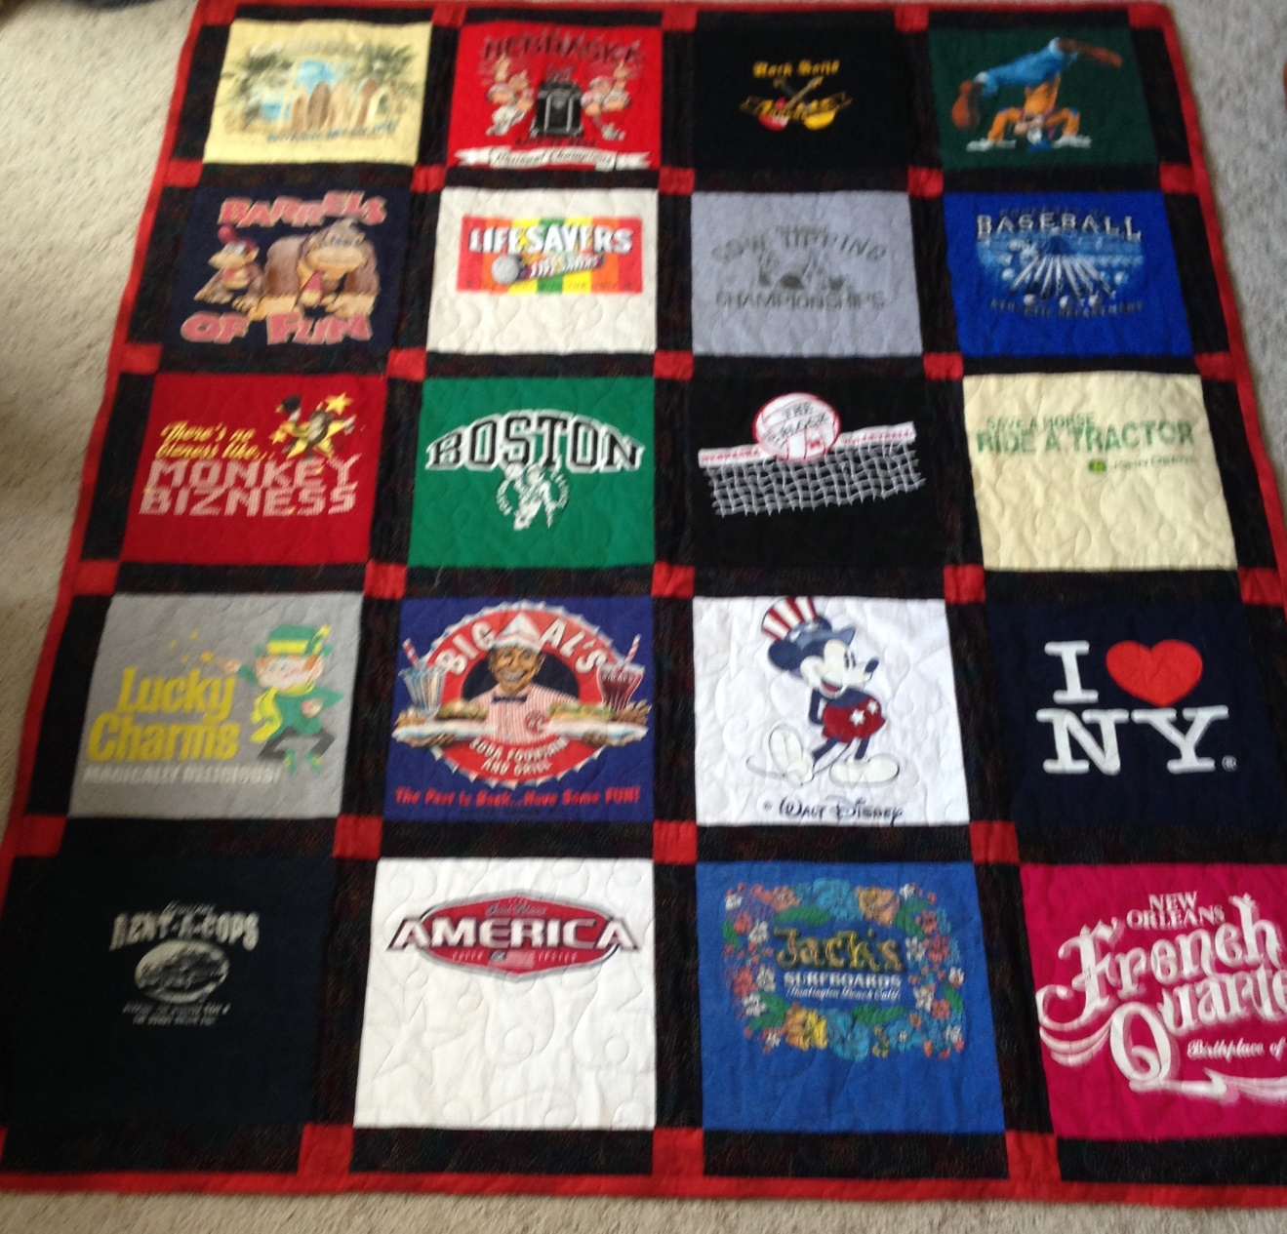
Corner stones are the red squares. Most lattice is cut about 3 ½”” wide so these corner stones are 3 1/2” squares

Slide 27
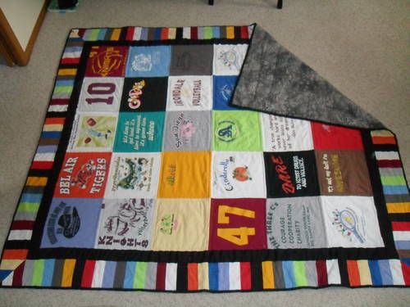
This quilt has 5 rows X 6 rows of tee shirt squares sewn together to form the body of the quilt.. There are 2 borders. One is a solid black that frames the quilt The outside border is strip pieced with mitered corners.

Slide 28
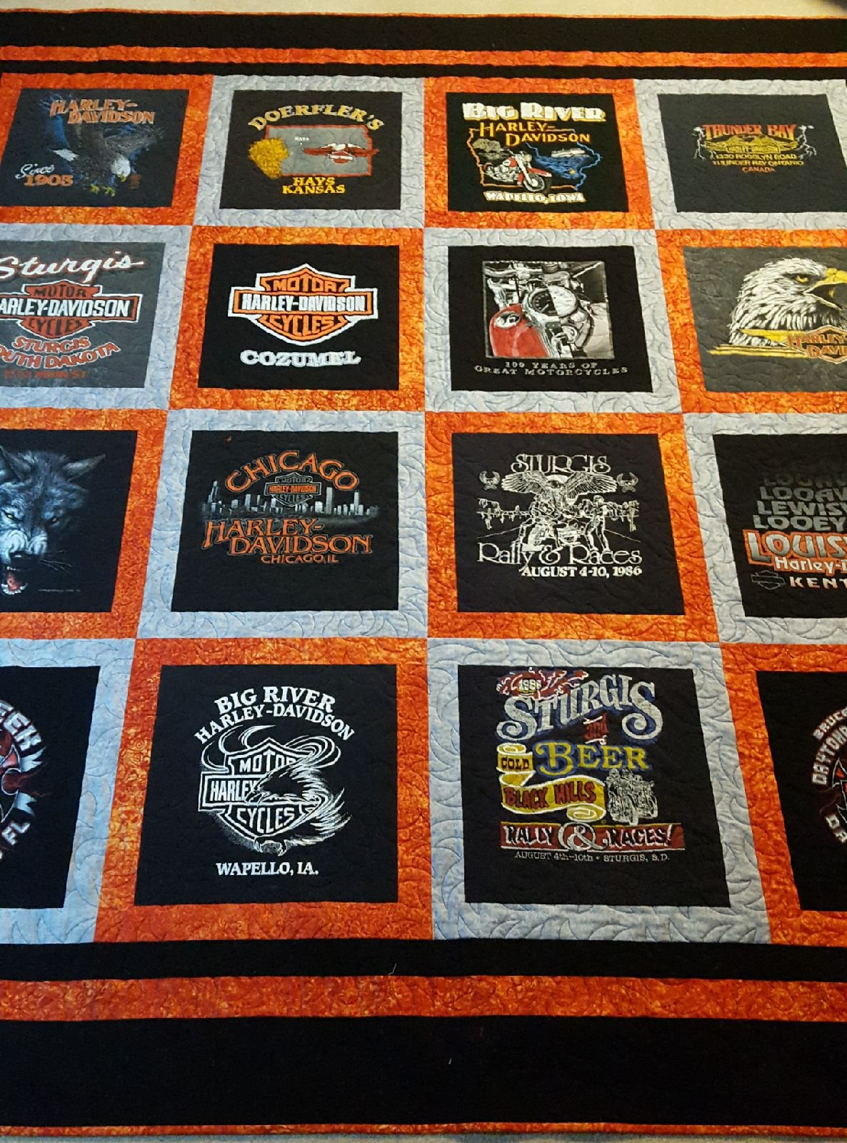
The sewer used 2 colors to frame the blocks on this quilt. Every other tee shirt square is framed with a 2” border. The outer edge was framed with 3 graduations of borders.

Slide 29
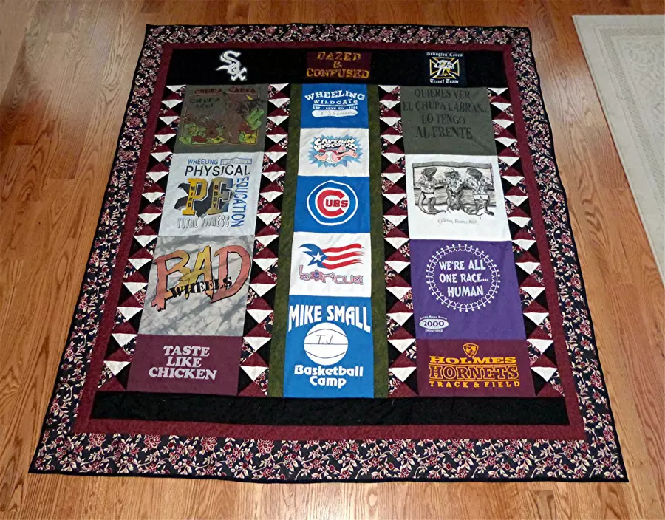

Slide 30
This tee shirt quilt was made using 4 rows of different size tee shirt squares. If you have a row of 15” blocks you may have to add some fabrics in between the blocks on the next rows so the block match the blocks on the previous row.
This gives a nice random look.

Slide 31
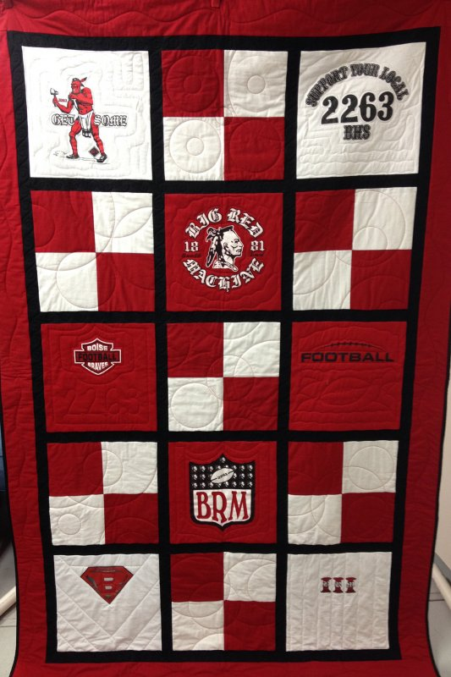
This quilt used pieced blocks in between the tee shirt blocks.

Slide 32
