Slide 1
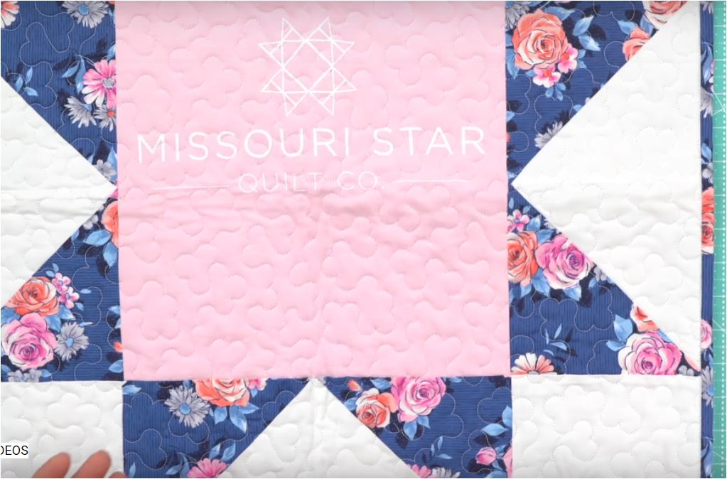
I found this quilt idea from Missouri Quilt Company quite exciting!

Slide 2
The center of the block is a tee shirt. Using the 12 ½” ruler to make the center of the quilt, the points of the star are achieved by using the 6 ½” square or A square from Lap quilting.. The star points use template E from lap Quilting.

Slide 3
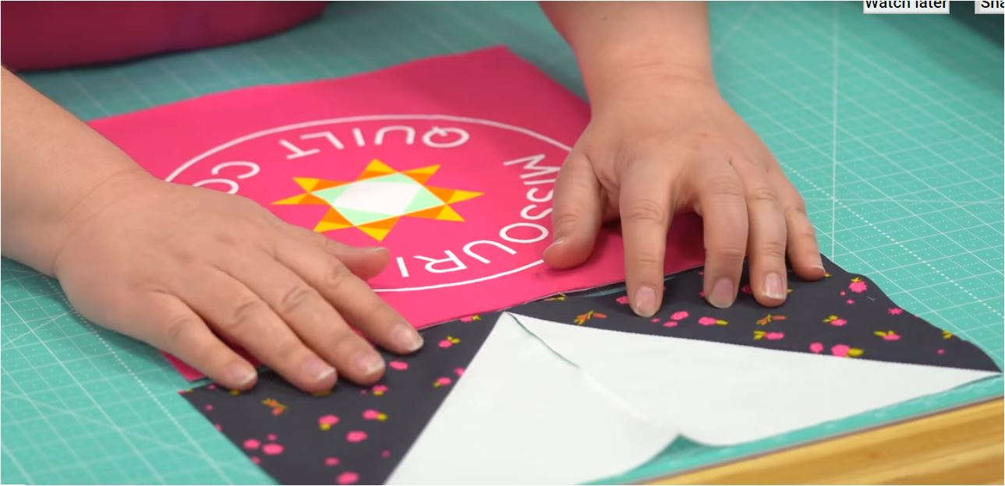
Thank you to Missouri Quilt Company for the design idea.

Slide 4
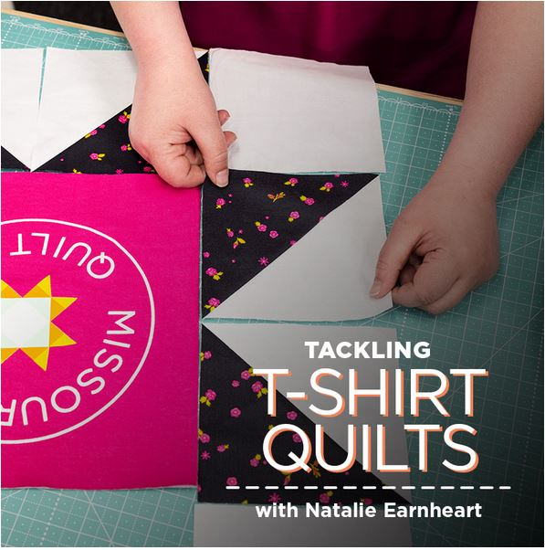

Slide 5
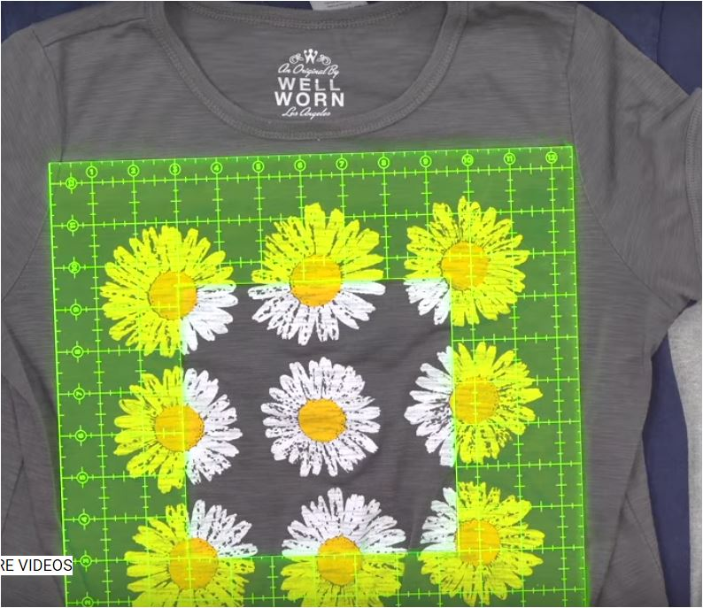
I am using templates A square and E triangle from the lap quilting book plus my 12 ½ “ ruler for the center of the block .
This block will be a small wall quilt and I can add borders to make it larger . The wall quilt block will measure 24” when finished. I used an old tee shirt I found in my closet for the center.

Slide 6
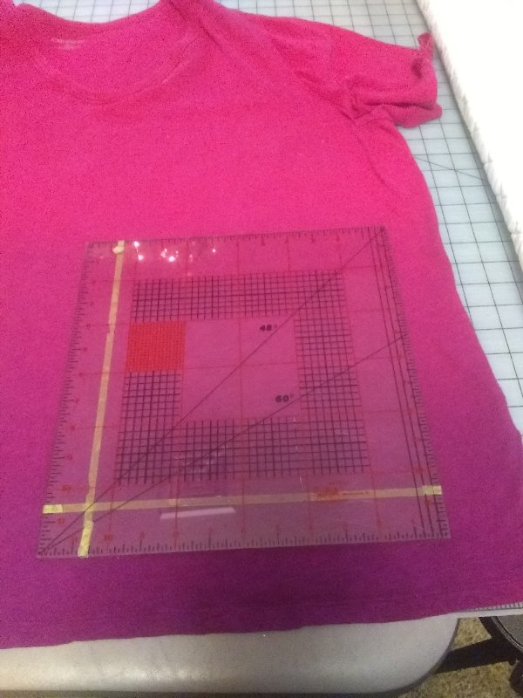
Pick your tee shirt and check to see if you have plenty of room for your design. I wanted a 12 ½’ area

Slide 7
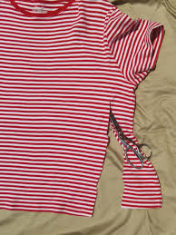
Trim your tee shirt with a rotary cutter. Make the trim area over sized. My tee will let me use the front and the back sides for 2 different blocks.

Slide 8
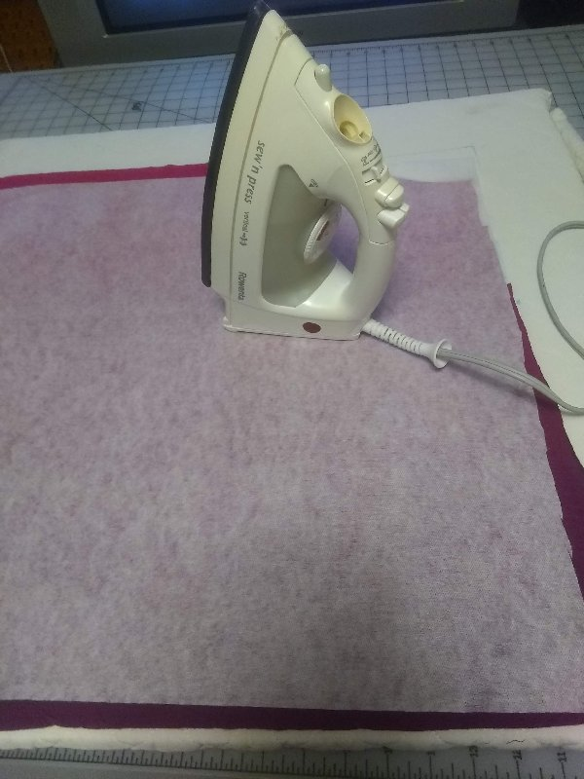
On the wrong side of your tee shirt iron on Light to Medium weight fusible interfacing to stabilize the tee shirt. I prefer fusi knit by Pellon but used what I have on hand.

Slide 9
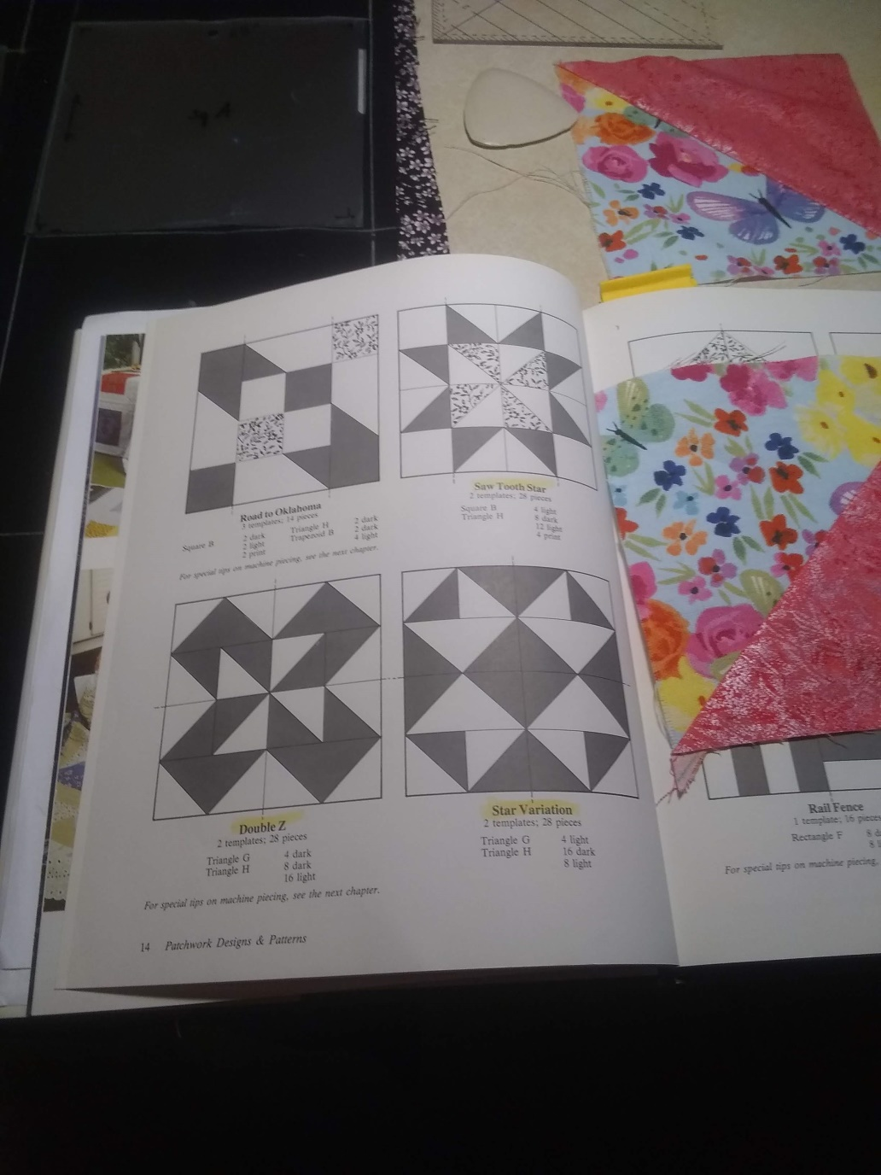
To give you an idea of the design of this wonder block go to page 14 in your lap quilt book and look at Saw Tooth Star. If you want to make this block for your lap quilt you can but I substituted the center template with my 12 ½” ruler and the star edges were made using E triangle and A square.

Slide 10
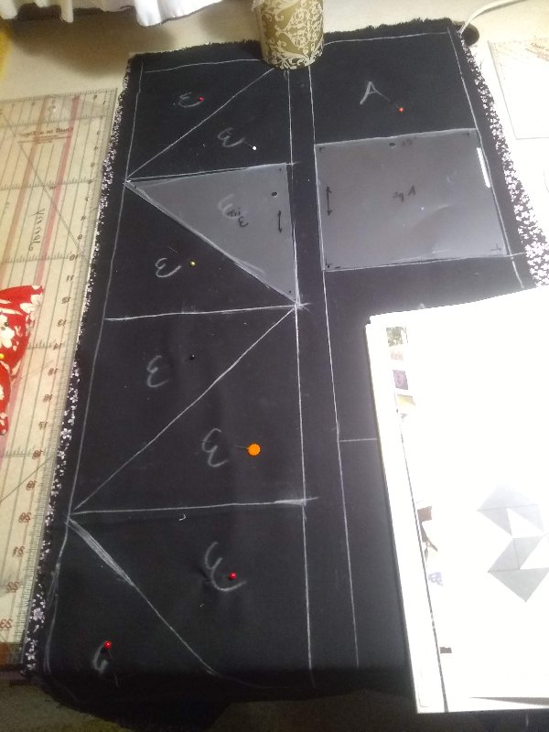
Using at least 3/8yd of 2 fabrics, I placed them right sides together and drew 4 - A squares of one color and 8 E-triangles in a row so I could quick piece them in a continuous row.

Slide 11
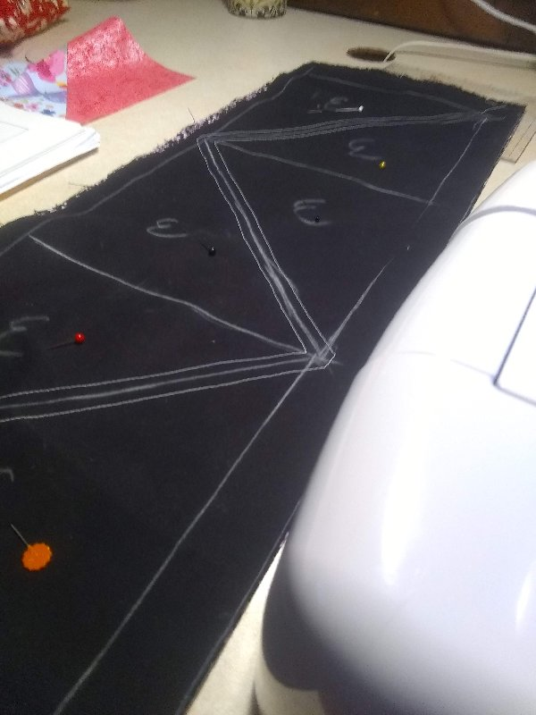
Here I quick pieced the E- triangles before I cut them out. I needed 8.

Slide 12
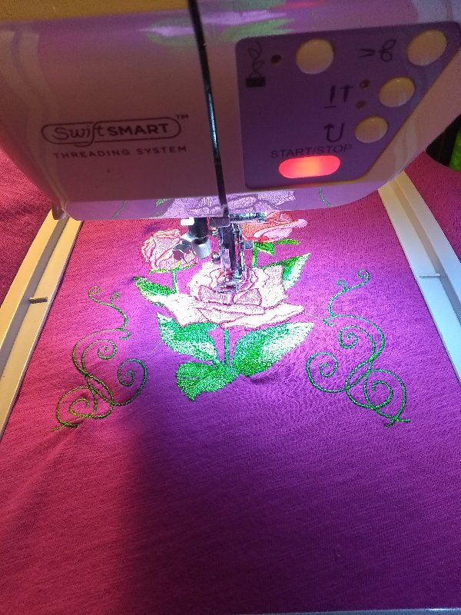
I did not have a fancy tee shirt so added embroidery to the shirt before I cut the block to size using the 12 ½” square.

Slide 13
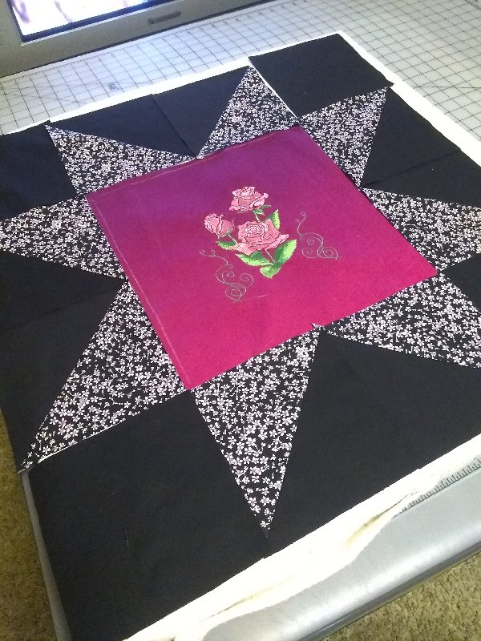
Here is the layout of my 24” block. Once sewn and quilted and bound I will make a wall quilt with it. The block could also be combined with other 24” blocks to make a quilt of any size.
I hope you enjoyed my quick wonder block project.

Slide 14
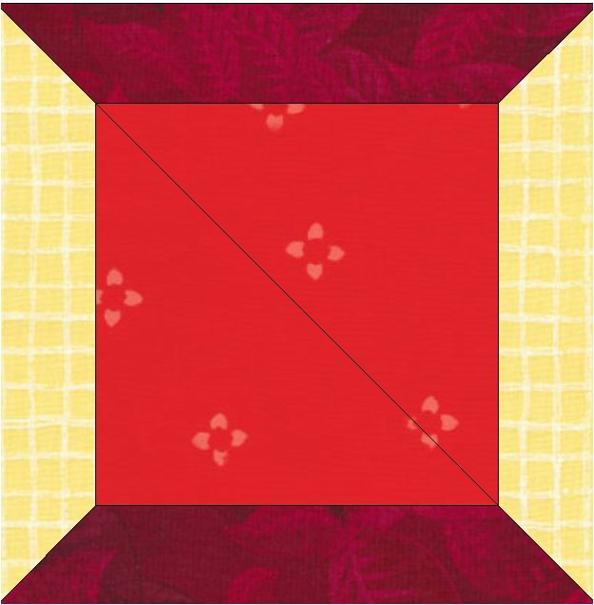
Here are other quilt blocks you could adapt to the tee shirt “one block wonder”.

Slide 15
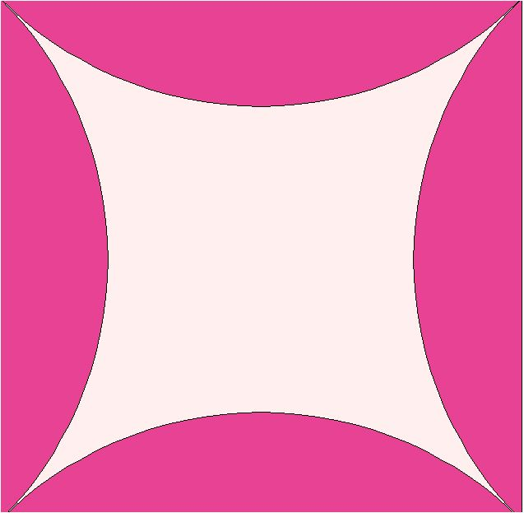
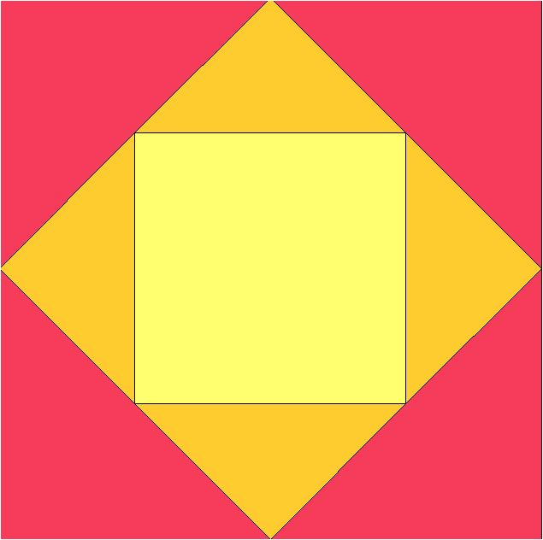

Slide 16
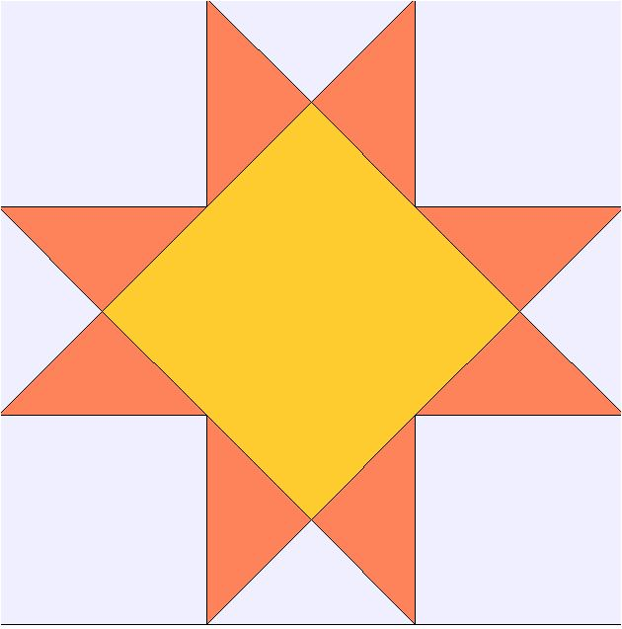
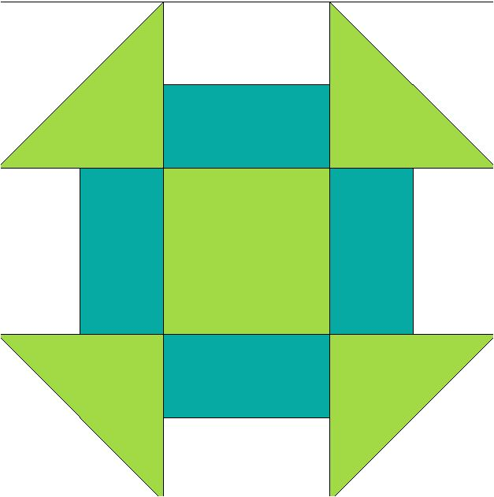

Slide 17
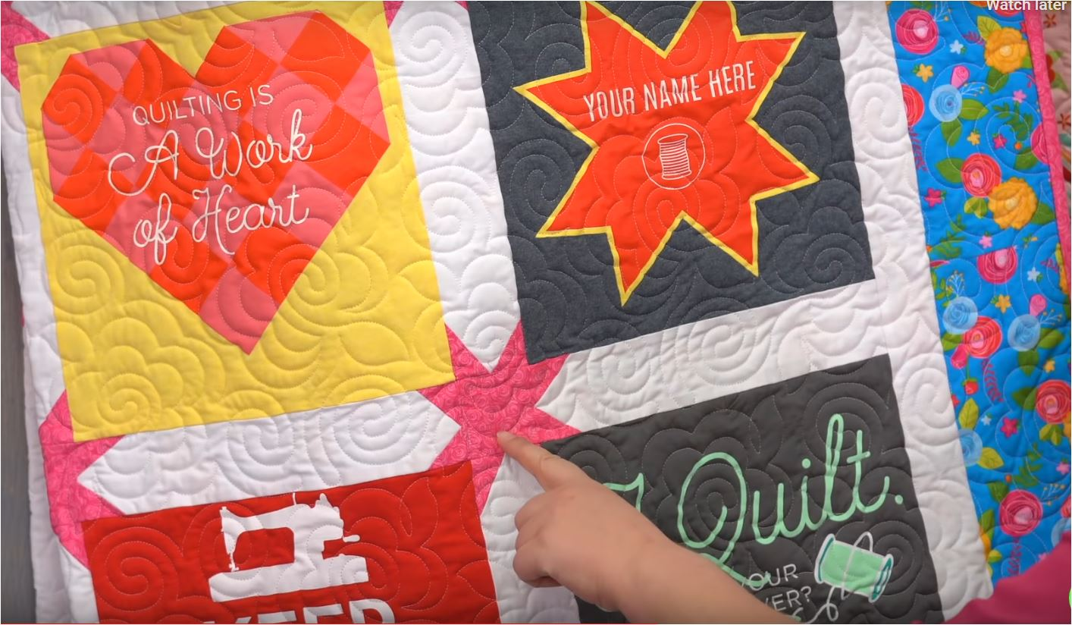
Special pieced borders.

Slide 18
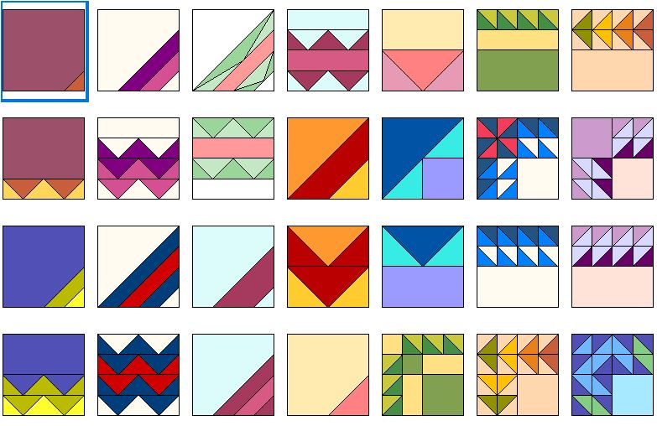
Here are other border ideas

Slide 19
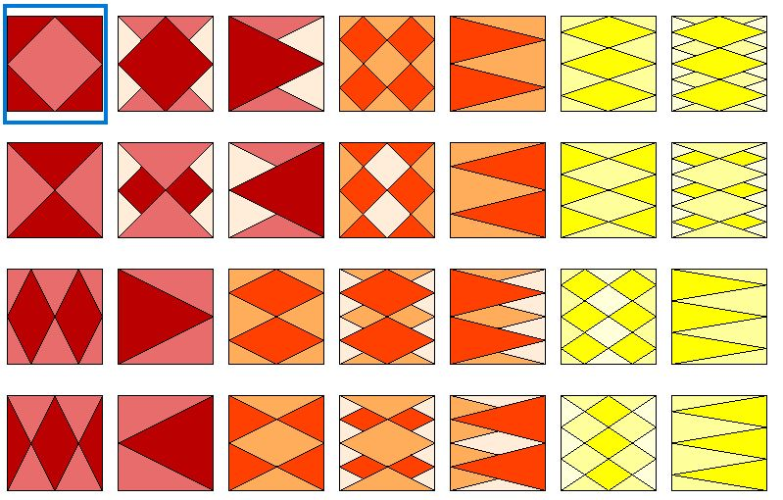

Slide 20
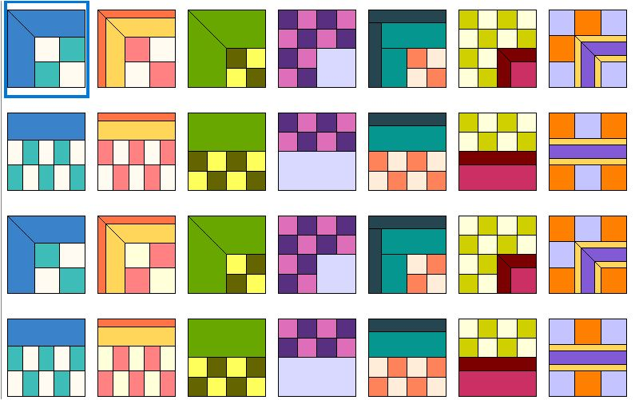

Slide 21
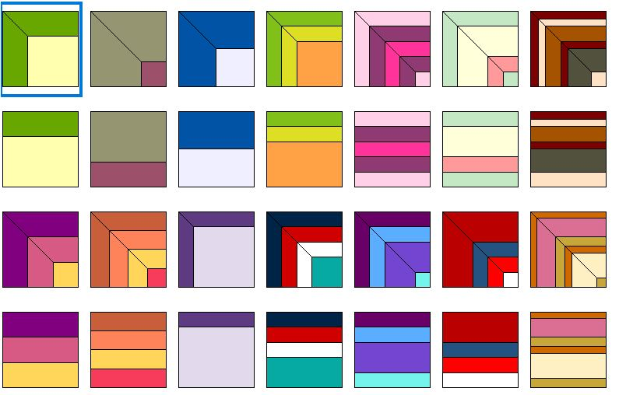

Slide 22
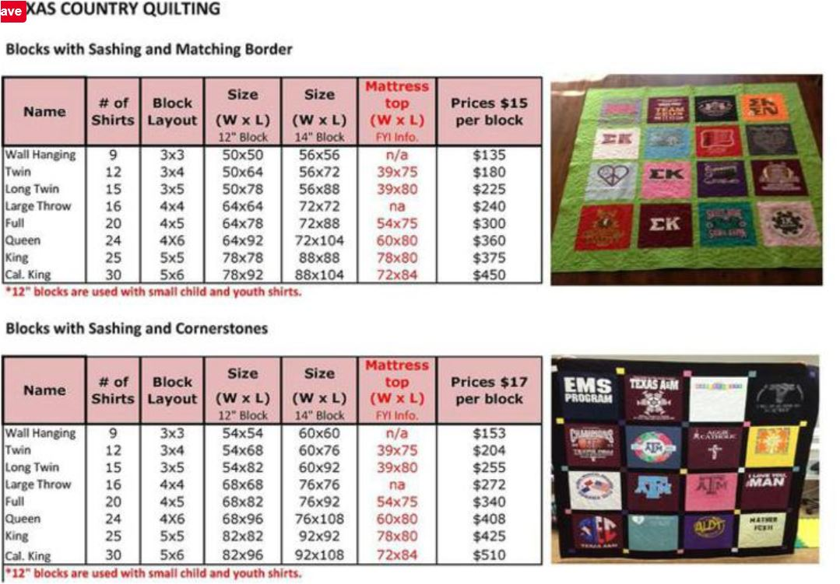

Slide 23
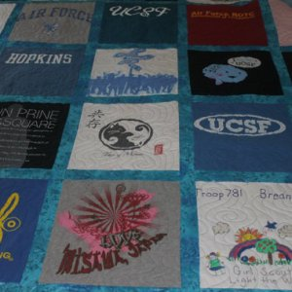
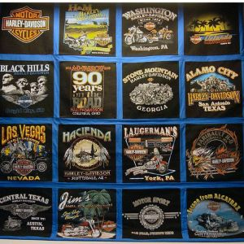
Tee Shirt Quilts are very popular and bring back a lot of memories. I have instruction to make a 20 block quilt. You can take a class with me to learn how tee shirts quilts are done. Jenny’s Sewing Studio offers a Tee Shirt Quilt class with the no sashing option

Slide 24
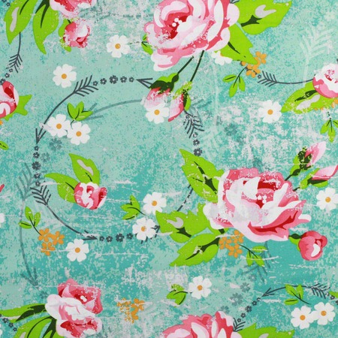
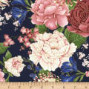
Fabric
I use 100% cotton for quilting. You can use blends but they do not piece as well, press as well or have the vivid color as 100% cotton. If you question the colorfastness of the fabric , prewash the material before use. Otherwise I use most fabric right from the bolt.
Most quilting fabrics are 45” wide. Since this is a standard measurement it will help you calculate yardage.
Straight of grain lines follows the selvedge.

Slide 25

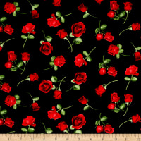

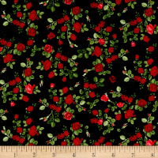
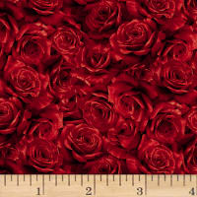
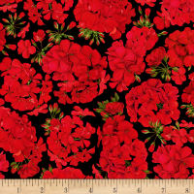
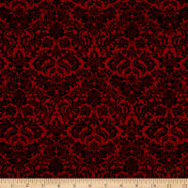
Watch out for directional prints. You have to use them carefully!

Slide 26


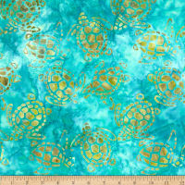
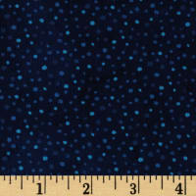
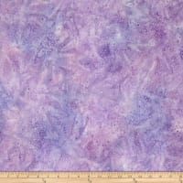
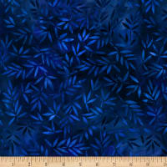
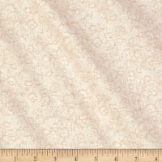
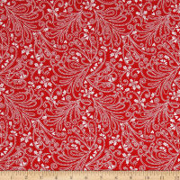
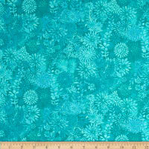
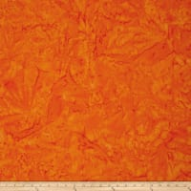
Always look for blenders and batiks that make good backgrounds. These are fabric you buy to put in your stash because they can be used many ways. I always have muslin and black fabric on hand. My favorite solid fabric brand is Kona Bay. I use Roc-Lon muslin 403 as a brand of unbleached muslin. ( Roc-Lon was founded in 1832 in Baltimore, MD.)

Slide 27
White on White is a perfect stash fabric for backgrounds.

Slide 28
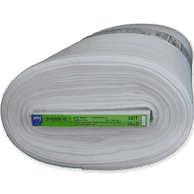
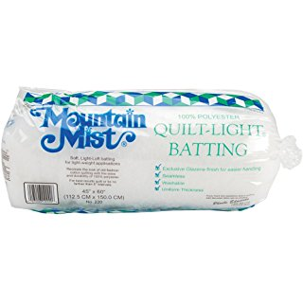
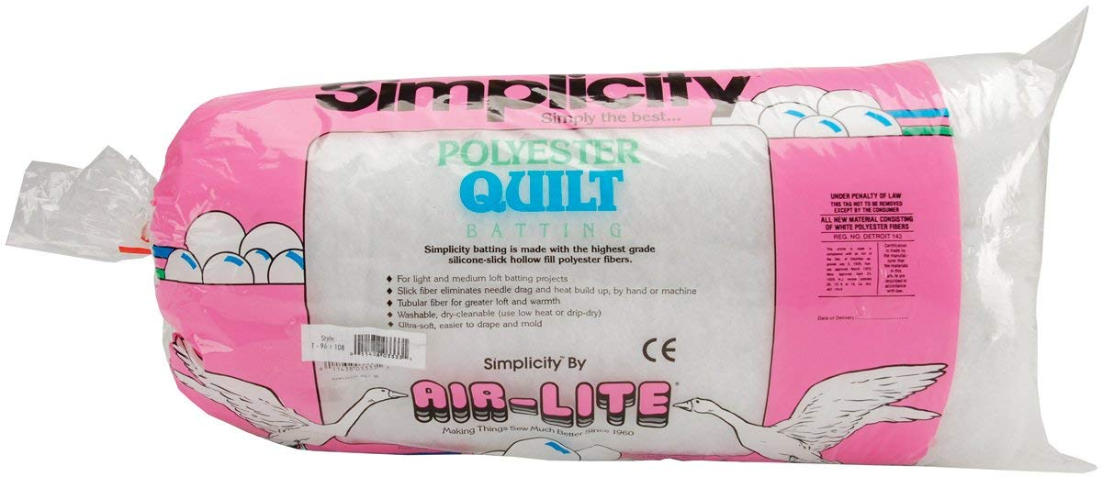
Here are some batting types. For machine and hand quilting I like light weight polyester and fusible batting. If you are going to use batting made sure it is bonded so it does not clump. Cotton batting is popular. Cotton does hold the layers together better as you quilt..

Slide 29
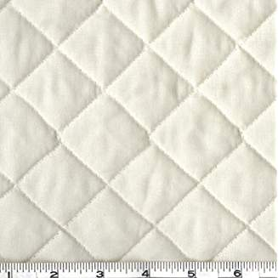
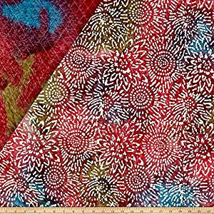
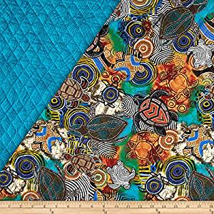
To quilt a whole piece quilt top I use double faced prequilted fabric. It makes assembly and sewing of the 3 layers a lot easier and cheaper than using a backing, batting and top layer. I have even suggested buying a comforter to use as 2 of the 3 layers when cost is a factor. Shop around. The best advise is the try the 3 layers together as one and feel the thickness and flexibility of the fabric layers before you decide what will make a good backing and batting. Try to avoid seams and extra loft battings when machine quilting.

Slide 30
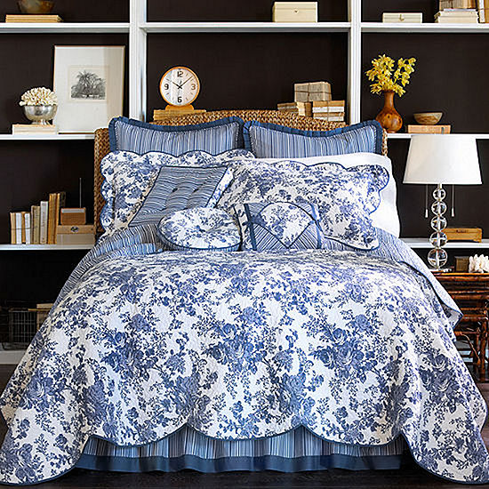
Sometimes buying a quilted comforter as a backing is cheaper and easier than buying backing and batting.

Slide 31
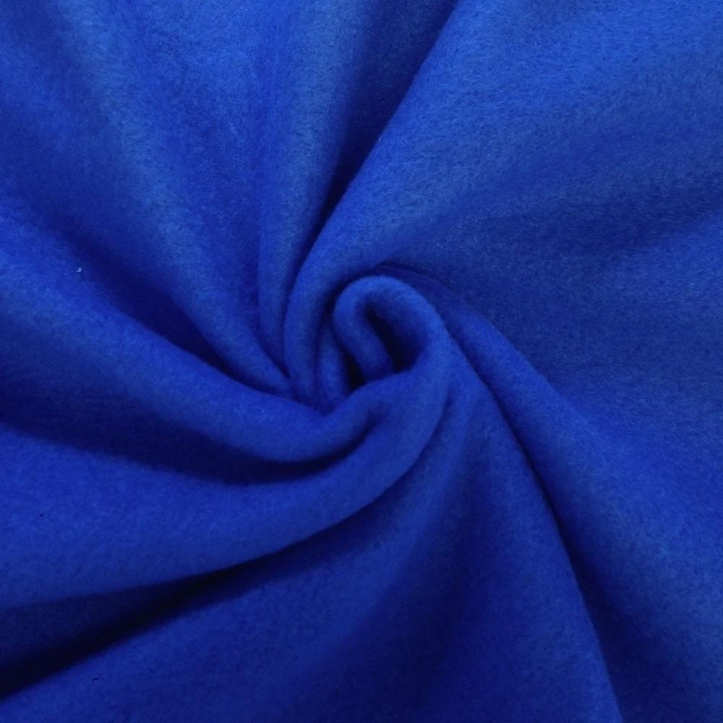
Some sewers like to use polar fleece as a batting and backing substitue. Check out Boscov’s, Walmart and Kohl’s as they may sell inexpensive throws the size you need for the backing.

Slide 32
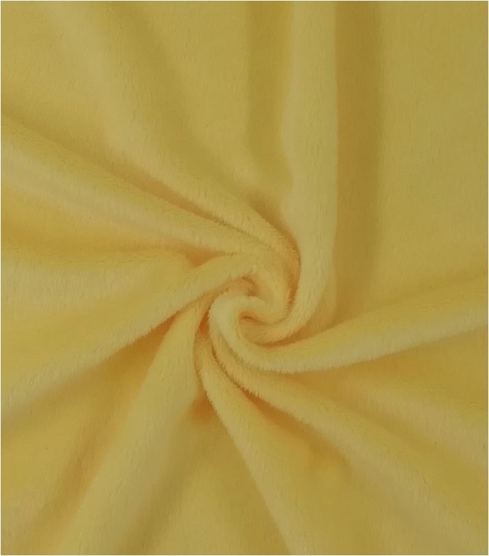
You can also choose Minky which is the softest choice. If you choose polar fleece or Minky you will probably turn and tie you quilt.

Slide 33
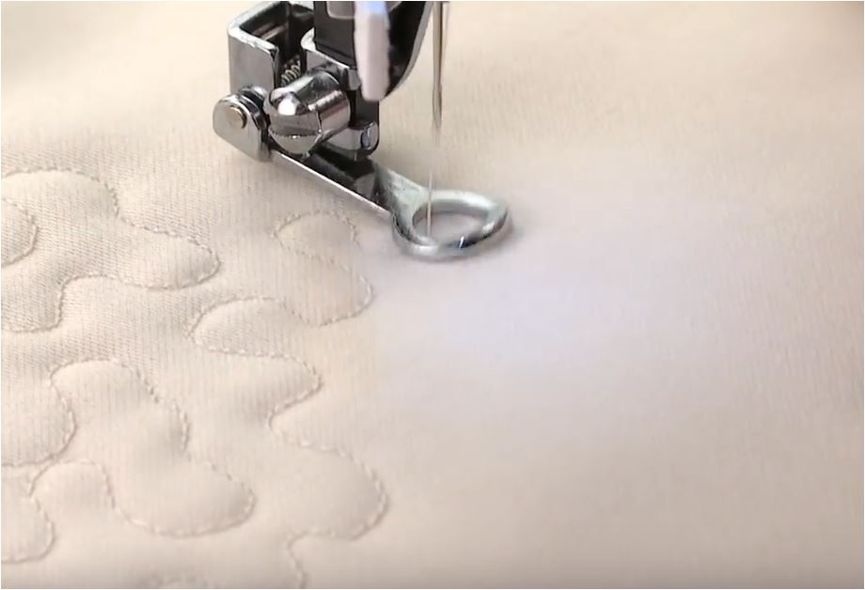
If you choose a backing and batting or a pre quilted fabric you will want to quilt the quilt by machine.
Learn to do free motion quilting. It is like drawing with your machine. Use the free motion foot for best results. I suggest making a practice square you can warm up on before you begin your good project.

Slide 34


Quilting is the act of putting three layers of fabric together. A top, batting and bottom layer make up the quilt.

Slide 35

I like to use my sewing machine to quilt. Some like the craft of hand sewing the 3 layers. Some use a frame to hold the quilt layers as the quilting is done. I use safety pins to hold the 3 layers together and then I use my machine to quilt.

Slide 36


Side to side motions and up and down motions are best. Try to run your sewing machine at a good even and medium sewing speed. I use quilting gloves for a good grip on the fabric. Here is a demonstration on how the technique works using this foot. The video was created by Singer.

Slide 37


Once you learn to free motion quilt you can even make fancy quilting designs on solid fabrics.

Slide 38

The walking foot helps feed all the layers of the quilt
You will need a walking foot for the quilt edges, straight line stitching, stitch in the ditch and binding. If you do not use a walking foot I guarantee a lot of puckering.

Slide 39

Safety pin layers for quilting

Slide 40

Free motion quilt the outlines

Slide 41

Quilt straight areas with walking foot

Slide 42

Sewing the Binding

Slide 43



If you need a class to finish a quilt top, I teach that class. Learn to layer and quilt the top. In class I show you how to sew the binding and how to miter the corners.

Slide 44




Slide 45

Quilting is a vast subject and we have only touch the surface of the quilting methods you can learn and sew.
You only need to know how to use your sewing machine straight stitch to learn machine quilting. Learn how many fun this craft can be!

Slide 46

To keep the art of quilting alive Jenny’s Sewing Studio offers a Lap Quilt club monthly. To start your quilting adventure please register in advance at www.jennys-sewing-studio I suggest you start with “One on One” lessons to get up the speed with the group. Classes are only $20 to learn the basics of Lap Quilting..

Slide 47

The quilting style I will introduce is Lap Quilting with Georgia Bonesteel. The Lap Quilt book contains a showcase of traditional piecing and quilting for all beginner quilters
One of the first quilting projects I completed was a Lap Quilt. It is called a Lap Quilt because it is portable and needs no frame to quilt.

Slide 48

Each student can bring their sewing machine ( in good working order ) to work along with the instructor. Enroll for one or more months and sew along as we build a quilt from your fabrics or scraps. A monthly materials list will be emailed once you enroll. The Lap Quilt Book is strongly suggested as a follow along guide. A sewing machine can be provided on request if available.

Slide 49

In 2016 I have moved my studio to my home at 1030 South Schumaker Dr. I teach classes by enrollment and appointment only. Class information and calendar links can be found in my "One on One instruction" link at:
http://blog.jennys-sewing-studio.com/sewing-classes/

Slide 50

I offer Beginning and Intermediate sewing classes; Quilt classes; classes on how to operate your sewing machine, serger and embroidery machine; Purse classes; Knitting and Crochet basics, Pillows, a Class on Ruffled Curtains, How to Applique’ by sewing machine and a 1 day seminar on the Singer Futura embroidery machine. Here are some of my students.
See our sewing class offerings click here for a link.

Slide 51

One on One classes give our customers the benefit of personalized sewing instruction. I can discuss what you want to learn and I can tailor the class time to fit your needs. I can choose the perfect day for your class and give you my undivided attention.

Slide 52

With over 41 years of hands on experience as a sewing machine educator, trainer, and sewing machine dealer, I can show you how to make sewing a fun and enjoyable hobby, inspire you to greater heights with the latest sewing products, embroidery ideas, and software. I strive to provide all of our customers with PERSONAL CARE and assistance.
Sincerely, Jennifer Friedel

