Slide 1
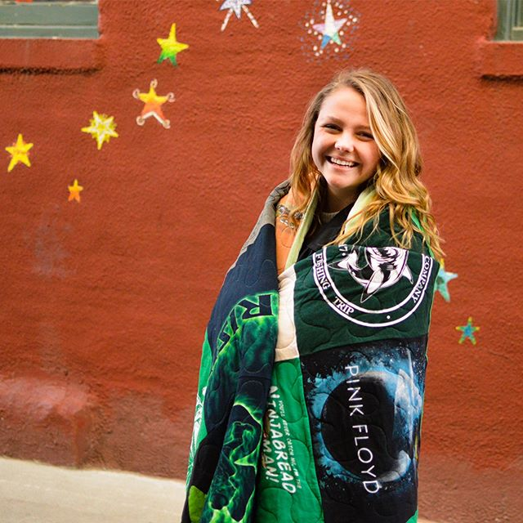

Learn How Sew a Tee Shirt Quilt!

Slide 2
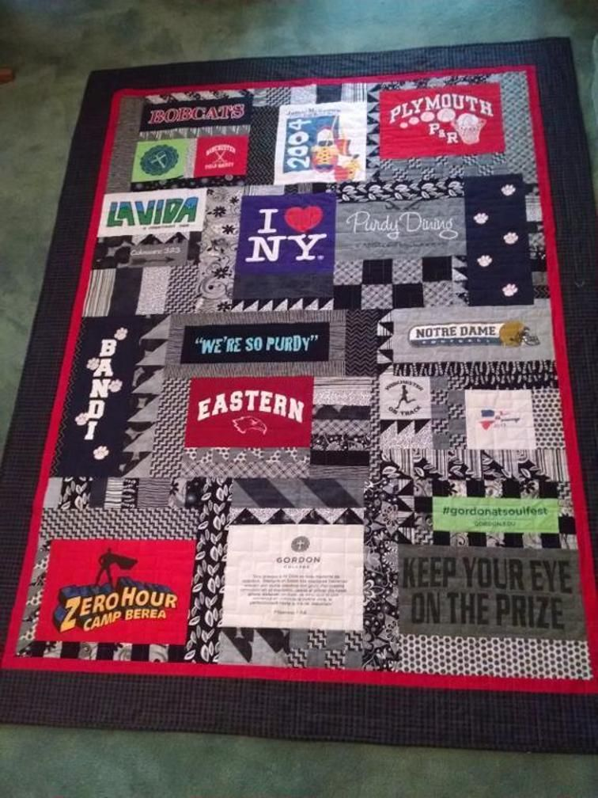
Quilting is fun and easy !
All you need to know is how to use the straight stitch on your machine!

Slide 3
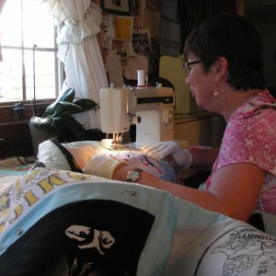

Slide 4
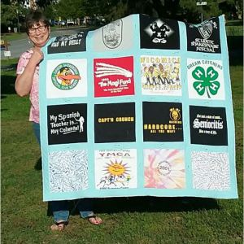

Slide 5
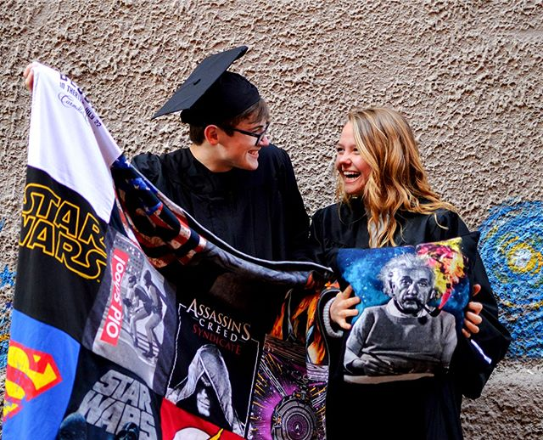
Tee Shirt Quilts are great for the graduate, remembering a vacation or a special event or a special group of friends. Sports fans love them. This is a special gift.

Slide 6
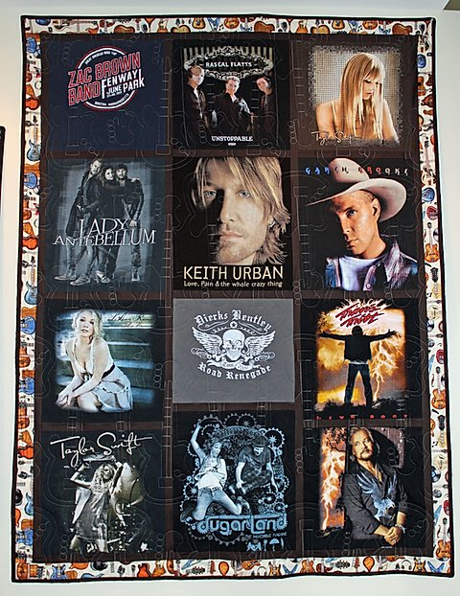

Slide 7
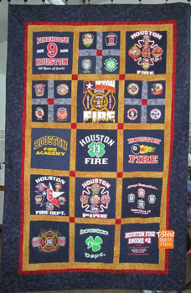

Slide 8
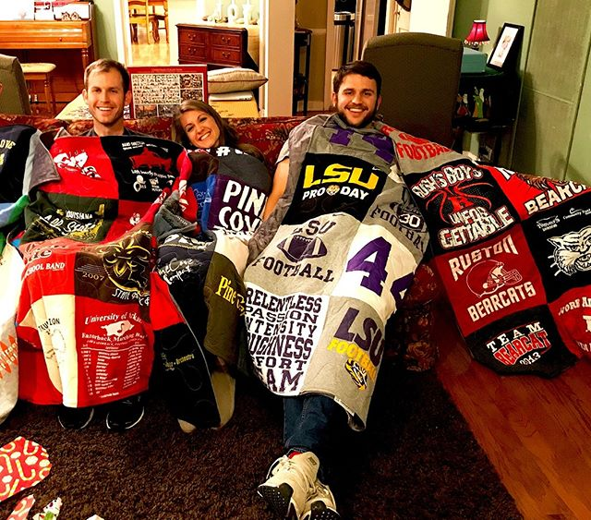

Slide 9
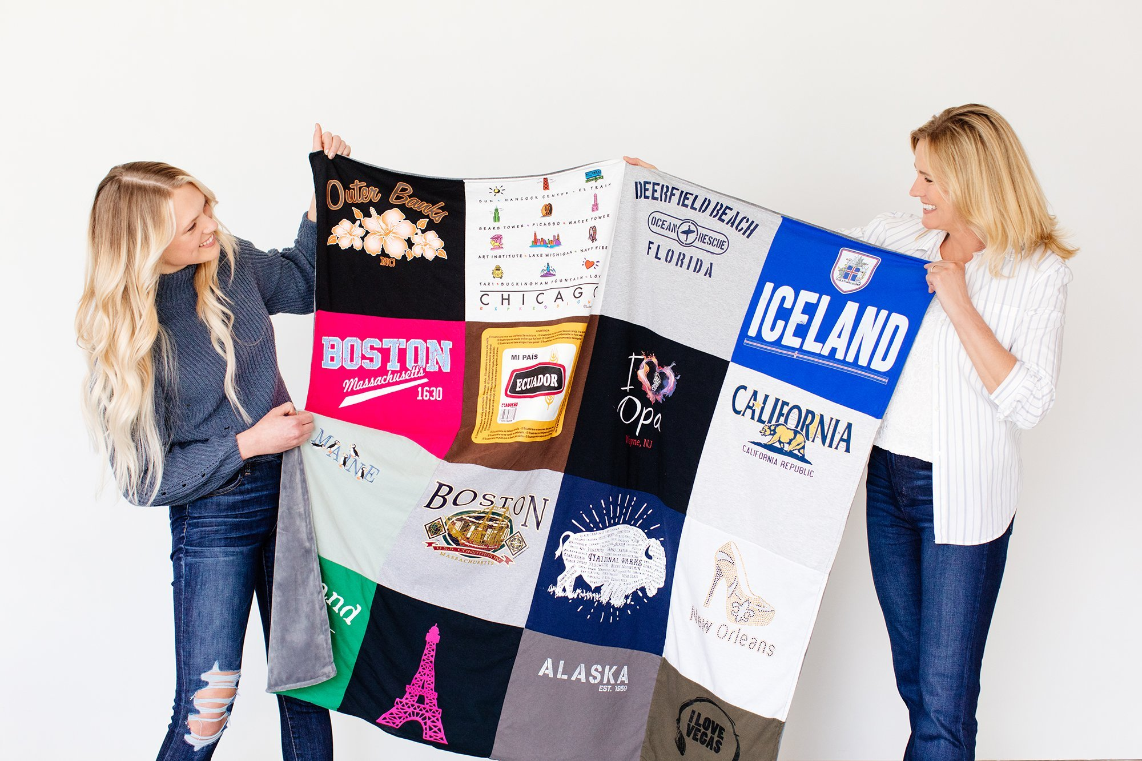

Slide 10
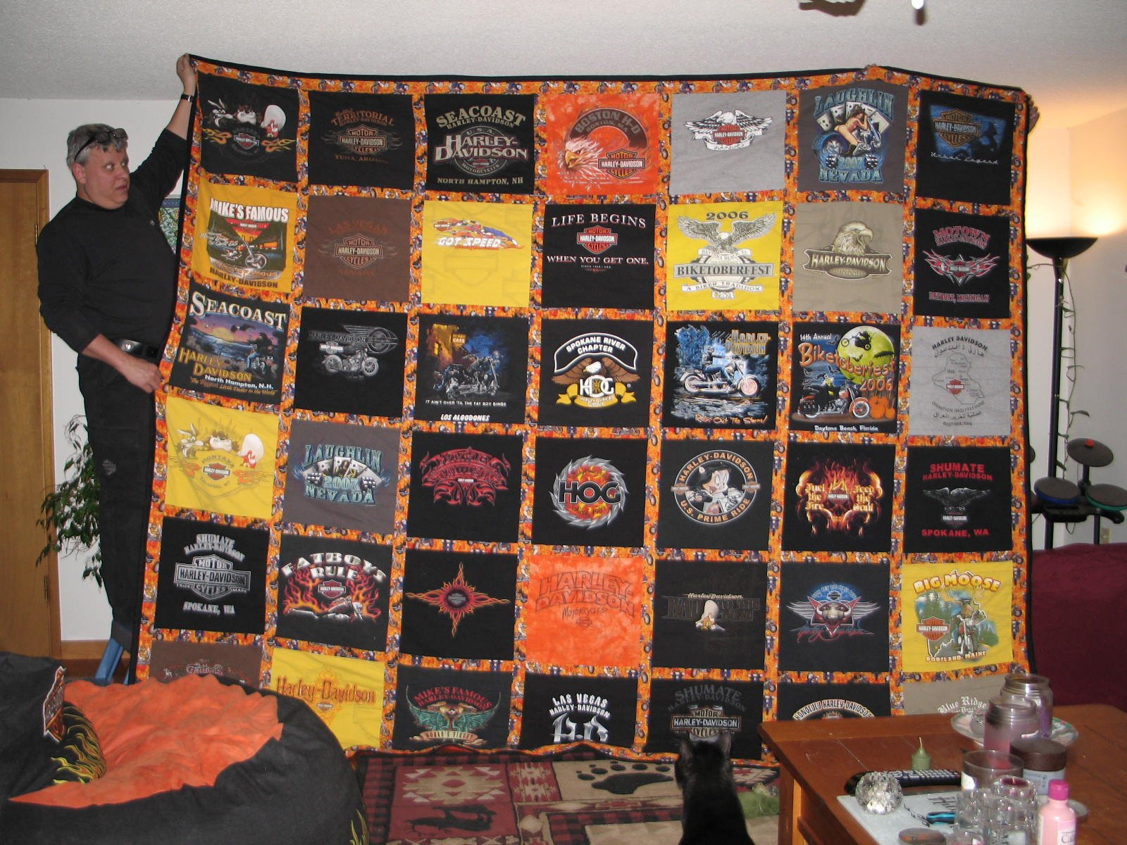
You are only limited by the number of tee shirts you have.

Slide 11
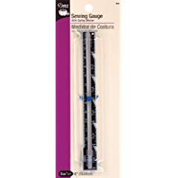
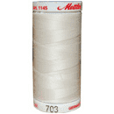
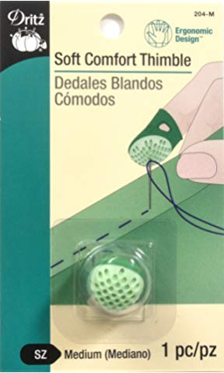
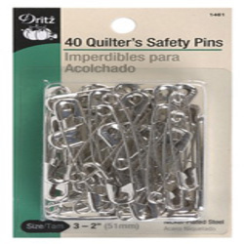
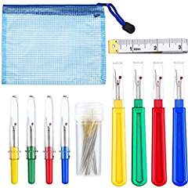
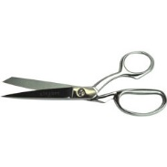
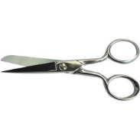
Here is a list of other supplies you will need. I will cover how you will use them as we talk about technique.
Good sharp scissors and trimmers
Seam gauge
Thimble
Seam ripper
Safety pins
Steam iron and pressing mat
Thread in a neutral shade

Slide 12

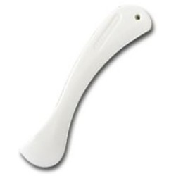
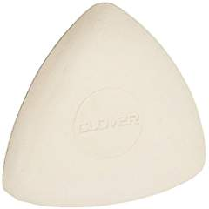
Fabric markers like a wash away pen
Clover chalk in white for dark colors
Seam presser
Good see thru rulers and squares

Slide 13
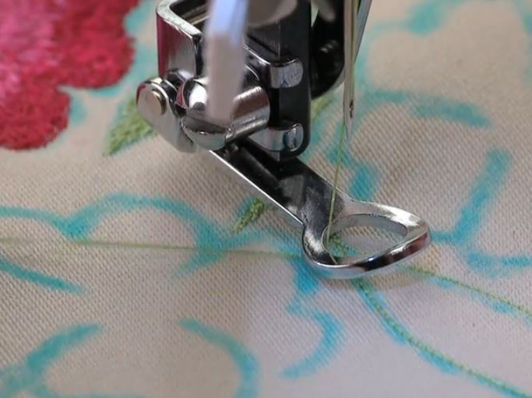
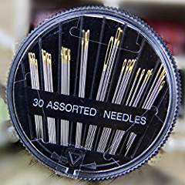
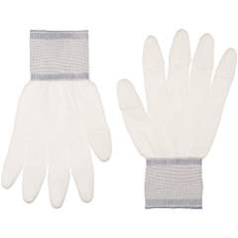
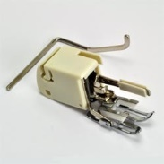
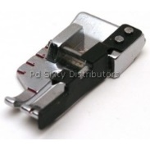
Walking Foot
¼” foot
Free motion foot
Quilter’s gloves
Hand sewing needles assorted
Hand quilting needles – start with size 7 between
Template plastic and permanent marker
highlighters
Layout area

Slide 14
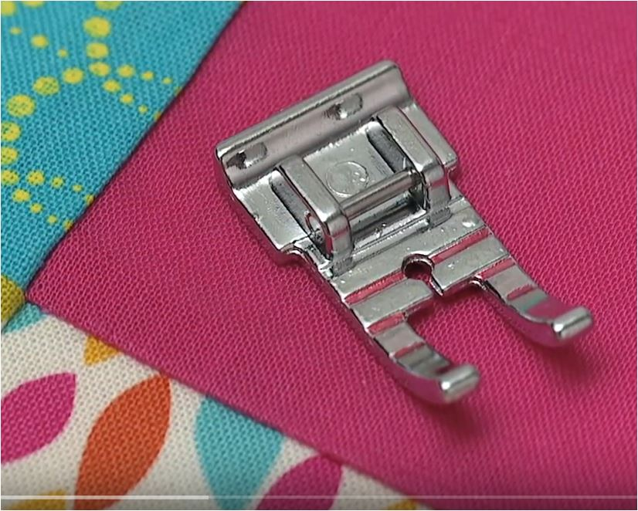
The ¼” foot is a great guide foot to get accurate ¼” seams. ¼” is the standard use to piece patchwork. There are many styles of ¼” feet and they all offer a guide for you to sew a perfect ¼”. Here is how it works.
When doing any type of patchwork or strip piecing you will need a guide to help you.

Slide 15
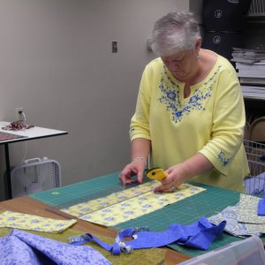
Rotary Cutter
A quilter’s best friends are a good machine, a wonderful steam iron and a rotary cutter plus a 24” X 6” ruler and at least a 24” cutting mat. Safety pins, clover chalk, and straight pins come in a close second.
To cut your tee shirt squares or strips of fabric accurately you need the rotary cutting system. For strip piecing, binding and borders, it is a must.

Slide 16
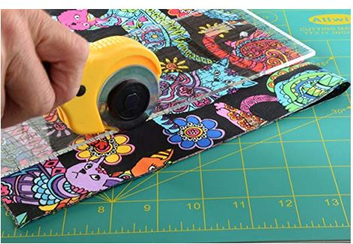
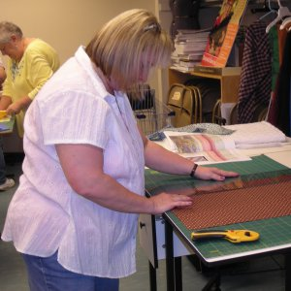
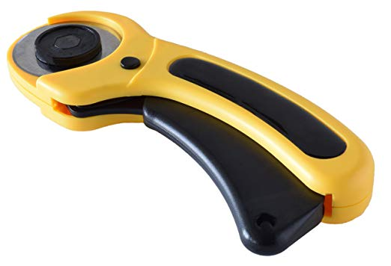
Here is a picture of the rotary cutter, ruler and mat. All are essential in using the cutting system. The rotary cutter is surgically sharp so it is important to follow all the safety rulers.

Slide 17
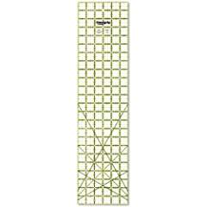
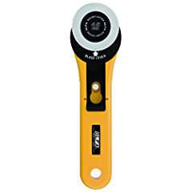
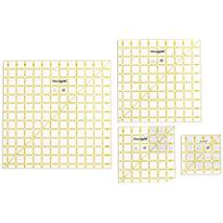
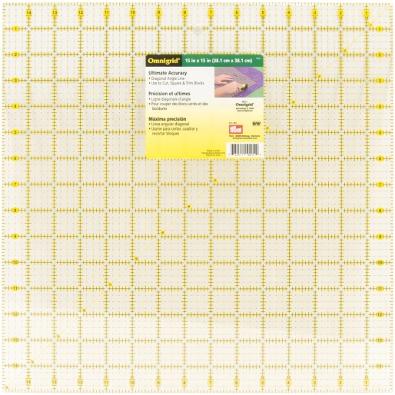
15” square rulers and 12” or 12 ½” and 6” and 6 ½” plastic see through rulers come in handy. Most rulers are marked every 1”, ½” and ¼”. Ruler also have a 45 and 60 degree angle markings for triangles. 24” x 6” rulers are perfect for the rotary cutter. You will need a 24” X 18” mat for cutting with the rotary cutter.

Slide 18
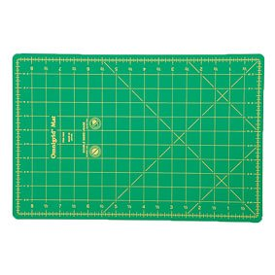
You will need at least a 24” X 18” mat

Slide 19
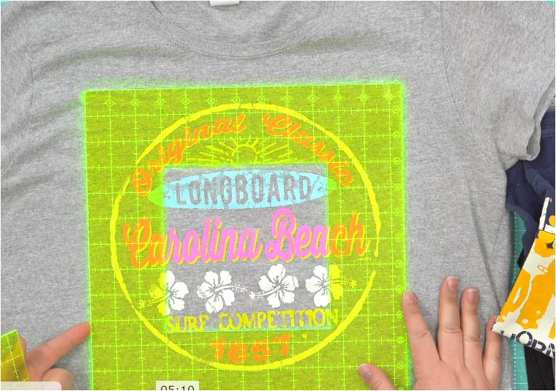
Once you sort the tee shirts you will see what size blocks you need to cut. Some tee shirts have writing or designs that extend up to 15”. Some designs are small. That is why sorting is a good idea. Make a plan.

Slide 20
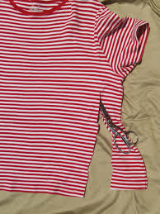
Trim off the sides, neckline and sleeves of the tee shirt. It is easier to use a rotary cutter and mat for this procedure.

Slide 21
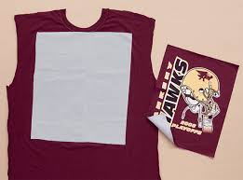
Check the tee shirt for the size block you need to work with and cut the tee shirt larger than the ruler so you can press the interfacing on the back of the block before you cut the block to the finished size.

Slide 22
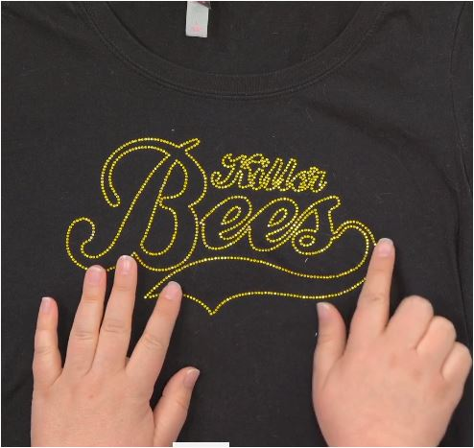
Some tee shirts have rhinestones and buttons as decoration so be careful the objects will not get in the way of sewing the block. Striking these items will break needles.

Slide 23
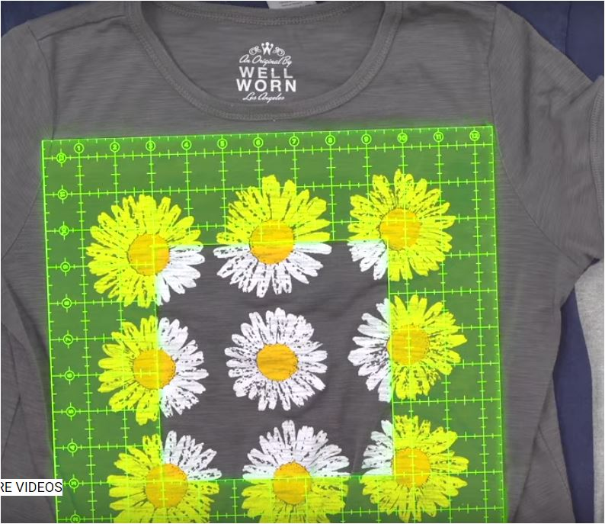

Slide 24
Pick a size for your tee shirt square that works with the designs you see on the shirt. Here is a childrens quilt that was planned using 5” squares and a charm pack of cotton 5” square to match for piecing.
Most blocks are cut 12”,12 ½ “or 15”. You can plan to sew the quilt with just tee shirt blocks or you can add lattice, corner stones and borders.

Slide 25
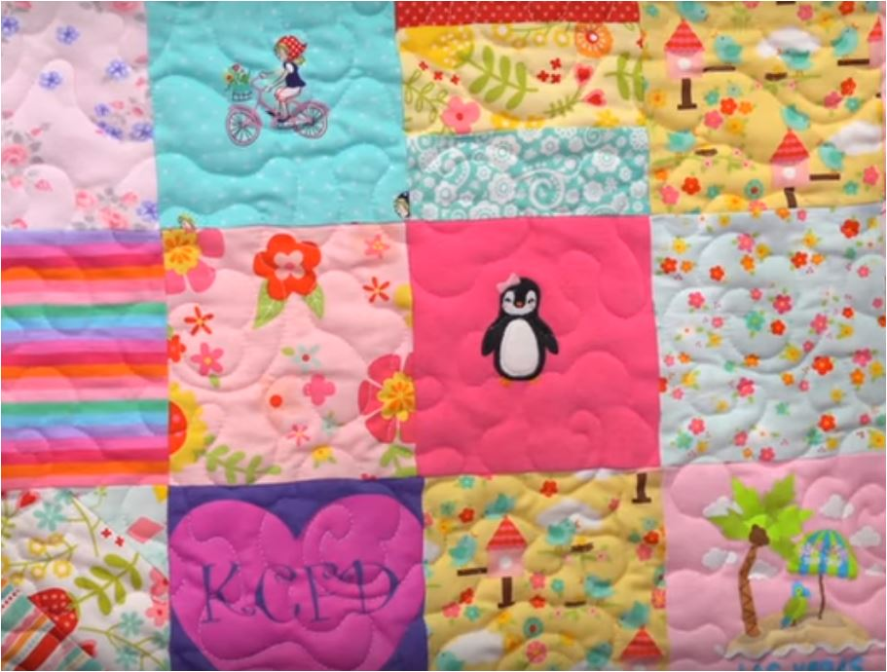
Use onies to cut into 5” squares and then piece the 5” squares in 9 square blocks and then put the quilt together.

Slide 26
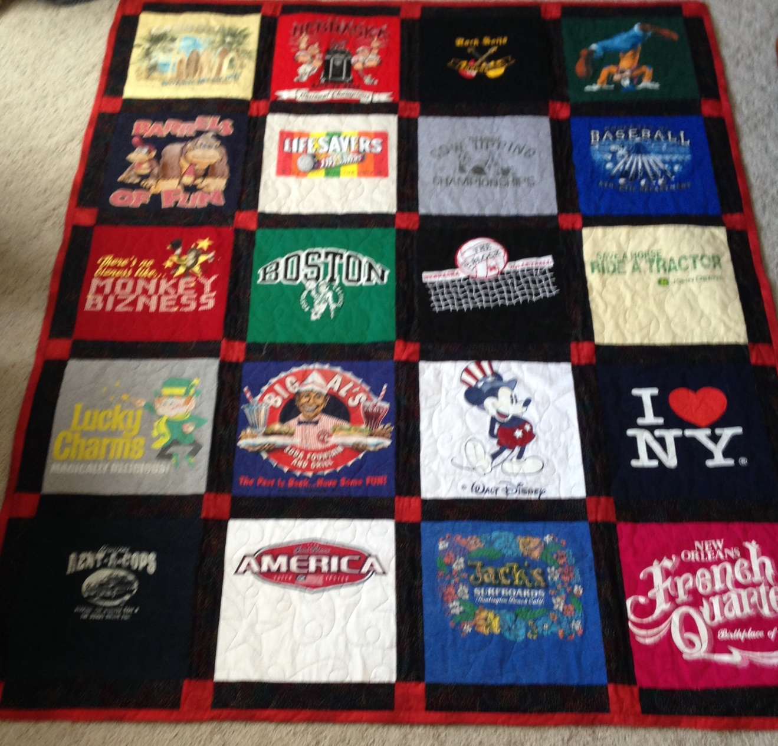
Corner stones are the red squares. Most lattice is cut about 3 ½”” wide so these corner stones are 3 1/2” squares

Slide 27
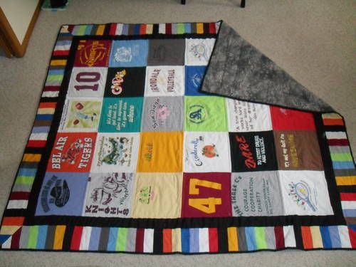
This quilt has 5 rows X 6 rows of tee shirt squares sewn together to form the body of the quilt.. There are 2 borders. One is a solid black that frames the quilt The outside border is strip pieced with mitered corners.

Slide 28
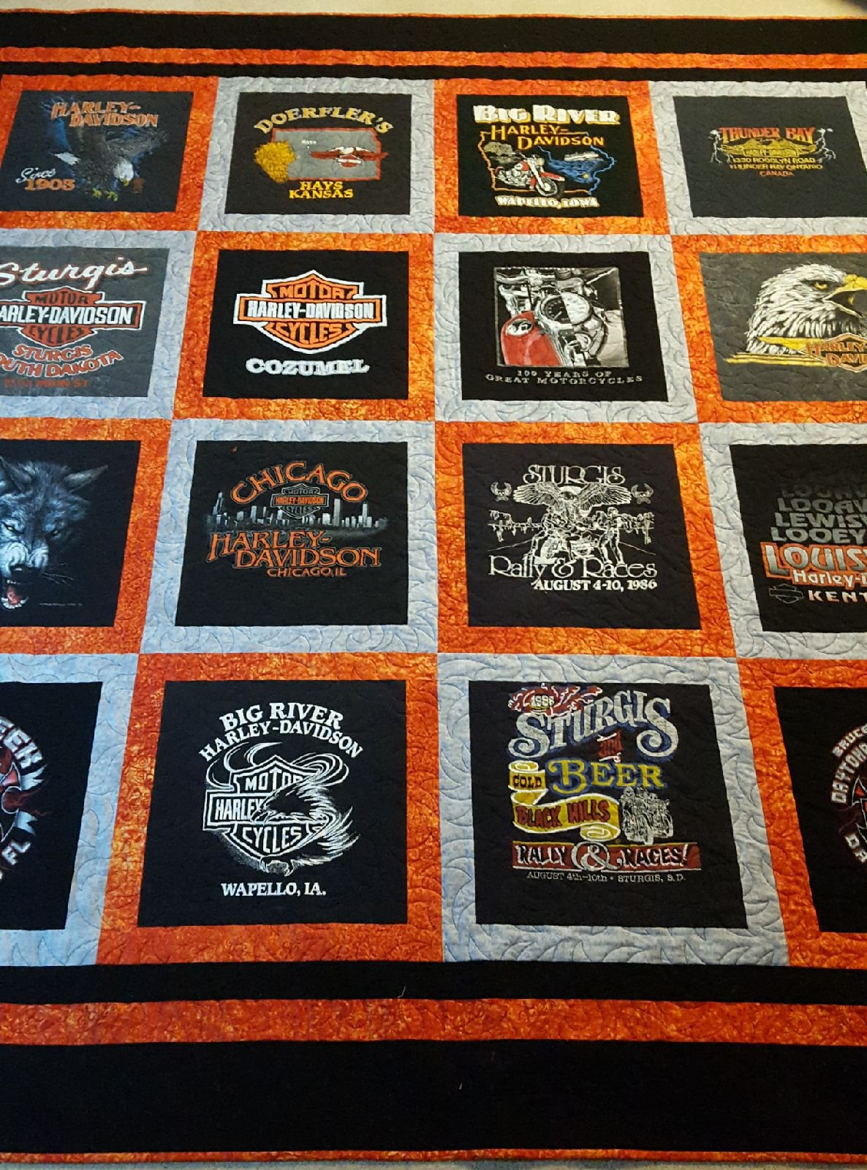
The sewer used 2 colors to frame the blocks on this quilt. Every other tee shirt square is framed with a 2” border. The outer edge was framed with 3 graduations of borders.

Slide 29
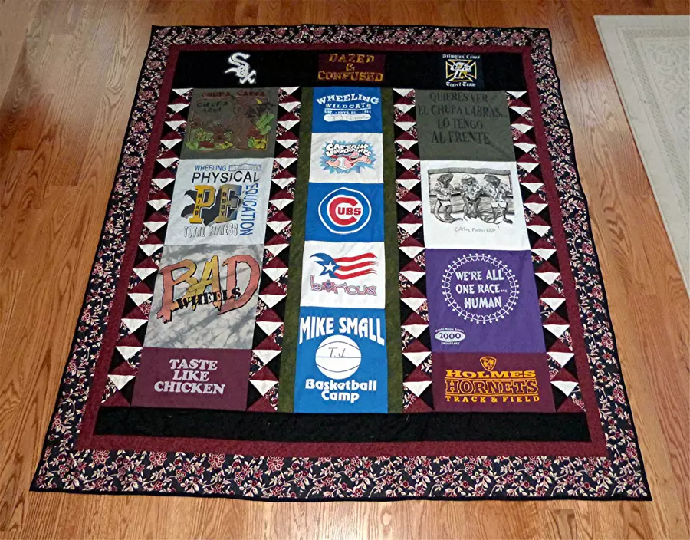

Slide 30
This tee shirt quilt was made using 4 rows of different size tee shirt squares. If you have a row of 15” blocks you may have to add some fabrics in between the blocks on the next rows so the block match the blocks on the previous row.
This gives a nice random look.

Slide 31
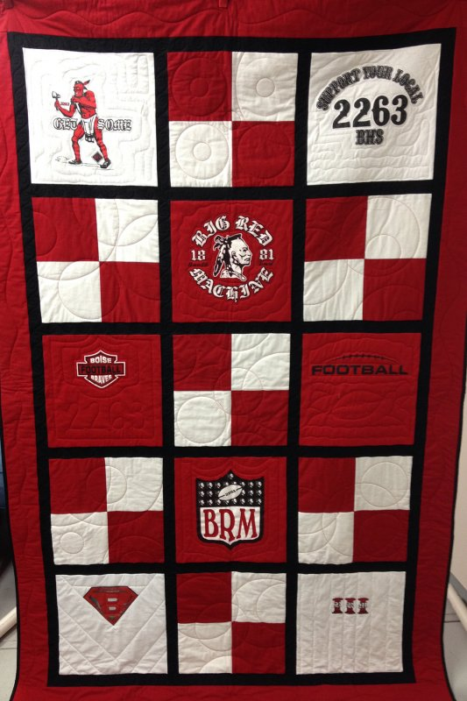
This quilt used pieced blocks in between the tee shirt blocks.

Slide 32
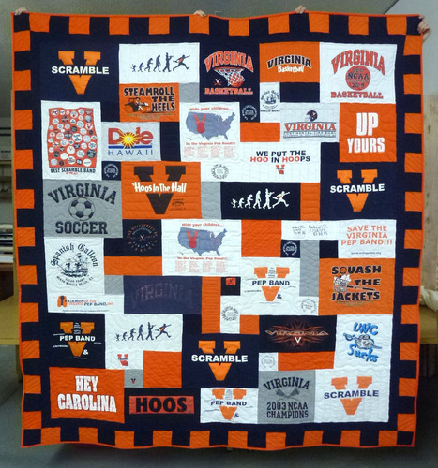

Slide 33
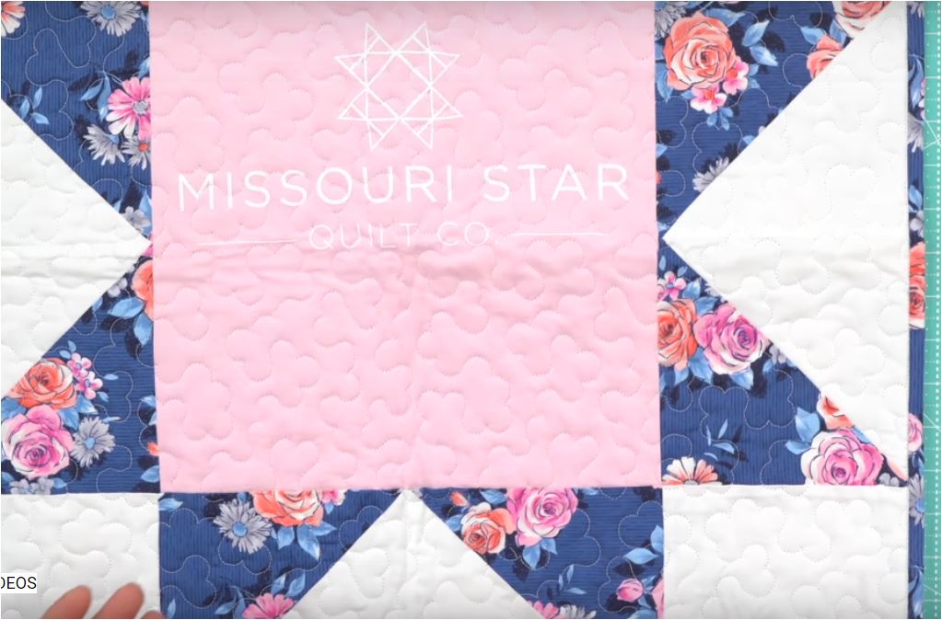
I found this quilt idea from Missouri Quilt Company quite exciting!

Slide 34
The center of the block is a tee shirt. Using the 12 ½” ruler to make the center of the quilt, the points of the star are achieved by using the 6 ½” square or A square from Lap quilting.. The star points use template E from lap Quilting.

Slide 35
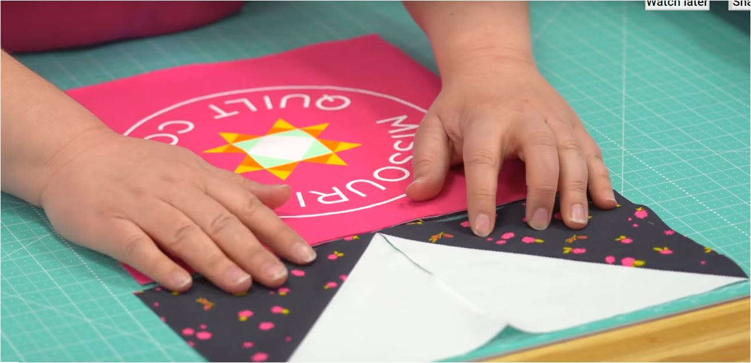
Thank you to Missouri Quilt Company for the design idea.

Slide 36
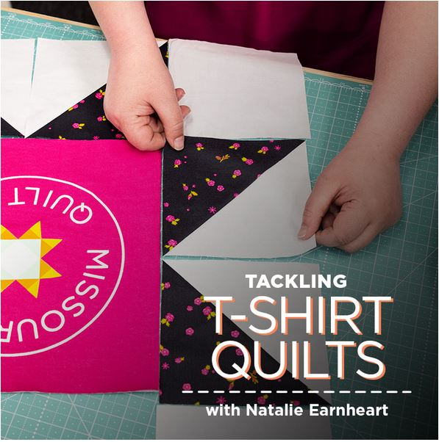

Slide 37
I am using templates A square and E triangle from the lap quilting book plus my 12 ½ “ ruler for the center of the block .
This block will be a small wall quilt and I can add borders to make it larger . The wall quilt block will measure 24” when finished. I used an old tee shirt I found in my closet for the center.

Slide 38
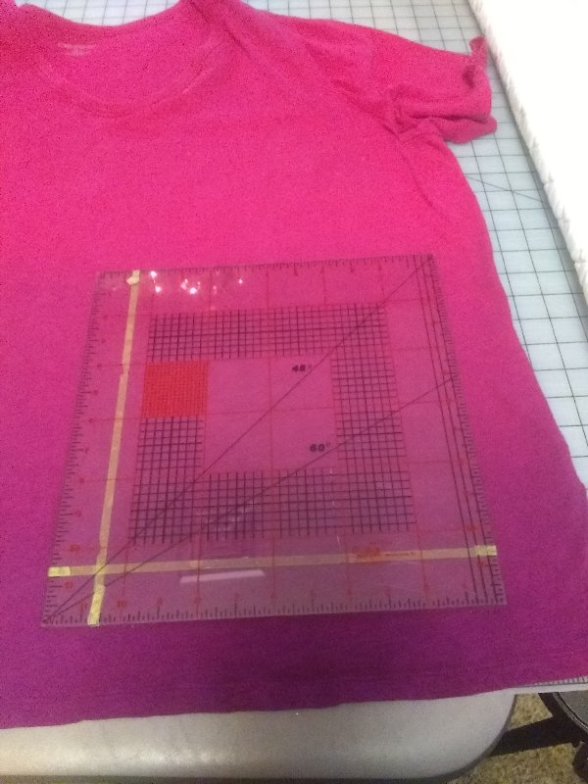
Pick your tee shirt and check to see if you have plenty of room for your design. I wanted a 12 ½’ area

Slide 39
Trim your tee shirt with a rotary cutter. Make the trim area over sized. My tee will let me use the front and the back sides for 2 different blocks.

Slide 40

On the wrong side of your tee shirt iron on Light to Medium weight fusible interfacing to stabilize the tee shirt. I prefer fusi knit by Pellon but used what I have on hand.

Slide 41

To give you an idea of the design of this wonder block go to page 14 in your lap quilt book and look at Saw Tooth Star. If you want to make this block for your lap quilt you can but I substituted the center template with my 12 ½” ruler and the star edges were made using E triangle and A square.

Slide 42

Using at least 3/8yd of 2 fabrics, I placed them right sides together and drew 4 - A squares of one color and 8 E-triangles in a row so I could quick piece them in a continuous row.

Slide 43

Here I quick pieced the E- triangles before I cut them out. I needed 8.

Slide 44

I did not have a fancy tee shirt so added embroidery to the shirt before I cut the block to size using the 12 ½” square.

Slide 45

Here is the layout of my 24” block. Once sewn and quilted and bound I will make a wall quilt with it. The block could also be combined with other 24” blocks to make a quilt of any size.
I hope you enjoyed my quick wonder block project.

Slide 46

Here are other quilt blocks you could adapt to the tee shirt “one block wonder”.

Slide 47



Slide 48



Slide 49

Special pieced borders.

Slide 50

Here are other border ideas

Slide 51


Slide 52


Slide 53


Slide 54


Slide 55


Tee Shirt Quilts are very popular and bring back a lot of memories. I have instruction to make a 20 block quilt. You can take a class with me to learn how tee shirts quilts are done. Jenny’s Sewing Studio offers a Tee Shirt Quilt class with the no sashing option

Slide 56


Fabric
I use 100% cotton for quilting. You can use blends but they do not piece as well, press as well or have the vivid color as 100% cotton. If you question the colorfastness of the fabric , prewash the material before use. Otherwise I use most fabric right from the bolt.
Most quilting fabrics are 45” wide. Since this is a standard measurement it will help you calculate yardage.
Straight of grain lines follows the selvedge.

Slide 57







Watch out for directional prints. You have to use them carefully!

Slide 58










Always look for blenders and batiks that make good backgrounds. These are fabric you buy to put in your stash because they can be used many ways. I always have muslin and black fabric on hand. My favorite solid fabric brand is Kona Bay. I use Roc-Lon muslin 403 as a brand of unbleached muslin. ( Roc-Lon was founded in 1832 in Baltimore, MD.)

Slide 59
White on White is a perfect stash fabric for backgrounds.

Slide 60



Here are some batting types. For machine and hand quilting I like light weight polyester and fusible batting. If you are going to use batting made sure it is bonded so it does not clump. Cotton batting is popular. Cotton does hold the layers together better as you quilt..

Slide 61



To quilt a whole piece quilt top I use double faced prequilted fabric. It makes assembly and sewing of the 3 layers a lot easier and cheaper than using a backing, batting and top layer. I have even suggested buying a comforter to use as 2 of the 3 layers when cost is a factor. Shop around. The best advise is the try the 3 layers together as one and feel the thickness and flexibility of the fabric layers before you decide what will make a good backing and batting. Try to avoid seams and extra loft battings when machine quilting.

Slide 62

Sometimes buying a quilted comforter as a backing is cheaper and easier than buying backing and batting.

Slide 63

Some sewers like to use polar fleece as a batting and backing substitue. Check out Boscov’s, Walmart and Kohl’s as they may sell inexpensive throws the size you need for the backing.

Slide 64

You can also choose Minky which is the softest choice. If you choose polar fleece or Minky you will probably turn and tie you quilt.

Slide 65

If you choose a backing and batting or a pre quilted fabric you will want to quilt the quilt by machine.
Learn to do free motion quilting. It is like drawing with your machine. Use the free motion foot for best results. I suggest making a practice square you can warm up on before you begin your good project.

Slide 66


Quilting is the act of putting three layers of fabric together. A top, batting and bottom layer make up the quilt.

Slide 67

I like to use my sewing machine to quilt. Some like the craft of hand sewing the 3 layers. Some use a frame to hold the quilt layers as the quilting is done. I use safety pins to hold the 3 layers together and then I use my machine to quilt.

Slide 68

Side to side motions and up and down motions are best. Try to run your sewing machine at a good even and medium sewing speed. I use quilting gloves for a good grip on the fabric. Here is a demonstration on how the technique works using this foot. The video was created by Singer.

Slide 69


Once you learn to free motion quilt you can even make fancy quilting designs on solid fabrics.

Slide 70

The walking foot helps feed all the layers of the quilt
You will need a walking foot for the quilt edges, straight line stitching, stitch in the ditch and binding. If you do not use a walking foot I guarantee a lot of puckering.

Slide 71

Safety pin layers for quilting

Slide 72

Free motion quilt the outlines

Slide 73

Quilt straight areas with walking foot

Slide 74

Sewing the Binding

Slide 75



If you need a class to finish a quilt top, I teach that class. Learn to layer and quilt the top. In class I show you how to sew the binding and how to miter the corners.

Slide 76




Slide 77

Quilting is a vast subject and we have only touch the surface of the quilting methods you can learn and sew.
You only need to know how to use your sewing machine straight stitch to learn machine quilting. Learn how many fun this craft can be!

Slide 78

To keep the art of quilting alive Jenny’s Sewing Studio offers a Lap Quilt club monthly. To start your quilting adventure please register in advance at www.jennys-sewing-studio I suggest you start with “One on One” lessons to get up the speed with the group. Classes are only $20 to learn the basics of Lap Quilting..

Slide 79

The quilting style I will introduce is Lap Quilting with Georgia Bonesteel. The Lap Quilt book contains a showcase of traditional piecing and quilting for all beginner quilters
One of the first quilting projects I completed was a Lap Quilt. It is called a Lap Quilt because it is portable and needs no frame to quilt.

Slide 80

Each student can bring their sewing machine ( in good working order ) to work along with the instructor. Enroll for one or more months and sew along as we build a quilt from your fabrics or scraps. A monthly materials list will be emailed once you enroll. The Lap Quilt Book is strongly suggested as a follow along guide. A sewing machine can be provided on request if available.

Slide 81

In 2016 I have moved my studio to my home at 1030 South Schumaker Dr. I teach classes by enrollment and appointment only. Class information and calendar links can be found in my "One on One instruction" link at:
http://blog.jennys-sewing-studio.com/sewing-classes/

Slide 82

I offer Beginning and Intermediate sewing classes; Quilt classes; classes on how to operate your sewing machine, serger and embroidery machine; Purse classes; Knitting and Crochet basics, Pillows, a Class on Ruffled Curtains, How to Applique’ by sewing machine and a 1 day seminar on the Singer Futura embroidery machine. Here are some of my students.
See our sewing class offerings click here for a link.

Slide 83

One on One classes give our customers the benefit of personalized sewing instruction. I can discuss what you want to learn and I can tailor the class time to fit your needs. I can choose the perfect day for your class and give you my undivided attention.

Slide 84

With over 41 years of hands on experience as a sewing machine educator, trainer, and sewing machine dealer, I can show you how to make sewing a fun and enjoyable hobby, inspire you to greater heights with the latest sewing products, embroidery ideas, and software. I strive to provide all of our customers with PERSONAL CARE and assistance.
Sincerely, Jennifer Friedel

