Slide 1
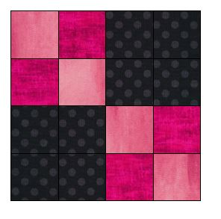

Learn How to Lap Quilt!
Lesson 1

Slide 2
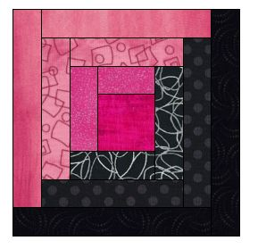
Quilting is fun and easy !
All you need to know is how to use the straight stitch on your machine!
Lap Quilting allows you to make small 12 ½” blocks that are bordered and assembled to make any size quilt you wish. You will learn a lot about different piecing techniques in the months to come.
For our Lap Quilting introduction I will suggest notions and tools and fabrics you may need to complete a quilt.
Class registration is required because of size restrictions!

Slide 3
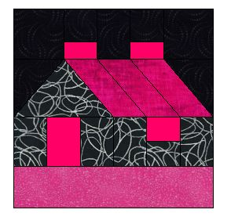
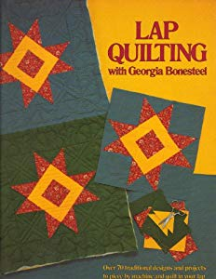
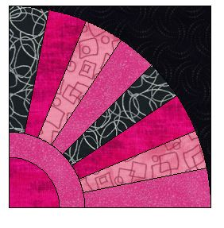
In Lesson 1 you will need to bring “Lap Quilting with Georgia Bonesteel”. The book can be found on line at Thriftbooks.com used for a reasonable price. You will also need to bring template plastic, a fine line sharpie, a ruler, straight pins, a blue wash away marker, 1 yard of 3 different 100% quilters cotton fabric to start making your quilt. In the following pages I will give you some pictures of the products you may use and some fabric color combinations you might like to use. You can find fabric and notions at Hobby Lobby, Serendipity Quilts in Dagsboro, De, Amazon or fabric.com.
You will not need a sewing machine at Lesson 1.

Slide 4
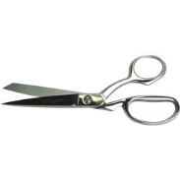
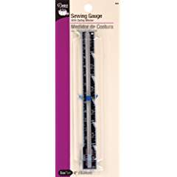
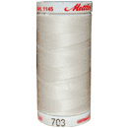
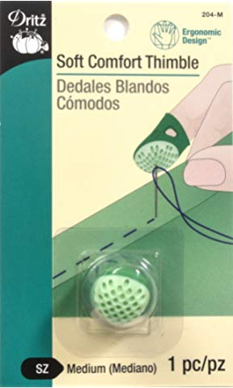
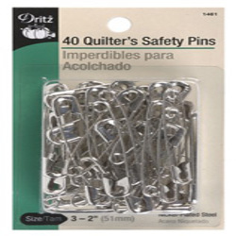
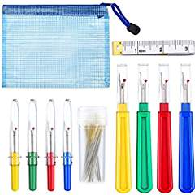
Here is a list of supplies you will need. I will cover how you will use them as we talk about technique.
Good sharp scissors and trimmers
Sewing and knitting or Seam gauge
Thimble
Seam ripper
Medium safety pins
Steam iron and pressing mat
(Jenny will supply an iron and press mat for class)
Thread in a neutral shade

Slide 5

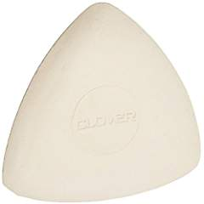
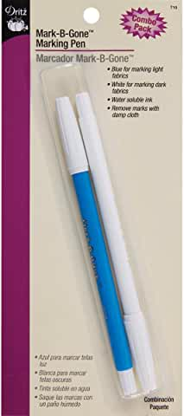
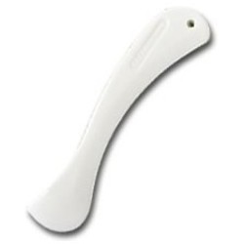
Fabric markers like a wash away pen
Clover chalk in white for dark colors
Seam presser

Slide 6
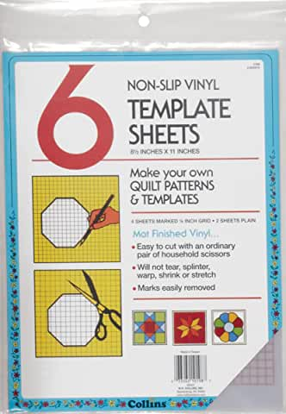
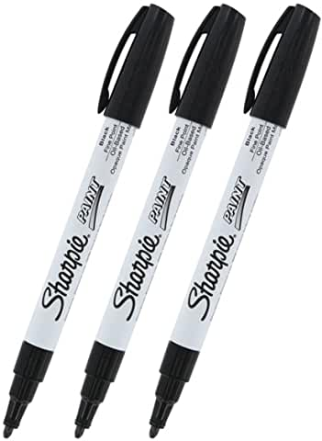
Template plastic and a sharpie marker.

Slide 7
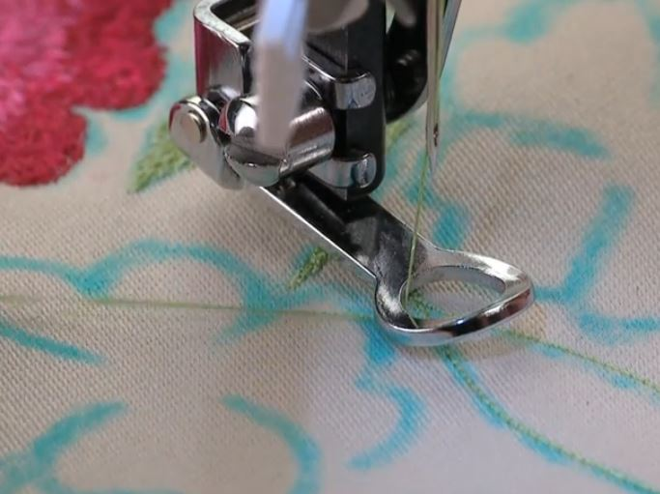
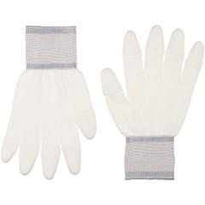
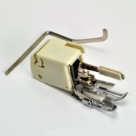
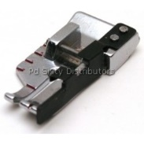
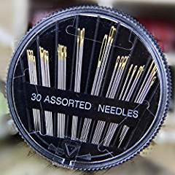
These are things you will need in future lessons. We will talk about them in lesson one but you do not need to bring any of the following items to lesson 1.
.
Walking Foot
¼” foot
Free motion foot
Quilter’s gloves
Hand sewing needles assorted

Slide 8
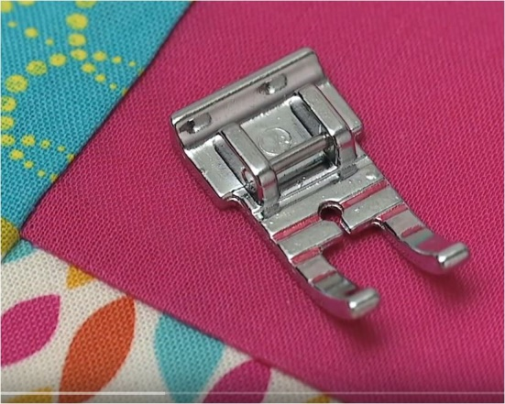
The ¼” foot is a great guide foot to get accurate ¼” seams. ¼” is the standard used to piece patchwork. There are many styles of ¼” feet and they all offer a guide for you to sew a perfect ¼”.
We will practice the ¼” seam in lesson 2. You will need to purchase and have your regular presser foot and a ¼” foot for lesson 2. In lesson 2 you will need your thread and sewing machine ( or reserve one of mine). All the items covered in lesson like marked templates and marked fabric will be used and sewn in lesson 2.

Slide 9
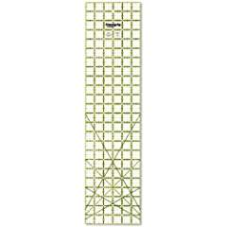
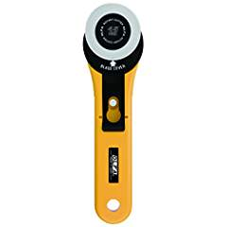
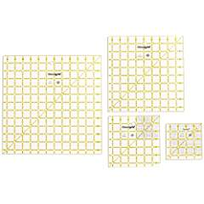
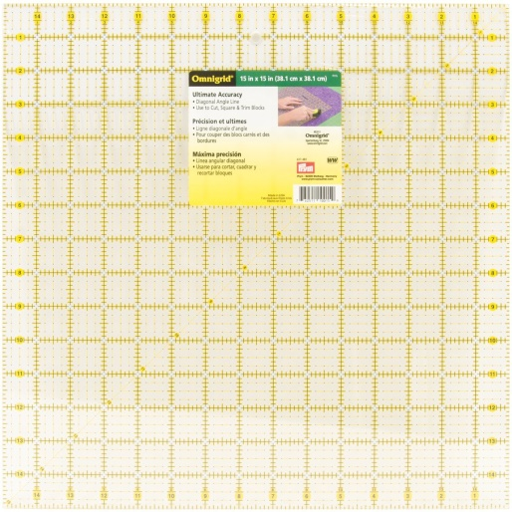
Plastic see through rulers come in handy. Most rulers are marked every 1”, ½” and ¼”. Ruler also have a 45 and 60 degree angle markings for triangles. 24” x 6” rulers are perfect for the rotary cutter. You will also need a 24” X 18” mat if you want to learn strip piecing. I will show you rulers in lesson 1.

Slide 10
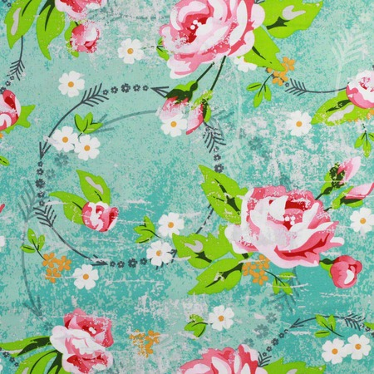
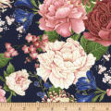
Fabric
I use 100% cotton for quilting. You can use blends but they do not piece as well, press as well or have the vivid color as 100% cotton. If you question the colorfastness of the fabric , prewash the material before use. Otherwise I use most fabric right from the bolt.
Most quilting fabrics are 45” wide. Since this is a standard measurement it will help you calculate yardage.
Straight of grain lines follows the selvedge.

Slide 11

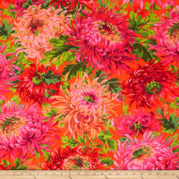
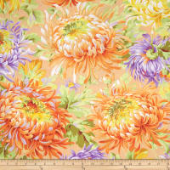
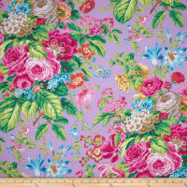
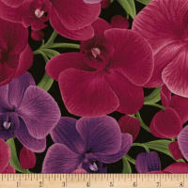
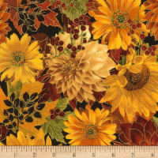
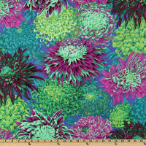
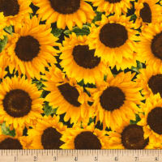
Buying quilting fabric is an adventure, especially “on line”. I have noticed some sites like www.fabric.com has a planning space to save your collection before purchase.
Find a favorite fabric that tells a color story you want in your space or home. I suggest a fabric with multiple colors and the print should be medium to large in size. Here are florals as an example. You can even use solids or muslin.

Slide 12

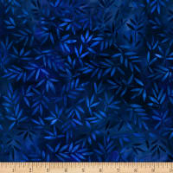
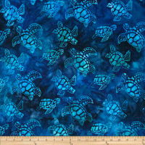


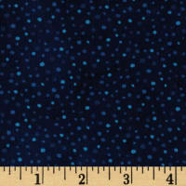
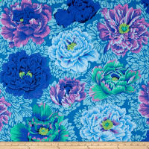
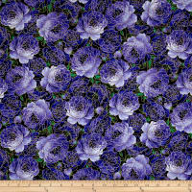
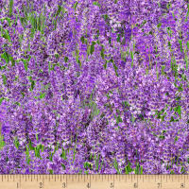
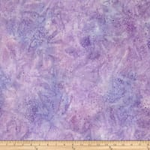
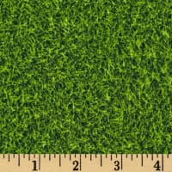
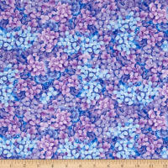
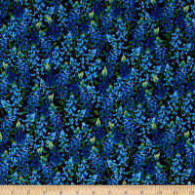
After you have chosen your statement print, try matching it up to various prints of different sizes, try solids too. Making some quilts takes as many as 6 to 10 prints. You can start the Lap Quilt with 3 prints or solids in the block. The border fabric is chosen separately and should be a fabric that frames the blocks you make. The book will guide you with yardage requirements. It is suggested to purchase the border at one time and set it aside.

Slide 13

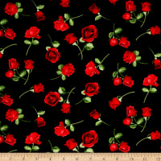

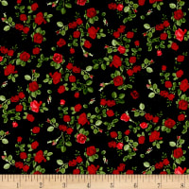
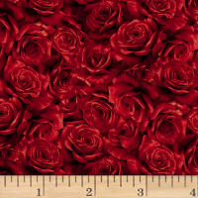
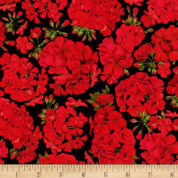
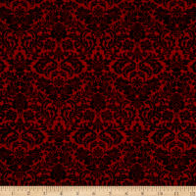
Watch out for directional prints. You have to use them carefully!

Slide 14








The fabrics I picked are from fabric.com

Slide 15



Fabric.com, and Amazon are good places to start shopping.

Slide 16






Always look for blenders and batiks that make good backgrounds. These are fabric you buy to put in your stash because they can be used many ways. I always have muslin and black fabric on hand. My favorite solid fabric brand is Kona Bay. I use Roc-Lon muslin 403 as a brand of unbleached muslin. ( Roc-Lon was founded in 1832 in Baltimore, MD.)

Slide 17
White on White is a perfect stash fabric for backgrounds.

Slide 18




There are so many designers and brands of quilting fabrics they are hard to list. Here are a few of my favorites.
Cranston Prints-
Jinny Beyer
Amy Butler
Kaffe Fassett
Fabric Quilt
Moda
Kona Bay

Slide 19

Amy Butler Fabrics

Slide 20


Fat quarters are sold on line as collections and blended fabrics. A fat quarter is a ½ yard cut on the fold. It measures approximately 18” X 22”. A ¼ of a yard is 45” X 9” so a fat quarter can sometimes be beneficial because of the width. Do not plan a quilt around fat quarters because the fat quarter is limited and you will not be able to repeat the print in various blocks unless you buy several fat quarters.

Slide 21



Here are some batting types. I like a traditional medium weight polyester. If you are going to use batting, made sure it is bonded so it does not clump. Cotton batting is popular too. I have used both cotton and polyester in my quilts and in lesson one will show you the differences so you can decide.

Slide 22


In our Lap Quilt Club we will cover enough quilt blocks for you to make the quilt the size you need. I will show you the original methods Georgia used and explore some new techniques and equipment that are now available. If you follow the club each month and do the assignment you will end up with a quilt or 2 or 3.

Slide 23






Learn to be your own quilt designer. Learn to make your own templates. The color choice really makes the difference. Learn to sew the blocks with ease.

Slide 24


I suggest you purchase “Lap Quilting” by Georgia Bonesteel before the first session. The book will offer you over 70 blocks with templates to trace. Amazon offers many used books starting at $5.00.

Slide 25


Slide 26

Press your fabric before you mark the templates. I used a steam iron.

Slide 27

When you make templates..
Mark the letter or number of the template on your block (fabric) for reference once you draw and cut it for piecing. I placed all cut fabric templates in a marked baggie for sewing later. Do not make all the fabric blocks right now. I will show you other marking and piecing methods so wait for the assignment please.

Slide 28
I suggest you go through the book and check off all the block you want and need. I used a highlighter in my book.
Next make a plastic template for all the blocks you plan to make. I used a hole punch on each template and placed it on a circular clip. I will give each student a circle clip to keep for this purpose.

Slide 29

Pin the fabric layers before you cut to keep them from sliding.
Cutting is going to take some time.
I found a nice box to put all my cut blocks into before I sewed them. Either use the sticky notes to organize the blocks or use a separate baggy for each block.

Slide 30

It is important to double and triple check the finished size of the template against the book and the fabric drawn against the template. Make corrections so you will be accurate. A little 1/16” or 1/8” off will multiply fast when doing patchwork piecing.

Slide 31

I marked as many templates on my plastic sheet as would fit. You will need some paper or craft scissors to cut the templates out.

Slide 32

I used a straight edge or ruler to help draw a straight line with the sharpie as I made the templates

Slide 33



Slide 34


In our 1st lesson we will make templates for some easy to piece 4 patch block. Using the Lap Quilt book you will choose Square A and Square B plus Triangle E.

Slide 35

Show and Tell your work. You can bring your projects to show your progress and brag! As we progress you can bring your quilt blocks to learn the hand work of marking, quilting and assembly. The session will be 2 hours depending on topic. The fabric requirements for the different size quilts are in the “Lap Quilt” book. I have over 12 sessions planned so far.
I suggest you start at the beginning. The monthly topics will progress with the quilt assembly.

Slide 36

Here is a preview of some of the blocks found in the Lap Quilting book.

Slide 37


To enroll and reserve your spot in the Lap Quilting Club you can sign up using an enrollment link on line to make enrollment each month easy. The fee is $5.00 per month. If you have questions please text or email me at:
jenny@jennys-sewing-studio.com
410 543 1212 is my cell for text.

Slide 38
Do you need extra “hands on help” sewing the Lap Quiltting blocks?
Jenny’s Sewing Studio will offer Extra Help sessions on request. You can request a private session or a group extra help session.

Slide 39

Each student can bring their sewing machine ( in good working order ) to work along with the instructor. You will not need a sewing machine in Lesson 1. A monthly materials list will be emailed once you enroll. The Lap Quilt Book is strongly suggested as a follow along guide. A sewing machine can be provided on request if available.

Slide 40

You can find me on line at:
www.jennys-sewing-studio.com

Slide 41

Jenny’s Sewing Studio is at my home 1030 South Schumaker Dr. I teach classes by enrollment and appointment only. Class information and calendar links can be found at
https://jennys-sewing-studio.com/sewing-classes/

Slide 42

Here are pictures of some of my quilt students who have taken other quilting classes from me.

Slide 43


Slide 44


Slide 45

One on One classes give our customers the benefit of personalized sewing instruction. I can discuss what you want to learn and I can tailor the class time to fit your needs. I can choose the perfect day for your class and give you my undivided attention.

Slide 46

With over 41 years of hands on experience as a sewing machine educator, trainer, and sewing machine dealer, I can show you how to make sewing a fun and enjoyable hobby, inspire you to greater heights with the latest sewing products, embroidery ideas, and software. I strive to provide all of our customers with PERSONAL CARE and assistance.
Sincerely, Jennifer Friedel

