Slide 1
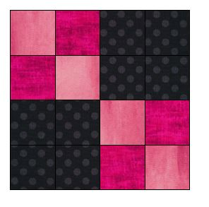

Learn How to Lap Quilt!
Lesson 1

Slide 2
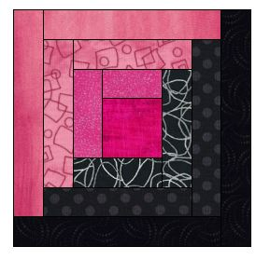
Quilting is fun and easy !
All you need to know is how to use the straight stitch on your machine!
Lap Quilting allows you to make small 12 ½” blocks that are bordered and assembled to make any size quilt you wish. You will learn a lot about different piecing techniques in the months to come.
For our Lap Quilting introduction I will suggest notions and tools and fabrics you may need to complete a quilt.
Class registration is required because of size restrictions!

Slide 3
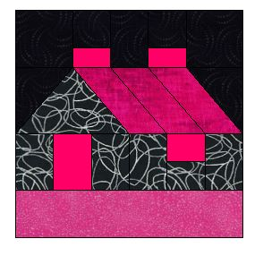
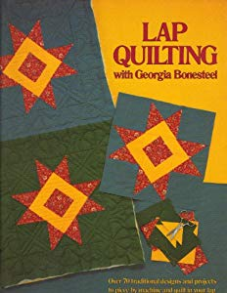
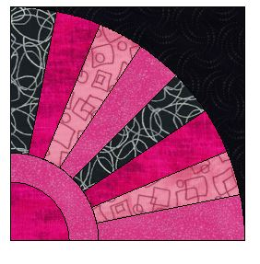
In Lesson 1 you will need to bring “Lap Quilting with Georgia Bonesteel”. The book can be found on line at Thriftbooks.com used for a reasonable price. You will also need to bring template plastic, a fine line sharpie, a ruler, straight pins, a blue wash away marker, 1 yard of 3 different 100% quilters cotton fabric to start making your quilt. In the following pages I will give you some pictures of the products you may use and some fabric color combinations you might like to use. You can find fabric and notions at Hobby Lobby, Serendipity Quilts in Dagsboro, De, Amazon or fabric.com.
You will not need a sewing machine at Lesson 1.

Slide 4
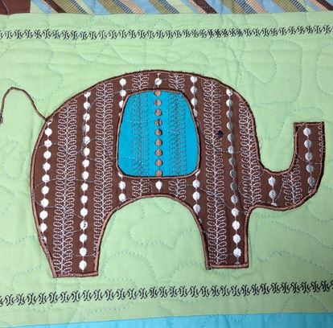
Here is a list of suggested equipment you will need for quilting!
________________________________
We will not be using a machine in Lesson 1 but we will use the sewing machine in all the future lessons.
If you need a new machine get one you can be creative with. I suggest an electronic sewing machine with electronic foot controller so you can easily control the feed of the fabric and the speed of the machine. It helps to be precise with the seams. I can supply a machine for your lesson. Please reserve the machine in advance to be use in the classroom.

Slide 5
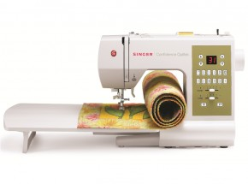
Look for a machine with a bed extension and a front drop in bobbin. The pictured machine is a basic and easy to use.

Slide 6
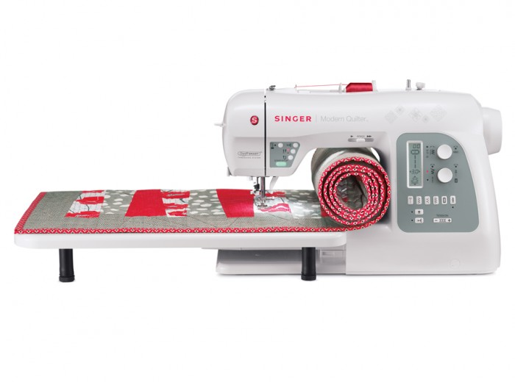
Spend a little more and get a wider arm extension. You can then fit a bigger quilt under the machine. You may also look for a machine that writes sewn letters. That way you can personalize.

Slide 7
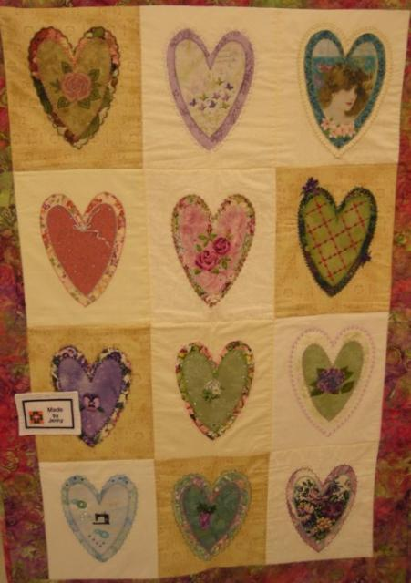
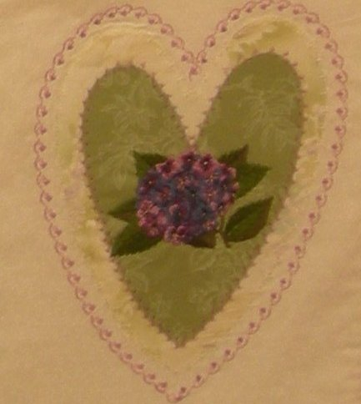
If you are considering a new machine, make sure to add a few built in decorative stitch functions. Here is a quilt I did using a heart applique’ and many combinations of decorative stitching. The quilt will give you an idea of how useful the stitches can be in the embellishment process. It was so much fun to be creative. These blocks were made by myself and several of my previous employees.

Slide 8
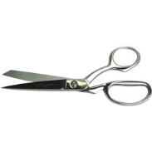
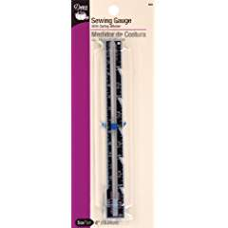
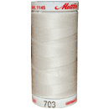
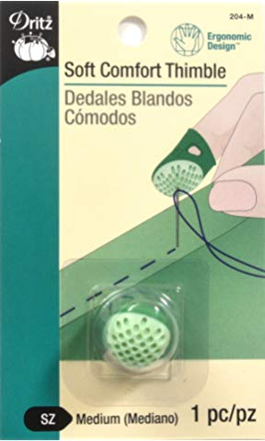
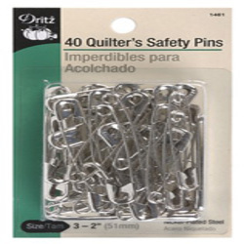
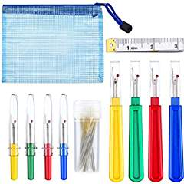
Here is a list of supplies you will need. I will cover how you will use them as we talk about technique.
Good sharp scissors and trimmers
Sewing and knitting or Seam gauge
Thimble
Seam ripper
Medium safety pins
Steam iron and pressing mat
(Jenny will supply an iron and press mat for class)
Thread in a neutral shade

Slide 9

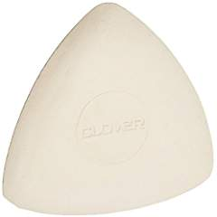
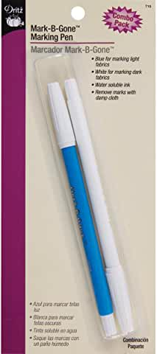
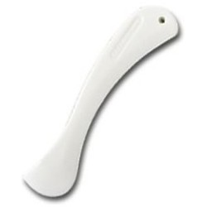
Fabric markers like a wash away pen
Clover chalk in white for dark colors
Seam presser

Slide 10
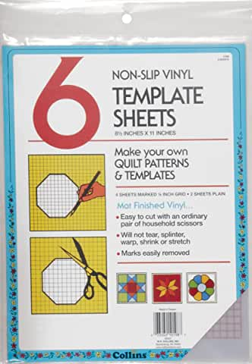
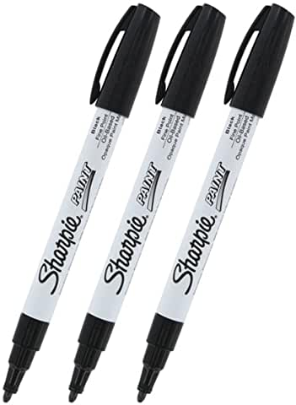
Template plastic and a sharpie marker.

Slide 11
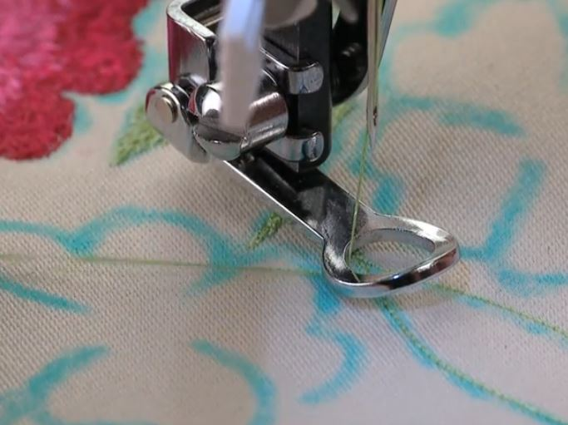
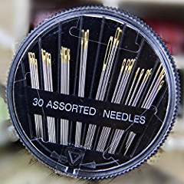
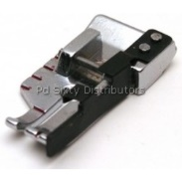
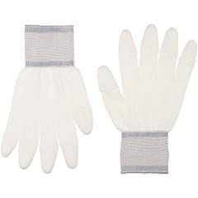
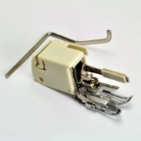
These are things you will need in future lessons. We will talk about them in lesson one.
Walking Foot
¼” foot
Free motion foot
Quilter’s gloves
Hand sewing needles assorted

Slide 12
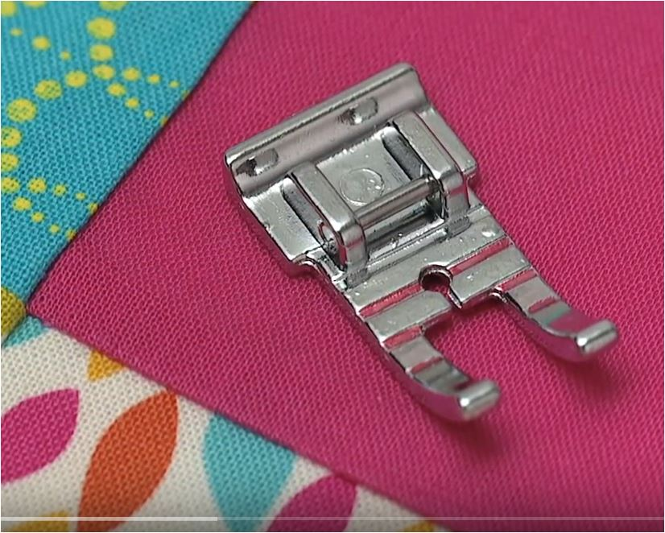
The ¼” foot is a great guide foot to get accurate ¼” seams. ¼” is the standard use to piece patchwork. There are many styles of ¼” feet and they all offer a guide for you to sew a perfect ¼”. Here is how it works.
When doing any type of patchwork or strip piecing you will need a guide to help you.

Slide 13
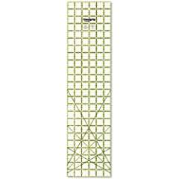
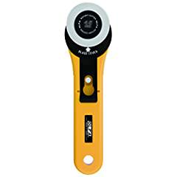
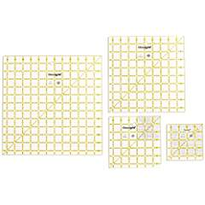
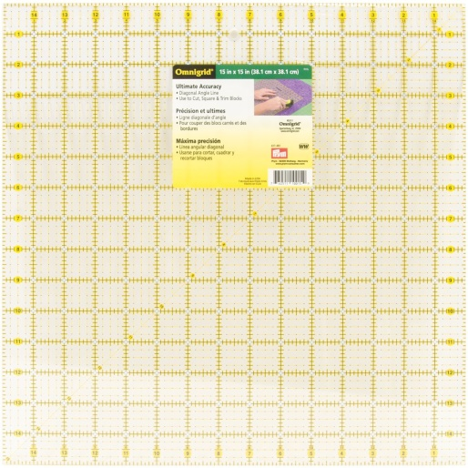
12” and 6” and 6 ½” plastic see through rulers come in handy. Most rulers are marked every 1”, ½” and ¼”. Ruler also have a 45 and 60 degree angle markings for triangles. 24” x 6” rulers are perfect for the rotary cutter. You will need a 24” X 18” mat if you want to learn strip piecing.

Slide 14
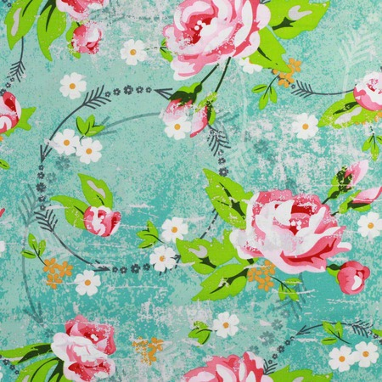
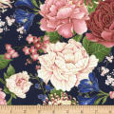
Fabric
I use 100% cotton for quilting. You can use blends but they do not piece as well, press as well or have the vivid color as 100% cotton. If you question the colorfastness of the fabric , prewash the material before use. Otherwise I use most fabric right from the bolt.
Most quilting fabrics are 45” wide. Since this is a standard measurement it will help you calculate yardage.
Straight of grain lines follows the selvedge.

Slide 15

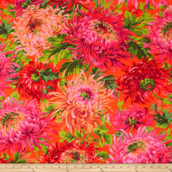
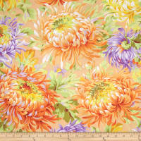
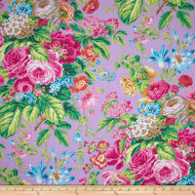
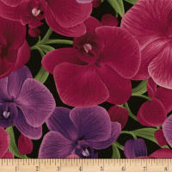
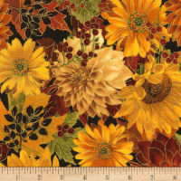
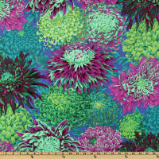
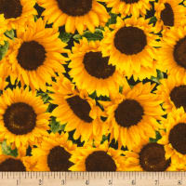
Buying quilting fabric is an adventure, especially “on line”. When I had my store I used to help customers coordinate quilts. I have noticed some sites like www.fabric.com has a planning space to save your collection before purchase.
Find a favorite fabric that tells a color story you want in your space or home. I suggest a fabric with multiple colors and the print should be medium to large in size. Here are florals but it can be a animal print or a check or a theme fabric. You can even use solids or muslin.

Slide 16

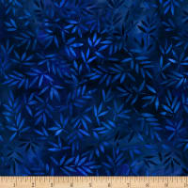
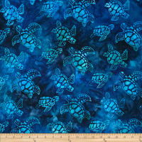


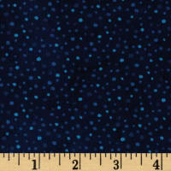
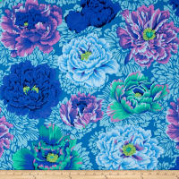
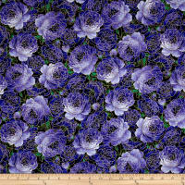
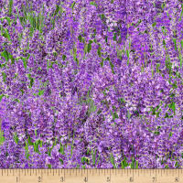
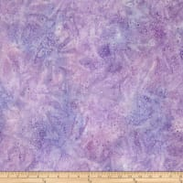
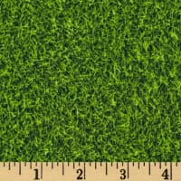
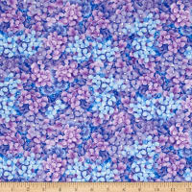
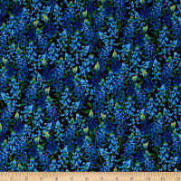
Next take your favorite statement print and try matching it up to various prints of different sizes, try solids too. Making some quilts takes as many as 6 coordinating prints. A Lap Quilt can use 3 prints in the block and a border. The prints should compliment each other. Pick several prints, blend and eliminate anything that you do not like from your original selection.

Slide 17







Watch out for directional prints. You have to use them carefully!

Slide 18








I owned my own quilt shop and bought quilt fabrics every season. I needed to look at a story the fabric told. I will tell you each quilt shop is different because the owners tend to like either bright or old fashion or regional prints. Here is another fabric story. You can see I like bights.

Slide 19



Since there are not as many fabric shops available locally you may need to do shopping with the copy paste method on-line. Every on-line merchant has the fabric photos. Make a folder and call it quilt fabric. Right click on your fabric choices for a quilt and save them in the folder.
Try pasting the pictures into a blank page in Microsoft word and you can combine, edit, move and delete the pictures.
Fabric.com, and Amazon are good places to start shopping.

Slide 20






Always look for blenders and batiks that make good backgrounds. These are fabric you buy to put in your stash because they can be used many ways. I always have muslin and black fabric on hand. My favorite solid fabric brand is Kona Bay. I use Roc-Lon muslin 403 as a brand of unbleached muslin. ( Roc-Lon was founded in 1832 in Baltimore, MD.)

Slide 21
White on White is a perfect stash fabric for backgrounds.

Slide 22




There are so many designers and brands of quilting fabrics they are hard to list. Here are a few of my favorites.
Cranston Prints-
Jinny Beyer
Amy Butler
Kaffe Fassett
Fabric Quilt
Moda
Kona Bay

Slide 23

Amy Butler Fabrics

Slide 24


Fat quarters are sold on line as collections and blended fabrics. A fat quarter is a ½ yard cut on the fold. It measures approximately 18” X 22”. A ¼ of a yard is 45” X 9” so a fat quarter can sometimes be beneficial because of the width. Do not plan a quilt around fat quarters because the the fat quarter is limited and you will not be able to repeat the print in various blocks unless you buy several fat quarters.

Slide 25



Here are some batting types. I like a traditional medium weight polyester. If you are going to use batting, made sure it is bonded so it does not clump. Cotton batting is popular too. I have used both cotton and polyester in my quilts and in lesson one will show you the differences so you can decide.

Slide 26


In our Lap Quilt Club we will cover enough quilt blocks for you to make the quilt the size you need. I will show you the original methods Georgia used and explore some new techniques and equipment that are now available. If you follow the club each month and do the assignment you will end up with a quilt or 2 or 3.

Slide 27






Learn to be your own quilt designer. Learn to make your own templates. The color choice really makes the difference. Learn to sew the blocks with ease.

Slide 28


I suggest you purchase “Lap Quilting” by Georgia Bonesteel before the first session. The book will offer you over 70 blocks with templates to trace. Amazon offers many used books starting at $5.00.

Slide 29


Slide 30

Show and Tell your work. You can bring your projects to show your progress and brag! As we progress you can bring your quilt blocks to learn the hand work of marking, quilting and assembly. The session will be 2 hours depending on topic. The fabric requirements for the different size quilts are in the “Lap Quilt” book. I have over 12 sessions planned so far.
I suggest you start at the beginning. The monthly topics will progress with the quilt assembly.

Slide 31


Slide 32


To enroll and reserve your spot in the Lap Quilting Club you can sign up using an enrollment link on line to make enrollment each month easy. The fee is $5.00 per month. If you have questions please text or email me at:
jenny@jennys-sewing-studio.com
410 543 1212 is my cell for text.

Slide 33
Do you need extra “hands on help” sewing the Lap Quiltting blocks?
Jenny’s Sewing Studio will offer Extra Help sessions on request. You can request a private session or a group extra help session.

Slide 34

Each student can bring their sewing machine ( in good working order ) to work along with the instructor. You will not need a sewing machine in Lesson 1. A monthly materials list will be emailed once you enroll. The Lap Quilt Book is strongly suggested as a follow along guide. A sewing machine can be provided on request if available.

Slide 35

You can find me on line at:
www.jennys-sewing-studio.com

Slide 36

Jenny’s Sewing Studio is at my home 1030 South Schumaker Dr. I teach classes by enrollment and appointment only. Class information and calendar links can be found at
https://jennys-sewing-studio.com/sewing-classes/

Slide 37

Here are pictures of some of my quilt students who have taken other quilting classes from me.

Slide 38


Slide 39


Slide 40

One on One classes give our customers the benefit of personalized sewing instruction. I can discuss what you want to learn and I can tailor the class time to fit your needs. I can choose the perfect day for your class and give you my undivided attention.

Slide 41

With over 41 years of hands on experience as a sewing machine educator, trainer, and sewing machine dealer, I can show you how to make sewing a fun and enjoyable hobby, inspire you to greater heights with the latest sewing products, embroidery ideas, and software. I strive to provide all of our customers with PERSONAL CARE and assistance.
Sincerely, Jennifer Friedel

Slide 42

Finally, no sewing room would be complete without a buddy. Many years ago Bandit was my sewing room cat! He watched me make a lot of projects and took over my ironing board. Happy Quilting!

