Slide 1
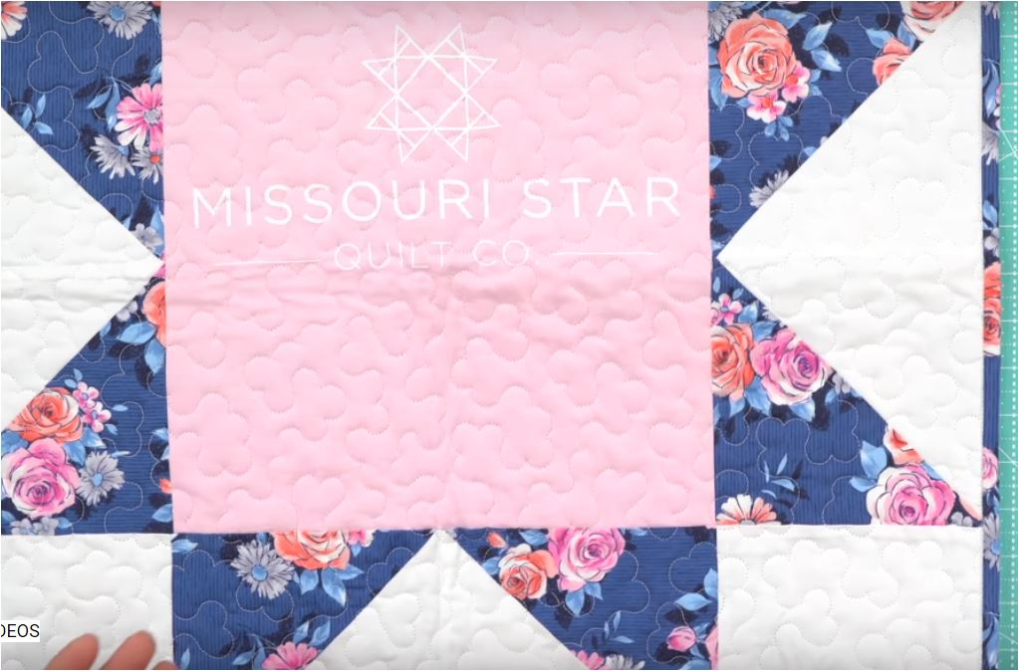
Make a one block wonder with your favorite Tee Shirt!

Slide 2
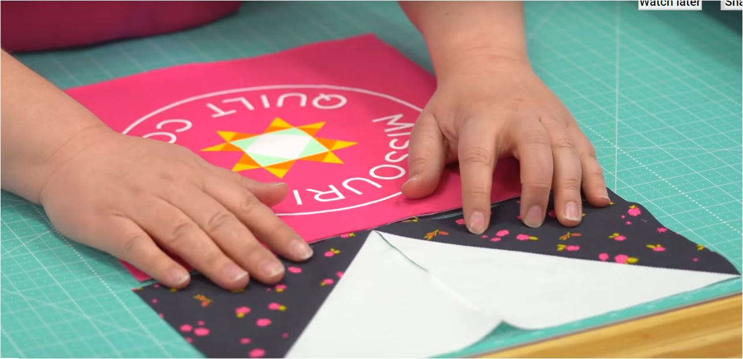
Thank you to Missouri Quilt Company for the design idea.

Slide 3
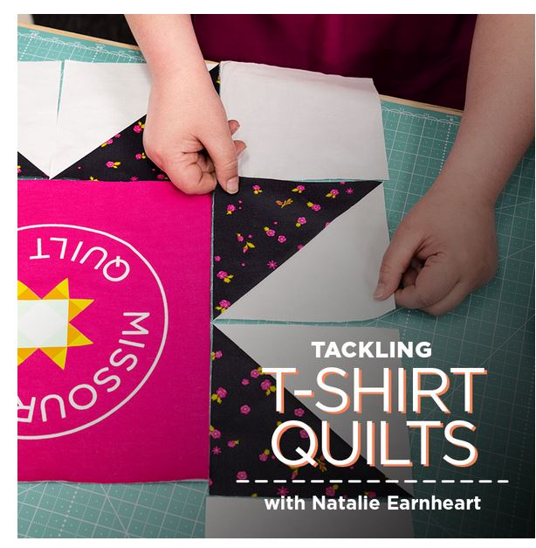
I will be using this sample in my MAC Summer institute talk about tee shirt quilts in June??. Watch for the date.

Slide 4
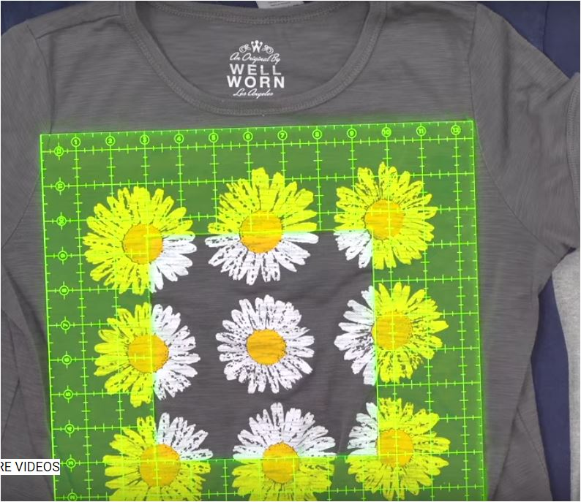
I am using templates A square and E triangle from the lap quilting book plus my 12 ½ “ ruler for the center of the block . This block will be a small wall quilt and I can add borders to make it larger . The wall quilt block will measure 24” when finished. I used an old tee shirt I found in my closet for the center.

Slide 5
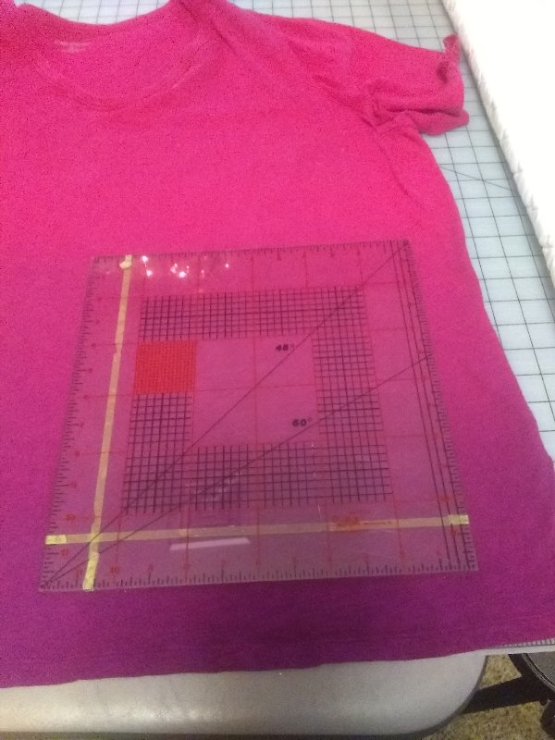
Pick your tee shirt and check to see if you have plenty of room for your design. I wanted a 12 ½’ area

Slide 6
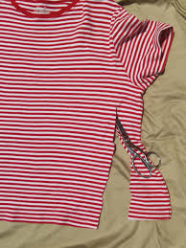
Trim your tee shirt with a rotary cutter. Make the trim area over sized. My tee will let me use the front and the back sides for 2 different blocks.

Slide 7
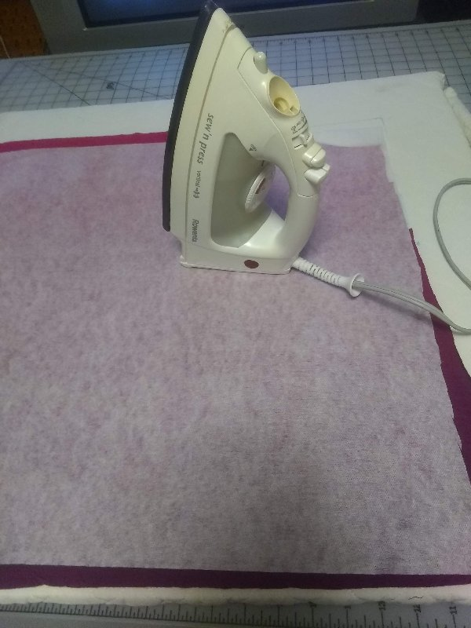
On the wrong side of your tee shirt iron on Light to Medium weight fusible interfacing to stabilize the tee shirt. I prefer fusi knit by Pellon but used what I have on hand.

Slide 8
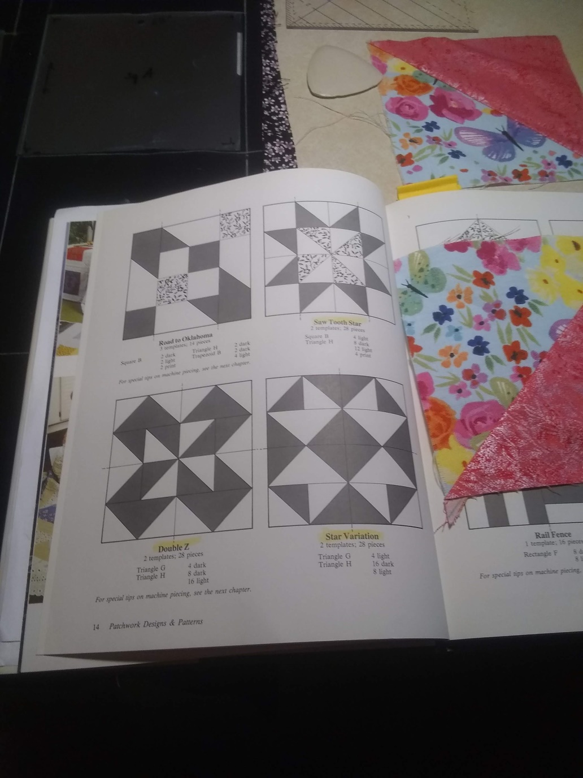
To give you an idea of the design of this wonder block go to page 14 in your lap quilt book and look at Saw Tooth Star. If you want to make this block for your lap quilt you can but I substituted the center template with my 12 ½” ruler and the star edges were made using E triangle and A square.

Slide 9
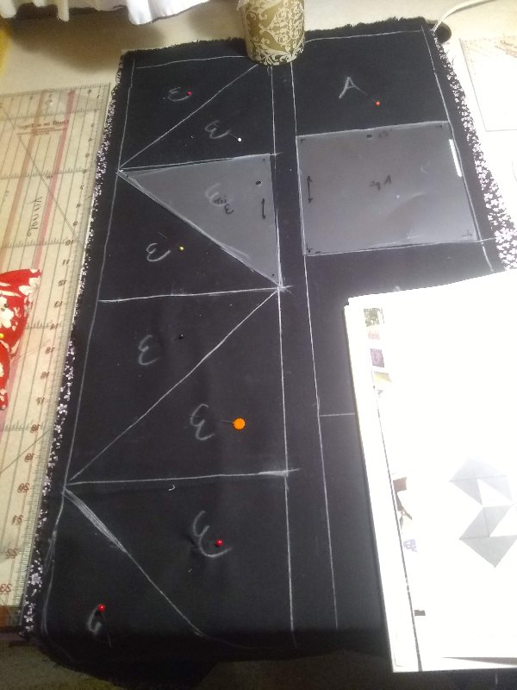
Using at least 3/8yd of 2 fabrics, I placed them right sides together and drew 4 - A squares of one color and 8 E-triangles in a row so I could quick piece them in a continuous row.

Slide 10
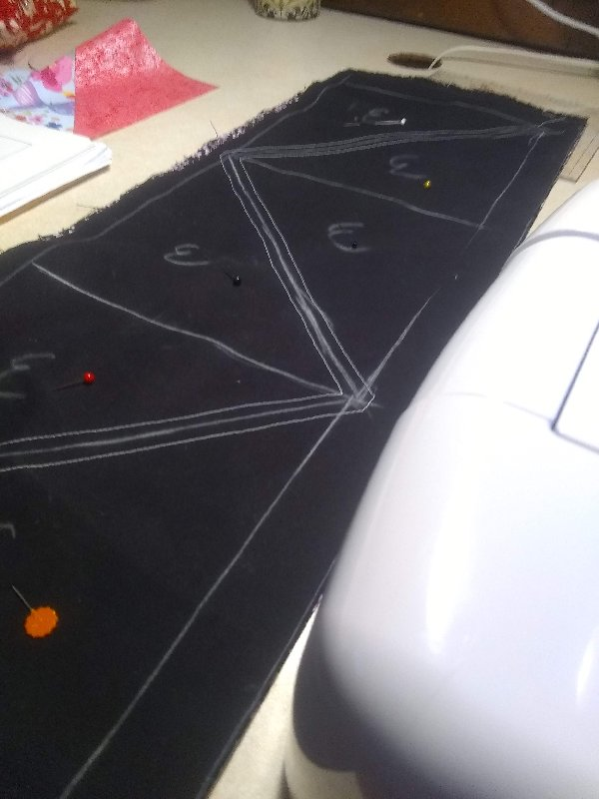
Here I quick pieced the E- triangles before I cut them out. I needed 8.

Slide 11
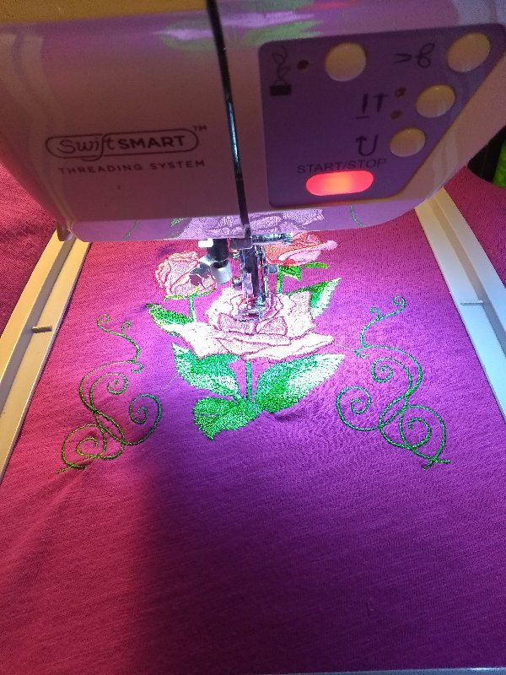
I did not have a fancy tee shirt so added embroidery to the shirt before I cut the block to size using the 12 ½” square.

Slide 12
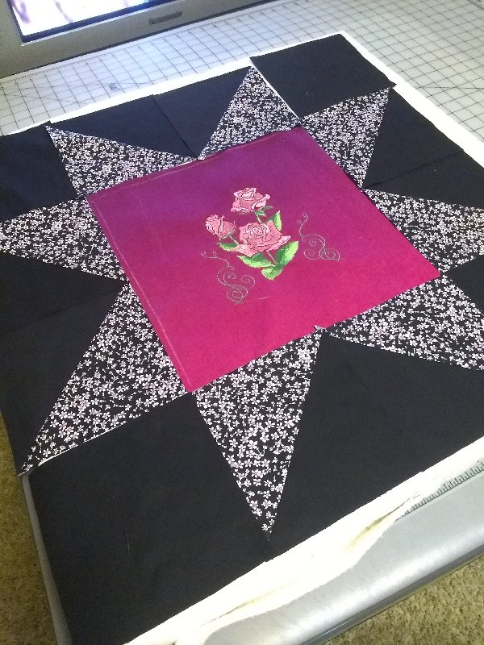
Here is the layout of my 24” block. Once sewn and quilted and bound I will make a wall quilt with it. The block could also be combined with other 24” blocks to make a quilt of any size.
I hope you enjoyed my quick wonder block project.

