Slide 1

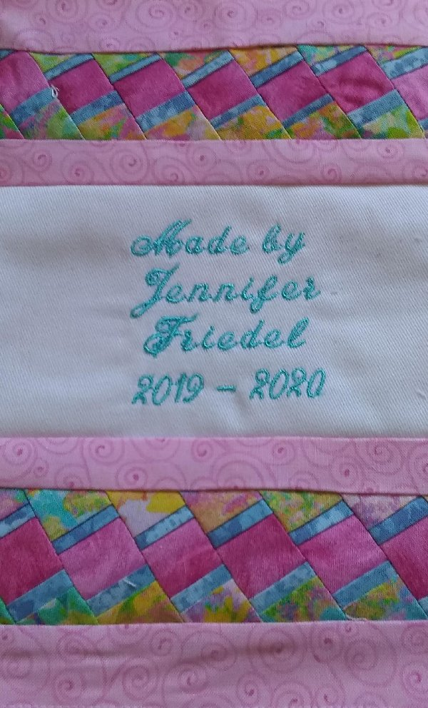
Seminole Patchwork and a signature block for my Lap Quilt

Slide 2
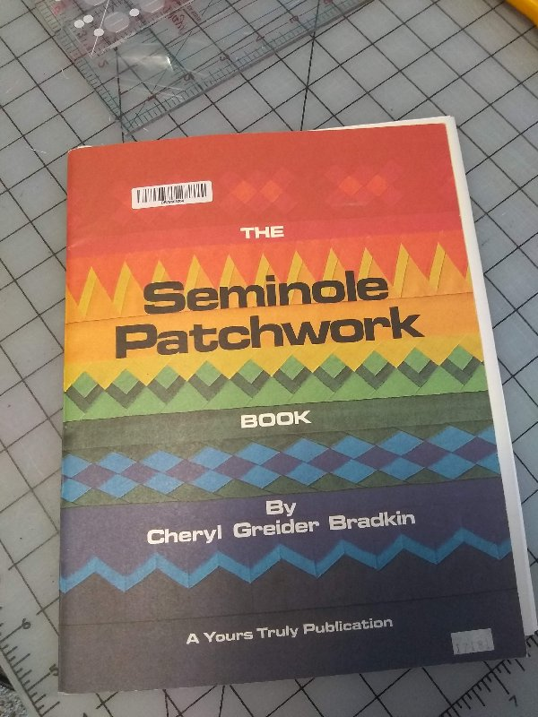
You will need:
- rotary cutter, a 24 X 6” ruler and a 6” square ruler for trimming.
¼” foot and your all purpose sewing machine foot.
a sewing machine
steam iron and press board
Refer to Seminole Patchwork Book

Slide 3
Start your signature block either with a hand or machine embroidered 6 ½” embroidered signature block. I made a 6 ½ “ block for my current Piecemakers Lap quilt club members in Salisbury, MD.
Learn to do a Seminole Patchwork border for your quilt label.
You will need:
If you have fabric from your lap quilt you may wish to match the label to the Seminole border.
Please cut these strips:
-Light print or solid- 2- 1 ½” strips X 45” (width)
-Dark print or solid – 2- ¾” strips X 45”
-Bright center solid or print – 1- 1 ¼” strip X 45”
-If you want a border for the Seminole patch work cut 2- 1 ¼” X 45” strips to frame the finished strip
-Thread to match
You will need a piece of fabric to back the quilt label to finish the patch. When finished, this label will be something you can sew on the back of your quilt.

Slide 4
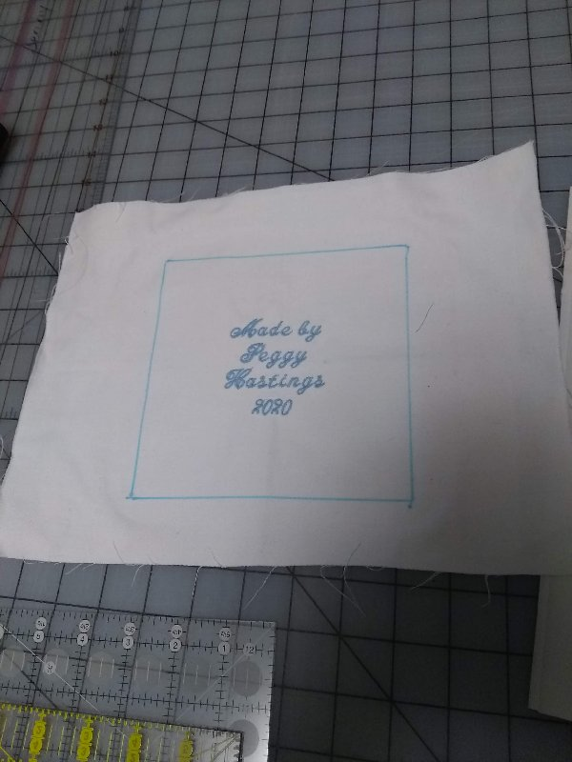
Embroidery block done as the base for the signature block.

Slide 5
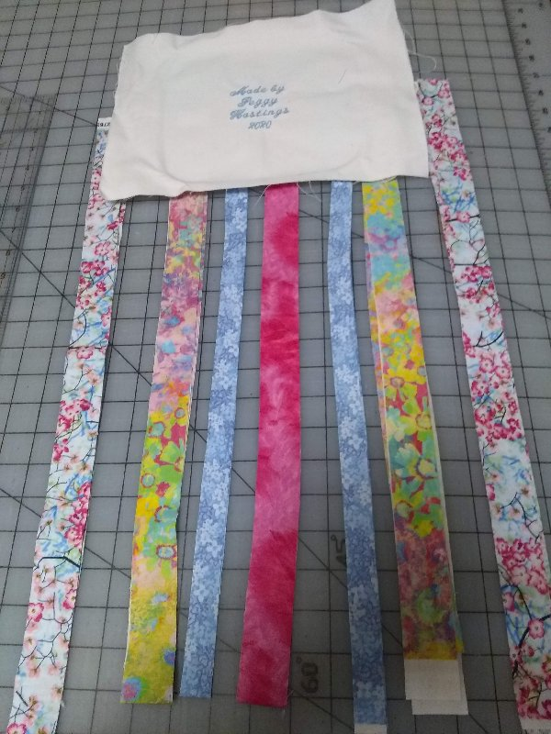
Be very precise when cutting and piecing your strips.

Slide 6
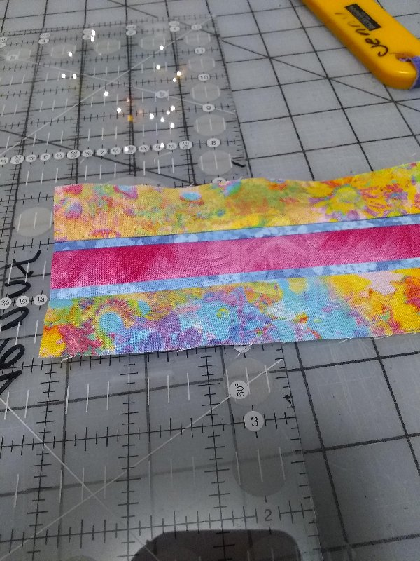
Layout the strips and sew the strips together with a ¼” seam. Be precise and start in the middle with the bright strip. Carefully press the seams to the center so you do not catch them in the next row of stitching. Press every time you sew a strip in place.

Slide 7
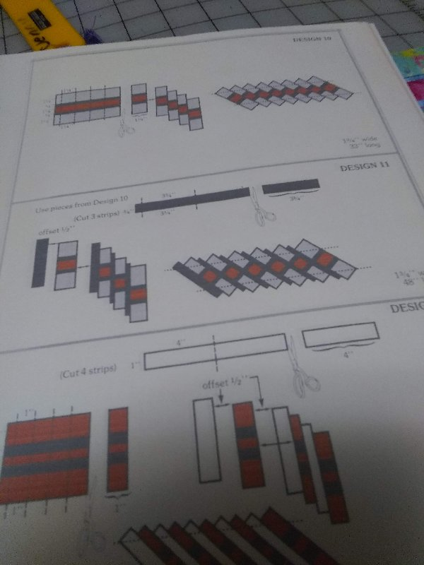
We are doing design 10 from the Seminole patchwork book.

Slide 8
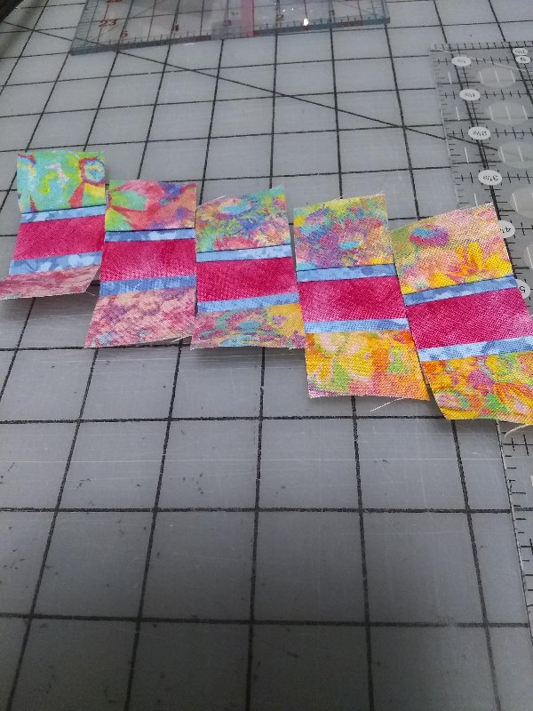
Cut 1 ¼” strips from the long strip. Align the strips “consistently” in an off set. I choose to have the narrow blue strip to line up in the middle of the bright strip as I pieced the 1 ¼” strips together. (see the picture)

Slide 9
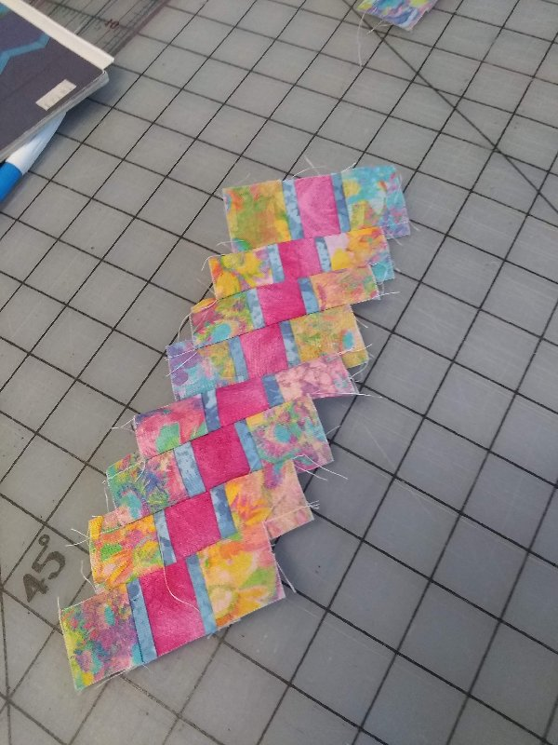
Using ¼” seam off set and sew the strips together to form a long border.

Slide 10
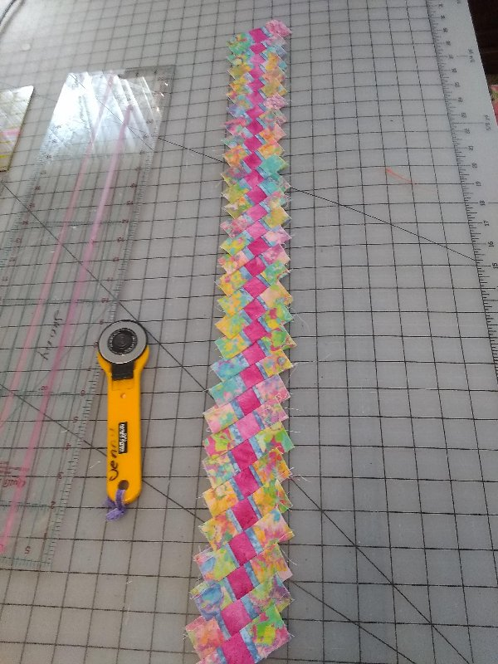

Slide 11
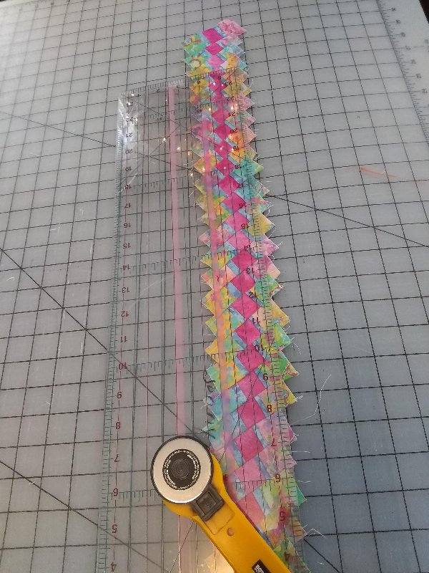
Place the ruler to cut a straight edge on the seminole strip. I allowed ¼” from the point the bright center formed to gauge my trimming of the strip on each side of the center.

Slide 12
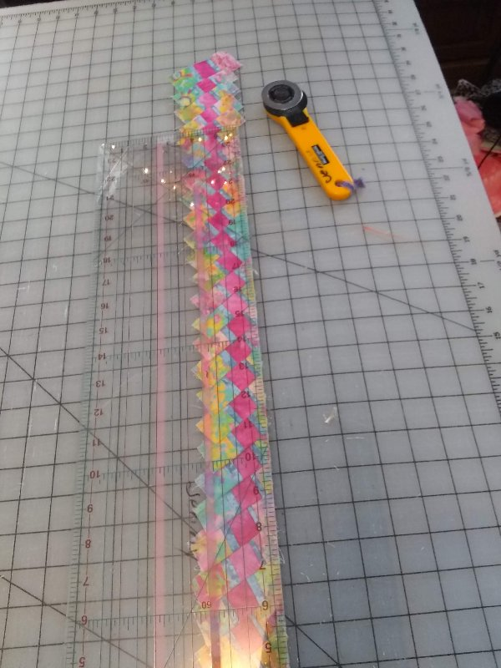
Here I am trimming one side of the strip.

Slide 13
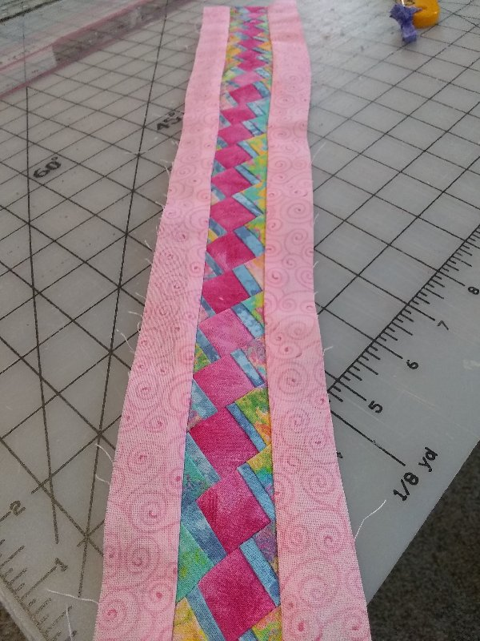
When both sides of the center are trimmed, sew the 1 1 /4” border to each side of the Seminole patchwork to finish the trim.

Slide 14
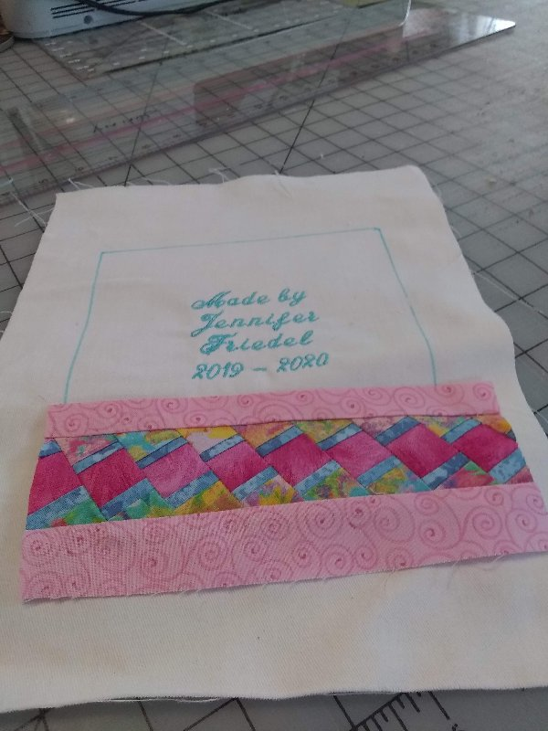
Here I am sewing the Seminole border to each side of the signature block

Slide 15
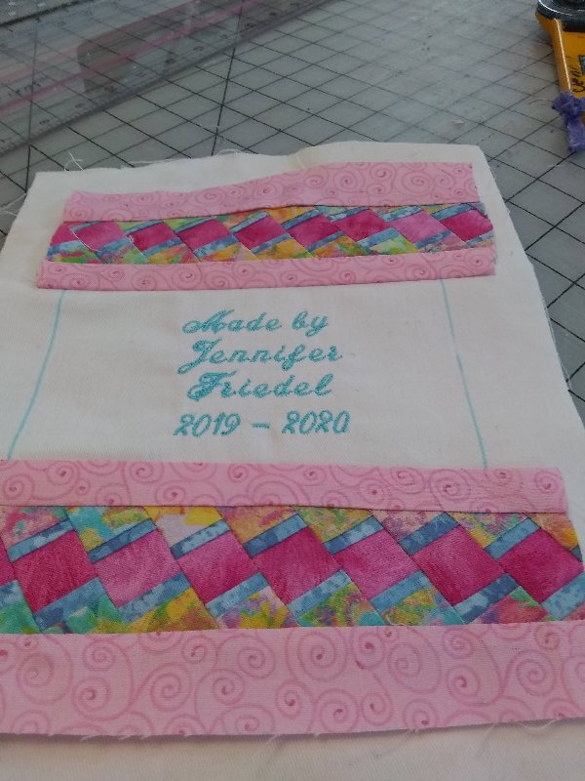

Slide 16
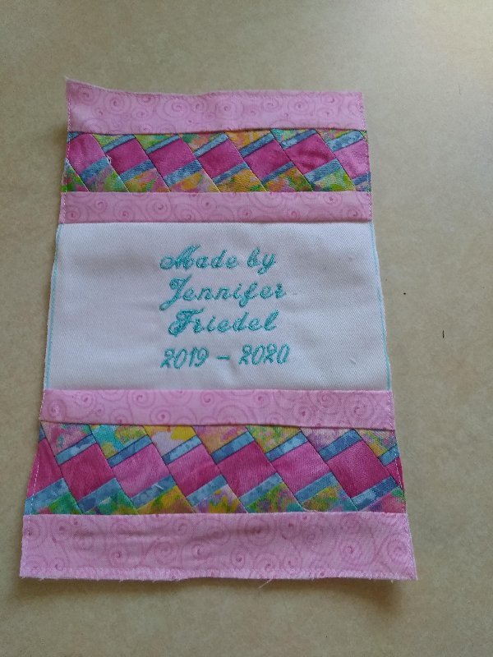
Final step is to trim the block and line the patch. Once turned and pressed, you can sew the signature patch to the back of your quilt.

